Slide 1
Veterinary Accreditation
Core Orientation
July 19, 2018
Notes:
The National Veterinary Accreditation Program presents the Veterinary Accreditation Core Orientation.

Slide 2
Outline
Section 1: What Is Accreditation?
Section 2: Animal Movement
Section 3: VS Program Diseases
Section 4: Animal ID & Laboratory Support
Section 5: Foreign Animal Diseases
Section 6: Disease Scenarios
Notes:
This training is the Core Orientation that is mandatory for all veterinarians who wish to be accredited by the USDA.

Slide 3
Section 1
What is Accreditation?

Slide 4
What is Accreditation?
Accreditation is government approval of private veterinarians to perform official regulatory functions.
Authorization is granting accredited veterinarians the right to work in additional States.
Notes:
Accreditation is a one-time process which gives you the authority to administer APHIS regulations related to animal health in the State of in which you initially become accredited. The Federal government accredits veterinarians and reviews the work done by accredited veterinarians.
Authorization is the process which provides you, after you have become accredited, the opportunity to conduct accredited duties in additional States. If you, as an accredited veterinarian, wish to perform accredited duties in a State other than the State in which you were initially accredited, you must complete an application (VS Form 1-36A) to request authorization to perform accredited duties in that State. That form is available from the Area Office which services that State and from the National Veterinary Accreditation Program (NVAP). The completed form should be submitted to the Area Office of the State in which you seek authorization. As part of the authorization process, you may need to attend a state-specific orientation, that is prepared as a collaborative effort by the VS Area Office and the Office of the State Animal Health Official.
Note: The State Animal Health Official is the State Veterinarian in most states. In a few states, it is the State Department of Agriculture, the Board of Animal Health, or the Livestock Commission.

Slide 5
Accreditation Requirements
Initial Accreditation Training (IAT) in vet schools
Graduate with DVM or equivalent
Attend Core Orientation
Submit application - VS form 1-36A
Licensed/legally able to practice in state of accreditation
Attend State-Specific Orientation (if required)
Notes:
To become an Accredited Veterinarian, one must:
Initial Accreditation Training (IAT) is available in veterinary schools now. After July 2011, all applicants for accreditation will need to pass the IAT with a score of 80% or higher in order to attend the Core Orientation.
Hold a veterinary medical degree.
Attend the Core Orientation (the current course you are taking).
Be licensed or legally able to practice veterinary medicine in the state in which you wish to be accredited.
Submit an application (VS Form 1-36A) to be an Accredited Veterinarian in each state in which you can legally practice.
Attend a State-Specific Orientation (if one is required) in each of the state or states in which you wish to be accredited. The State-Specific Orientation is provided by the combined efforts of the local federal veterinary office (the VS Area Office of that state or area) and the State Animal Health Office of that state. Check with the local VS Area office for more details on dates and locations of the State-Specific Orientation.
Note: Once you are accredited and receive your written authorization to work in one state, you can request authorization to work in other states. You don’t get a new accreditation; instead you get an additional authorization.

Slide 6
Authorization in Other States
To do accredited work in other States:
Be licensed/legally able to practice in State
Contact APHIS, VS District Office
Attend State-Specific Orientation
Receive written APHIS authorization before doing accredited work in new State
Notes:
To do accredited work in additional States from where you are initially accredited:
The veterinarian must have been initially accredited prior to being authorized to do accredited work in other States.
Contact area office for form 1-36A. “Application for Veterinary Accreditation”.
Attend a State-Specific Orientation if one is required by that State.
Be licensed or legally able to practice in that State.
Do not perform accredited duties in the new State until you receive written authorization from APHIS.

Slide 7
2 Tiered Accreditation Program
Category I: Limited
  Dogs and cats
Category II: All Animals
  Food and fiber species
  Horses
  Birds
  Farm-raised aquatic animals
  All other livestock species
  Zoo animals
Notes:
When you complete your 136-A, you will need to indicate which category of accreditation you are seeking and attest that you are familiar with and able to perform work on the animals in that category.
Category I animals: All animals except: food and fiber species, horses, birds, farm-raised aquatic animals, all other livestock species, and zoo animals that can transmit exotic animal diseases to livestock.
Category II animals: All animals
A veterinarian with category II accreditation is able to do Category I work as well.

Slide 8
Accreditation Renewal Process
Renew every 3 years
Complete supplemental training modules
  Category I: 3 modules
  Category II: 6 modules
Sources of modules:
  Internet-based
Notes:
Both categories of accreditation require the accredited veterinarian to renew the accreditation every 3 years
To renew the accreditation, you will need to complete supplemental training modules that are designed to address:
Current policy concerning domestic and international animal movement
Current animal health issues and zoonotic concerns
To maintain your category I accreditation, you will need to complete 3 supplemental training modules and for Category II accreditation, you will
need to complete 6 supplemental training modules.
Sources of modules: You can find the following types of supplemental training modules to address your accreditation renewal requirements:
Internet-based: These are the primary way you obtain the instruction. These modules are provided free of charge and each modules takes approximately 1 hour to complete.
Paper versions of all modules will be available for the cost of production and shipping

Slide 9
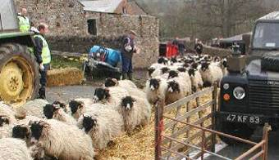
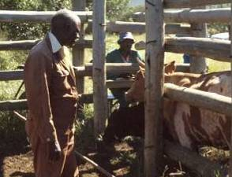
In Other Countries
Most countries use government veterinarians
  to examine animals
  to issue health certificates
Notes:
Why Are Accredited Veterinarians Important?
Most countries use government veterinarians to examine animals and to issue health certificates. We have such large numbers of animals moving and needing health certificates that there is no way that we could hire that many full-time veterinarians to handle every corner of the country.

Slide 10
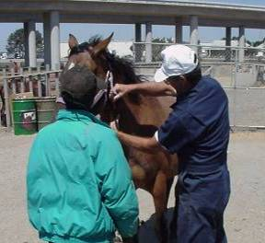
In the U.S.
APHIS relies on you to:
  Act as agents of Federal Government
  Test for program diseases
  Issue health certificates
  Perform examinations
  ID animals
  Report FADs
  Do surveillance
Notes:
Why are accredited veterinarians important?
In the U.S., APHIS relies on accredited veterinarians who act as representatives for the US government to examine animals, perform tests, and issue health certificates as required by federal regulations.
The number of federal veterinarians is only 540 in the field and area offices. There are only 318 AHTs. This number is not sufficient to perform all of the work required by federal regulations.
If we had an outbreak of a foreign animal disease in the US, it would require hundreds of veterinarians. With only 540 in VS, private practitioners are essential to meet the needs.
Accredited Veterinarians assist APHIS by:
Acting as agents of Federal Government
Testing for program diseases and tests
Issuing health certificates (also called “Certificate of Veterinary Inspection” or “CVI”)
Performing examinations
Identifying animals for testing and for health certificates/CVIs
Reporting suspected FADs
Doing surveillance and reports findings on targeted diseases.

Slide 11

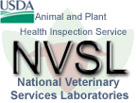
Accredited Veterinarians . . .
Work with
SDA
State
Federal
State
Labs
Laboratories
Clients & Industry
Notes:
SDA—State Departments of Agriculture. Accredited Veterinarians work with the State Departments of Agriculture as well as with the Federal (USDA) Area Office.
When you get to the state in which you are going to practice and in which you wish to be accredited, the Area Veterinarian in Charge for that state or area can inform you of the state laboratories which are approved to do accredited laboratory work.
An important component of working as an Accredited Veterinarian is that you represent USDA – locally, nationally and internationally.

Slide 12





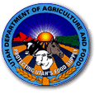
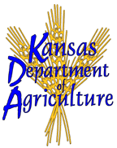



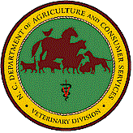
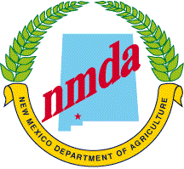
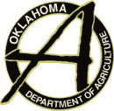




Accredited Veterinarians . . .
Participate in State-Federal
Cooperative Programs
Notes:
Examples of state-federal cooperative programs:
TB
Brucellosis

Slide 13
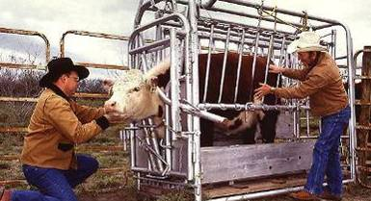
Accredited Veterinarians . . .
Assess and document animal health through
  Physical examinations
  Diagnostic testing (e.g. TB tests)
  Diagnostic sample submission
  Documentation

Slide 14
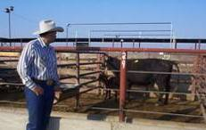
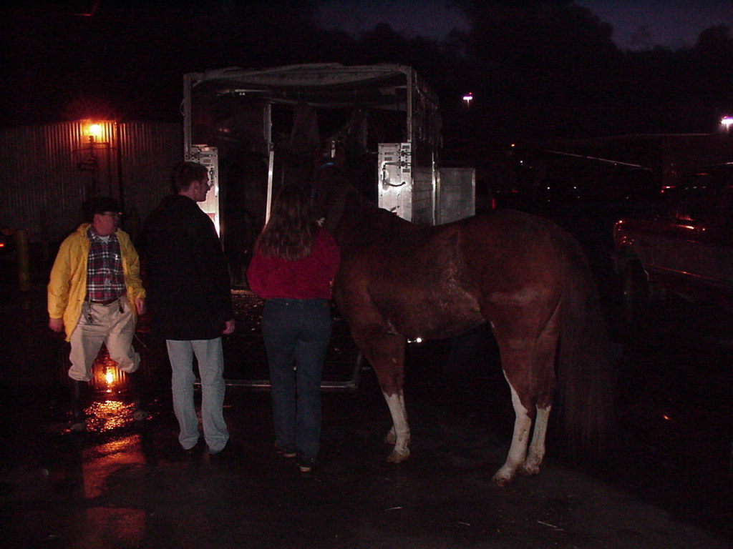
Accredited Veterinarians . . .
Assist with interstate and international movement of animals and animal products
Ensure national uniformity of regulatory programs

Slide 15
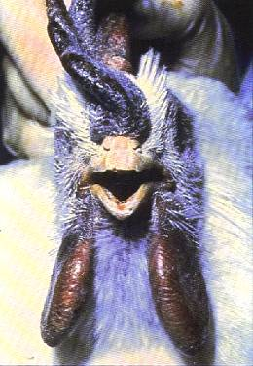
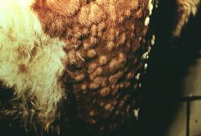
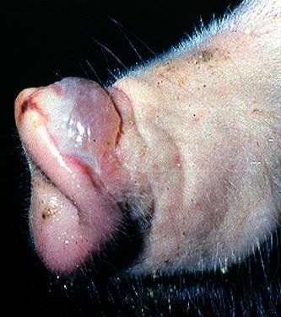
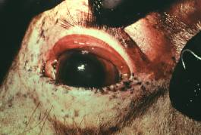
Accredited Veterinarians . . .
Are first line of surveillance for
program and foreign animal diseases
Notes:
Left: Avian Influenze (AI) as seen in rooster with edema and darkness in wattles; open mouth breathing.
Top middle: Lumpy Skin Disease as seen on rear leg of calf.
Bottom middle: African Horse Sickness: congestion of the conjunctiva in a horse.
Right: Vesicle on snout of pig with Foot and Mouth Disease (FMD).

Slide 16
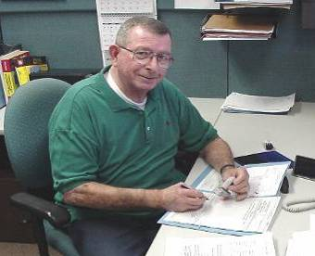
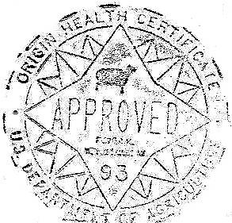
Accredited Veterinarians . . .
Complete certificates,
which are reviewed and endorsed by APHIS
Notes:
VS monitors the accredited veterinarians work. For example, rechecking submitted blood work and examining paperwork for accuracy.

Slide 17
Ethical/Professional Code
The Code of Federal Regulations (CFR)
describes:
  Requirements & application process
  Responsibilities
  Standards of conduct and practice
  Rules for suspension/revocation
  Guidelines on penalties for misconduct
Available online
Notes:
The Code of Federal Regulations (CFR), Title 9, Section 161 describes the purpose of accreditation; requirements and application process; responsibilities, standards of conduct and practice for accredited veterinarians; and regulations on suspension and revocation of accreditation as well as civil and criminal penalties for misconduct. The CFR is the document that interprets laws. The CFR is divided into 50 titles that represent broad areas subject to Federal regulation. Each volume of the CFR is updated once each calendar year and is issued on a quarterly basis. . There is a passage from the CFR relative to Veterinary Accreditation in your Practitioners Guide. The entire code is available online by googling “9 CFR 161”.

Slide 18
Ethical/Professional Code
Personally inspect animals and sign forms
Issue complete and accurate forms
Indicate and verify work of other accredited veterinarians
Perform activities according to regulation
Personally identify reactors
[9CFR, 161.4]
Notes:
The slide lists some of the activities that an accredited veterinarian performs. The CFR describes precisely the standards for performance of each of these duties.
You must personally inspect the animals for which you sign forms. You cannot allow others to do the inspection and then indicate that you performed that work.
Indicate and verify work of other accredited veterinarians. If an animal was vaccinated or inspected by another accredited veterinarian, you can use the work of that accredited veterinarian – BUT you must indicate that the work was performed by that person and not by you.
An accredited veterinarian shall perform official tests, inspections, treatments, and vaccinations and shall submit specimens to designated laboratories in accordance with Federal and State regulations and instructions issued to the accredited veterinarian by the Veterinarian-in-Charge.
An accredited veterinarian shall identify or be physically present to supervise the identification of reactor animals by tagging or such other method as may be prescribed in instructions issued to him or her by the Veterinarian-in-Charge or by a State Animal Health Official through the Veterinarian-in-Charge.

Slide 19
Ethical/Professional Code
Immediately report regulated diseases
Maintain biosecurity
Know current regulations; ask if unsure
Use accountable property in accordance with regulations
Maintain security of tags, forms and certificates, electronic signatures
[9CFR, 161.4]
Notes:
The slide lists more of the activities that an Accredited Veterinarian performs. Again, the CFR describes precisely the standards for performance of each of these duties.
An accredited veterinarian shall immediately report to the Veterinarian-in-Charge and the State Animal Health Official all diagnosed or suspected cases of a communicable animal disease for which a APHIS has a control or eradication program in 9 CFR chapter I, and all diagnosed or suspected cases of any animal disease not known to exist in the United States as provided by §71.3(b) of this chapter.
Maintain biosecurity – observe sanitation and other measures that will prevent the spread of communicable disease.
Know current regulations: Check regularly with the AVIC and State Animal Health Official and review websites regularly. ASK/CHECK if you are unsure!
An accredited veterinarian shall not use or dispense in any manner, any pharmaceutical, chemical, vaccine or serum, or other biological product authorized for use under any Federal regulation or cooperative disease eradication program, in contravention of applicable Federal or State statutes, regulations, and policies.
Maintain security of tags, forms and certificates, electronic signatures. Report to AVIC immediately if any are stolen. Do not pre-sign certificates!

Slide 20
Non-Compliance / Violation
Summary suspension
APHIS investigates non-compliance
Possible consequences of violation:
  Letter of information or letter of warning
  Suspension
  Revocation
  Loss of license
  Civil and/or criminal charges
Notes:
A Summary suspension can be invoked prior to or during the IES investigation. The AVIC can use the summary suspension at any time that she or he discovers information that shows a potentially serious violation. Accreditation is then suspended pending determination of the case. A summary suspension stops the Accredited Veterinarian from doing accredited work during the review process.
Investigative and Enforcement Services (IES) investigates alleged violations for VS. IES and VS are both programs in APHIS.
Possible penalties for violations include:
Letter of information: used for minor infractions where the accredited veterinarian is acting out of ignorance instead of intent
Letter of warning: stronger than a letter of information; often issued after letters of information have not brought any changes in performance
Suspension:
Penalty suspension of less than 6 months = automatic reinstatement of accreditation status once the 6 months has passed
Penalty suspension of more than 6 months = must reapply for accreditation in that state, which could include retaking training or other requirements.
Revocation means loss of accreditation.
Loss of license to practice veterinary medicine (by the State Board of Examiners). If a license in a particular state depends on the veterinarian having accreditation, then loss of accreditation could also result in loss of license. A state board of examiners could also determine that a license to practice vet medicine in that state would be suspended even if accreditation is not required for a license. Check on the rules in your state.
Civil penalties and such criminal liabilities as are provided by 7 U.S.C. 8313, 18 U.S.C. 1001, or other applicable Federal statutes.

Slide 21
Section 2
Animal Movement

Slide 22
Notes:
Expanding world trade and travel increases the risk of disease spread.
Import-export regulations, inspections, health certificates, and other measures decrease the chances of sharing diseases.
Early detection of a disease that makes it through these preventative measures avoids rapid and wide-spread dissemination.
Accredited veterinarians are essential in both the preventative and detection efforts.
This section of the Orientation addresses the ways accredited veterinarians help ensure that movement of animals is done in accordance with the regulations of the U.S. and other nations.

Slide 23
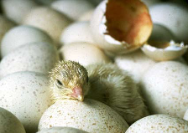
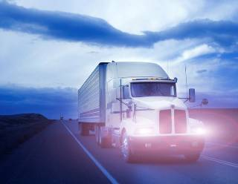
Why Regulate Animal Movement
Stop disease spread
Move healthy animals
Provide traces of movement
Protect export markets
Open new emerging markets
Notes:
Why VS regulates interstate and international movement of animals:
Stops the spread of disease
Ensures animals being moved are able to tolerate the move and have been checked for infectious diseases
Provides traces on the movement of animals, which assists when we need to locate animals that may have had contact with a diseased animal.
Protects export markets: billions can be lost in exports if country requirements are not met or unwanted diseases are transported and trade bans enacted. In 2007, the U.S. animal export value for our 3 largest export markets (bovine, poultry, and swine) was over $75,000,000,000 and export value of one of our “smaller” export markets (sheep, lamp and wool) was $400,000,000. Concerns about safety over any of those animals or products could have a major impact on US export markets.
Opens new emerging markets by assuring potential buyers of the safety of animals and animal products from the U.S.

Slide 24
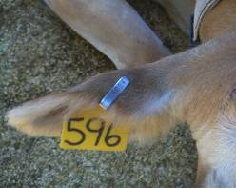
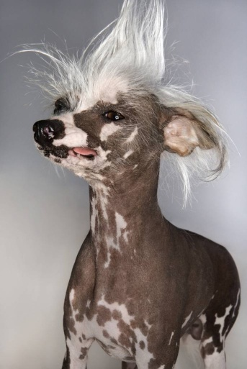
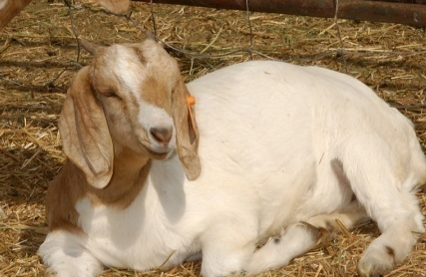
What is Your Role?
Accredited Veterinarians assist with interstate and international movement
BY:
Advising owners
Performing exams & administering vaccines
Collecting samples for lab work
Completing certificates
Notes:
What is the role of the Accredited Veterinarian in the regulation of animal movement?
Accredited veterinarians work with both interstate and international movement of animals.
Accredited veterinarians prepare the animals for movement by
Advising the owners on the requirements for the movement to the country or state of destination and use of animal ID.
Performing required physical exams, administering vaccines and any other treatments.
Collecting and sending in samples for laboratory tests that are required for admission of the animal(s) to the country or state of destination.
Once all of the preparatory work is done, the accredited veterinarian issues a certificate and attaches relevant documents. The certificate for interstate movement is called a “certificate for veterinary inspection” and for international movement, it is called a “health certificate”.
You can always contact the VS Area Office if you have questions concerning requirements for identification, certificates, examination, vaccines and tests for any interstate or international movement.

Slide 25
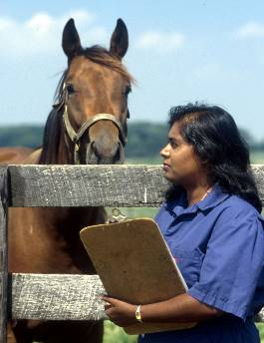
Interstate Movement
  Health requirements vary by State!
Federal requirements
  Health and fitness to travel
  Identification of animals
Entry requirements
  Differ by state of destination
Notes:
Health requirements vary by State!
Federal requirements for movement of animals
Examination for health and fitness is required. Signing that an animal has been examined for health and fitness means: “I certify as an Accredited Veterinarian, that the above described animals have been inspected by me and that they are not showing signs of infectious, contagious, and/or communicable diseases. The vaccinations are as indicated on the certificate. To the best of my knowledge, the animals listed on this certificate meet the state of destination and federal interstate requirements. No further warranty is made or implied.”
Identification of animals: Animal identification requirements can differ depending on the species and the form. Check on the required type of identification needed for movement to the State or Country of destination. Inform the owners of those requirements.
Check requirements for State of destination.
The requirements differ among the States depending on the disease status of the state of origin relative to the state of destination. You need to check with the State of destination as the requirements there could be quite different from what you are accustomed to in your State. The APHIS website has links to the information provided by each State. The online information includes State requirements and the name and contact information for the State Animal Health Official, whom you can contact with questions.
States may have more stringent requirements. For example, many states have implemented a requirement that cervidae herds be under a surveillance program for CWD for 3 years prior to entry into their state. Various states have tightened their TB testing requirements on dairy cattle after an increase in TB was found in dairies. Kentucky shut down movement of horses and livestock from counties with positive VSV cases. Many states have stringent import requirements on rodents after the Monkey Pox problem in prairie dogs. Most states in the Western Region require a negative trichomoniasis test on breeding bulls.

Slide 26
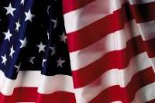





International Movement
Health requirements vary by country
  Disease protection
  Political & economic factors
  Trade agreements
Check with VS Field Office
Notes:
International Movement:
Health requirements vary by country: If a country doesn’t have or is eradicating a disease, their requirements will differ from a country where that disease is endemic. Health requirements are also based on political and economic factors and trade agreements. All of these can change rapidly, so check before you act. Additional certificates (possibly bilingual) may be required by the country of destination.
Check with VS Area office. It’s always good to check with VS Area Office when you are working with an international movement as the certificates you sign will also need to be signed by your local Area Office. The VS Area Office can also provide guidelines on shipping to countries or information on whom to contact for information. There is also information online; however, assess the source of your online information as country requirements can change and a website may not reflect that.
Note on Brokers:
Some clients may wish to use a broker – or may have to use a broker depending on the importing country requirements. Don’t take the word of either a client or broker regarding import requirements as correct. Check with the VS Area Office or the country of destination.

Slide 27
Movement Information
Sources of movement information
  USDA/APHIS/VS District Office
  Vet official in country or state of destination
  APHIS website: www.aphis.usda.gov
    NVAP website
    International Regs
    Interstate Regs
How far ahead should my clients plan?
Notes:
Movement Information
Where can you find Interstate/International Movement and Animal Health Requirements?
USDA/APHIS/VS Area Office
State Veterinarian in State of destination. The state veterinarian in the state of destination is often the best source of information for up-to-date interstate movement requirements.
Officials in consulates and countries of destination sometimes can provide you with up-to-date information. Sometimes your Area Office has the more up-to-date information.
APHIS website: www.aphis.usda.gov
Links to the National Veterinary Accreditation website, international and interstate regulations, and your local Area Office.
How far ahead should my clients plan for international movement:
Note the time involved for movement to each country. Sometimes your clients need to begin the process 6-8 months in advance. Starting early enough may reduce a lengthy quarantine at the destination site.

Slide 28
Pre-Export Isolation
On-farm isolation
  Check with VS District Office
  Obtain USDA approval for facility
  Oversee facility and work done
  Conduct testing
In-home isolation
USDA export isolation facility
Notes:
Pre-Export Isolation:
On-Farm Isolation:
Some countries require an on-farm isolation in a USDA-approved facility before export/shipment, for example the EU requires this for equines. The reason for this requirement is to prevent new exposure to disease and to allow animals time to express disease if the animals were incubating disease at the start of the isolation period. The length of the quarantine depends on the destination country’s requirements. An accredited veterinarian wishing to provide on-farm isolation services needs to:
Check with VS Area Office for specific requirements related to isolation facilities and the length of isolation required by different countries.
Request inspection and approval from APHIS if the facility does not already have that approval. A USDA-approved facility must have dedicated personnel to tend to animal needs and the facility must have proper biosecurity. The facility must also be approved PRIOR to placing animals into the pre-export isolation facility.
Accredited veterinarians can oversee the facility and supervise the work done there.
Accredited veterinarians can also vaccinate, treat, or test animals (and observe animals for clinical signs of disease) according to the destination country’s requirements during pre-export isolation.
In-home isolation:
In the case of small animals, an in-home isolation may be required by the country of destination. Check with the VS Area Office for requirements for this type of isolation.
USDA export isolation facility:
Some countries require this type of isolation. Full-time government-employed veterinarians, rather than accredited veterinarians, provide required vaccinations, testing, treatment, and observation of animals in USDA export isolation facilities.

Slide 29
International Certification Process
Accredited Veterinarian
Examines & tests animals
Completes certificate
Approved Laboratories
Test samples
Report results
Federal Veterinarian
Performs final inspection
Endorses certificate
Notes:
International certification is a collaborative process. The Accredited Veterinarian is part of a 3-member team preparing an animal or animal product for shipment.
The accredited veterinarian examines and tests animals, sending those samples to an approved laboratory. She/He also performs any other required treatments.
Once the results come back from the laboratory, the accredited veterinarian completes the health certificate and sends it and all other needed documents (e.g., test charts, ID information, vaccination certificates) to the VS Area Office. The health certificate is typically endorsed at the Area Office. Check with your Area Office for the process in your area.
The health certificate is reviewed and, if accurate, is endorsed.
The Accredited Veterinarian then communicates with the client or broker, providing the documents needed for shipment.
If a final inspection is needed, the Federal veterinarian completes that at the port of embarkation.

Slide 30
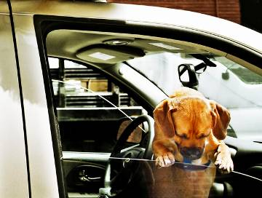
Certificates for Small Animals
Research animals
Pets
  Birds
  Dogs and Cats
Working animals
Differ by destination or origin
Differ by species
Notes:
Special Notes on Certificates of Veterinary Inspection for Small Animals
Small animals definition: refers to species that are not equine, poultry or livestock species or related to those species. These species may have export requirements that are regulated by other agencies (Example: CITES permits for certain birds).
Research animals: Depends on the animal. CDC regulates primates.
Pets: Always check with the country a client’s pet is going to. Each country has its own set of rules, and requirements may differ widely among animal species. Check the APHIS website and contact your AVIC or State Animal Health Official for information on pet movement. You don’t want a client’s pet in a long quarantine or rejected at the border because you weren’t aware of a change in requirements in the country of destination. Also, if the client is bringing the animal back into the U.S. (or might be acquiring an animal or additional animals in the country of destination), check on USDA and the CDC requirements for bringing pets into the country.
Note on Pet Birds: for pet birds moved internationally, check with the U.S. Fish and Wildlife Service to determine if the bird is covered by CITES and if a special export document is required. Birds must have a leg band and the original export certificate must be presented when re-entering the U.S. to prove the bird is a U.S.-origin bird. A quarantine may be required on re-entry to the U.S. Some birds cannot be imported due to CITES.
Note on Dogs and Cats: Most countries require dogs and cats to be vaccinated against rabies at least 30 days, but not more than one year prior to entry.
Working animals: It depends on the animal, the task and the destination or origin. For example, dogs that are coming from some countries and will be working with livestock will need to be inspected for tapeworm and quarantined at the port of entry.
What is needed differs by the destination (where the animal is going) or by the origin (where the animal is coming from). For example, pets coming from countries with screwworm need certification that they have been examined for and declared free of screwworm. Another example is that dogs and cats going to Hawaii will be quarantined for 5-120 days. This means that a certificate that works for one country or state does not necessarily work for another.
What is needed differs by the animal species.
Note: Small Animal CVIs may be good for only 10 days from the date of veterinary signature if the animal is traveling on a commercial airline.

Slide 31

Sections of a Certificate
A certificate generally requires information on:
  Consignor
  Consignee
  Official animal ID/description
  Required tests/vaccinations/treatments
  Certification statement(s)
  Signatures
Finding the right form
Notes:
A certificate generally requires information on:
Consignor is person shipping the animal
Consignee is person receiving the animal
Official animal ID/description: Check on which form of animal identification is required and ensure that the client’s animals have that form of identification. When describing an animal, check on which features are considered essential for describing that animal. An example of a descriptive ID for a horse would be: “5-year-old sorrel Quarter Horse with blaze face and white stockings on both front legs”.
Required tests/vaccinations
Certification statement(s)
Signatures:
All will need the issuing veterinarian’s signature in the appropriate box.
International shipments will require the Federal veterinarian’s signature and the endorsing seal.
Some interstate and international certificates also require the owner to sign. If there is a box for the owner’s signature, be sure to get it.
Finding the right form: Use the same sources you used to find information on movement requirements. VS is working toward having all forms available electronically. Some samples are available in your Practitioners Guide. Forms are also available online and from VS Area Offices and from Animal Health Official Offices in each State.

Slide 32

Filling Out the Certificate
Use appropriate form(s)
Fill out form completely and accurately
Include certification statements
Include lab results
Personally sign document in correct color
It’s a legal document!
Notes:
General procedures for filling out Health Certificates and Certificates of Veterinary Inspection (CVI):
Use appropriate form(s).
CVIs are issued using the form created in the state of export. If you work with multiple states, will need to get the appropriate form from each state. Sometimes a state requires a permit to bring animals in, as well as the CVI. If the movement requirements are not clear on the website, call the Animal Health Official’s Office in the State of destination.
For international shipment, some countries have species- or product-specific forms or certificates which must be used when exporting that particular animal or produce.
There are many, many forms and forms and needs change, so check first.
Fill out form completely and accurately. Many countries require that the form be typed and will reject a handwritten large-animal certificate. If you are allowed to submit a handwritten certificate, make sure to write legibly. Submitting an incomplete form may result in the it being returned to you, leading to delays in movement of the animal(s). If you are unsure of how to complete a part of a form, call the Area Office rather than sending in incomplete or inaccurate information. Inaccurate information is a form of making a false statement, which is an illegal act. The Export Document Examiner in the VS Area Office is often a good source of help for your questions.
Include certification statements. These are added statements required by the State or Country of destination. For example, “I have examined the animals in this shipment and find no clinical signs of vesicular stomatitis”.
Include all required laboratory results. If the results of a lab test are not included, delays or rejection can result. The results must be written on the certificate even if the test results accompany the certificate.
Your Signature is important! Personally sign the document in your own handwriting. You’d be surprised how many times we must return a certificate because the signature is missing. Some countries of destination require the signature to be in a specified color of ink (often a color other than black). Some places insist on an actual signature, not a rubber-stamp signature.
Remember that when you complete and sign the health certificate, you are creating a legal document, stating that you have completed, or verified completion of, the tests and treatments listed. Check the document for accuracy before signing.

Slide 33
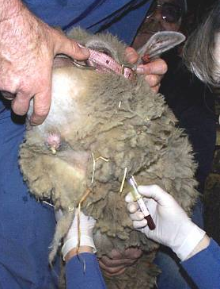
Ensuring Certificate is Valid
Time constraints and timing:
  Generally good for 30 days
  Exceptions exist – check!
  Timing of work on animals
Recording who worked the animal:
  Work personally done
  Work by other accredited veterinarian
    Name of vet
    Date & location
    Tests/vaccinations performed
Notes:
Time limits and timing:
In general a health certificate or CVI is good for 30 days after it is issued. This is true for MOST interstate and international health certificates and for MOST interstate certificates of veterinary inspection and international health certificates. Note: Small Animal CVIs are only good for 10 days from the date of veterinary signature when used for airline travel.
Exceptions exist: The certificate may be good for a shorter time frame for certain species, diseases, or country of destination. Check it out! Do not just assume that all health certificates are good for 30 days.
Timing of work: Work out the timing of the vaccinations, treatments, the drawing of samples for lab work and the physical exams with the departure and arrival dates of the animal(s) so that all are still valid when the animal travels.
Recording who worked on the animal:
When you sign the certificate, you are stating that you have personally inspected, tested, treated and/or vaccinated the animal(s) on the certificate. You must personally inspect the animal within 10 days of issuance of the certificate. Date of issuance is the last date you examined the animal. This is the date you put on the certificate.
If any test, vaccination, inspection or treatment was performed by another accredited veterinarian, you must identify that work on the health certificate by listing the name of the veterinarian, the date and location of work done, and the actual test and/or vaccinations done. Your signature states that you are taking responsibility for the work of another accredited veterinarian who is assisting you with work on the same animal or group of animals.

Slide 34
Common Mistakes on Certificates
Wrong form
Test results/vaccination records missing
Test results not recorded correctly
Questionable accreditation status
Missing certification statements
Incomplete certificate
Notes:
Common mistakes that occur on International Health Certificates:
The incorrect health certificate form was used.
Required (and perhaps completed) test results and vaccination certificates not included with the certificate.
Test results were not recorded on the certificate properly.
Date of test was outside valid period
Accreditation status of issuing veterinarian is questionable.
Missing certification statements. An example of a certifications statement for a bull to Canada: “I certify that this bull was not vaccinated against brucellosis”. An example of a certification statement for animals moving from a state with VSV: “I have examined the animals in this shipment and find no clinical signs of vesicular stomatitis. The animals in this shipment do not originate from a premises currently under quarantine for vesicular stomatitis.”
Incomplete certificate: For example, the name and address for the place of origin or destination of the animal (consignee or consignor) may be missing.

Slide 35
Common Mistakes on Certificates
User fee not included
Signature missing
Outdated information
Improper ID of animal
Improper test performed
No import permit
Notes:
Common mistakes that occur on International Health Certificates (continued):
User fee not included with health certificate. User fee information for international health certificates is available on the APHIS website.
Signature of issuing veterinarian missing.
Outdated information: Certificates and/or test results are outdated by the time the certificate is issued or reaches the AVIC (for international work) or will be outdated by the time the animal reaches the State or Country of destination.
Improper identification of an animal. The identification information may have been incorrectly entered on the form. The wrong type of identification may have been entered into the form.
Improper test performed: An example of an improper test is that the SN test for VSV is often required by other countries and is only performed in the US when specifically requested for export.
No import permit: Sometimes an import permit is required. If that is required and is missing, the certificate is held up.

Slide 36
DO NOT . . .
DO NOT issue pre-signed certificates
DO NOT issue certificates without examinations
DO NOT split blood samples
DO NOT ship animals with pending test results
These are illegal actions.
Is risking your license, accreditation,
and reputation really worth it?
Notes:
DO NOT . . .
Do NOT pre-sign Health Certificates and Certificates of Veterinary Inspection. Don’t sign a certificate if you haven’t filled in all the blanks. Don’t sign a certificate and have someone else fill in the information. If a certificate that you have signed contains incorrect information, you are still liable for those false statements even if they were added after you signed the certificate.
Do NOT complete Health Certificates and Certificates of Veterinary Inspection without examining the animals. Your signature states that you performed the work. Typically the animal must have been inspected within 10 days of completing the certificate. Check with the accreditation regulations or the VS Area Office for information on time frames for non-typical cases (e.g., for animals in a routine health maintenance program).
Do NOT split blood samples. Do not take a sample from one animal and say that it is for 1 or more other animals. Not only is this illegal, but it is also very easy to detect this illegal action when samples are processed at a competent lab.
Do NOT ship animals whose test results are still pending unless you have the express approval of the AVIC. Sending animals on a pending test sets us all up to fail since someday an animal will come back with a positive test and then we’ll all have to scramble to find, quarantine, and re-test/dispose of the animal and all the animals it came into contact during its movement.
These are illegal actions. Is risking your license, your accreditation, and your reputation really worth it?

Slide 37
10 POINTERS FOR A SUCCESSFUL LIVE ANIMAL EXPORT (PETS)
1) Check the APHIS website: www.aphis.usda.gov
2) If no requirements are listed, contact the Ministry of Agriculture in the country of destination.
3) If import guidelines cannot be obtained, consider an APHIS 7001. This may include a ship-at-your-own-risk statement from the owner.
4) Contact the VS office to verify your list of requirements is up-to-date.
5) The VS office does not have additional info that is not listed on our website.
6) Issue the HC after the exam and all requirements have been met. If a rabies vx is required, submit a rabies vaccination certificate with the health certificate.
7) Be aware of microchip requirements (e.g. microchip prior to rabies vx)
8) If you bring the HC to our office for an endorsement, schedule and appointment. We do not accept walk-ins.
9) If mailing the HC, we recommend overnight shipping with a tracking number. Also include a prepaid return label for quick turnaround (our default is USPS).
10) Fillable versions of HCs available on our website.

Slide 38
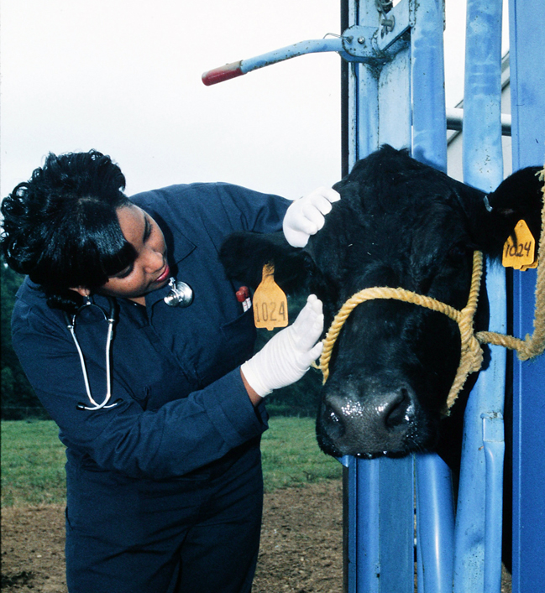
Sample Health Certificates
Sample International Health Certificates:
  APHIS Form 7001
  VS Form 17-140
  VS Form 17-145
  VS Form 10-11
  VS Form 17-6
Notes:
The following pages show some samples of VS health certificates that you might use in international movement of animals. Remember that these are only some of the commonly used forms for international movement. Check in all the multiple places described earlier to be sure you use the correct form.
APHIS Form 7001: United States Origin Health Certificate
VS Form 17-140: United States Origin Health Certificate
VS Form 17-145: U.S. Origin Health Certificate for Horses to Canada
VS Form 10-11: EIA Test
VS FORM 17-6: Certificate for Poultry or Hatching Eggs for Export
[Note to Presenters: You can choose to go through the forms and describe how to fill them out or elect to just flash through the samples. The forms are difficult to see on a screen. If you would like to work through a form with a group, it would be best to include a sample form in the handouts and go through the paper form.]

Slide 39
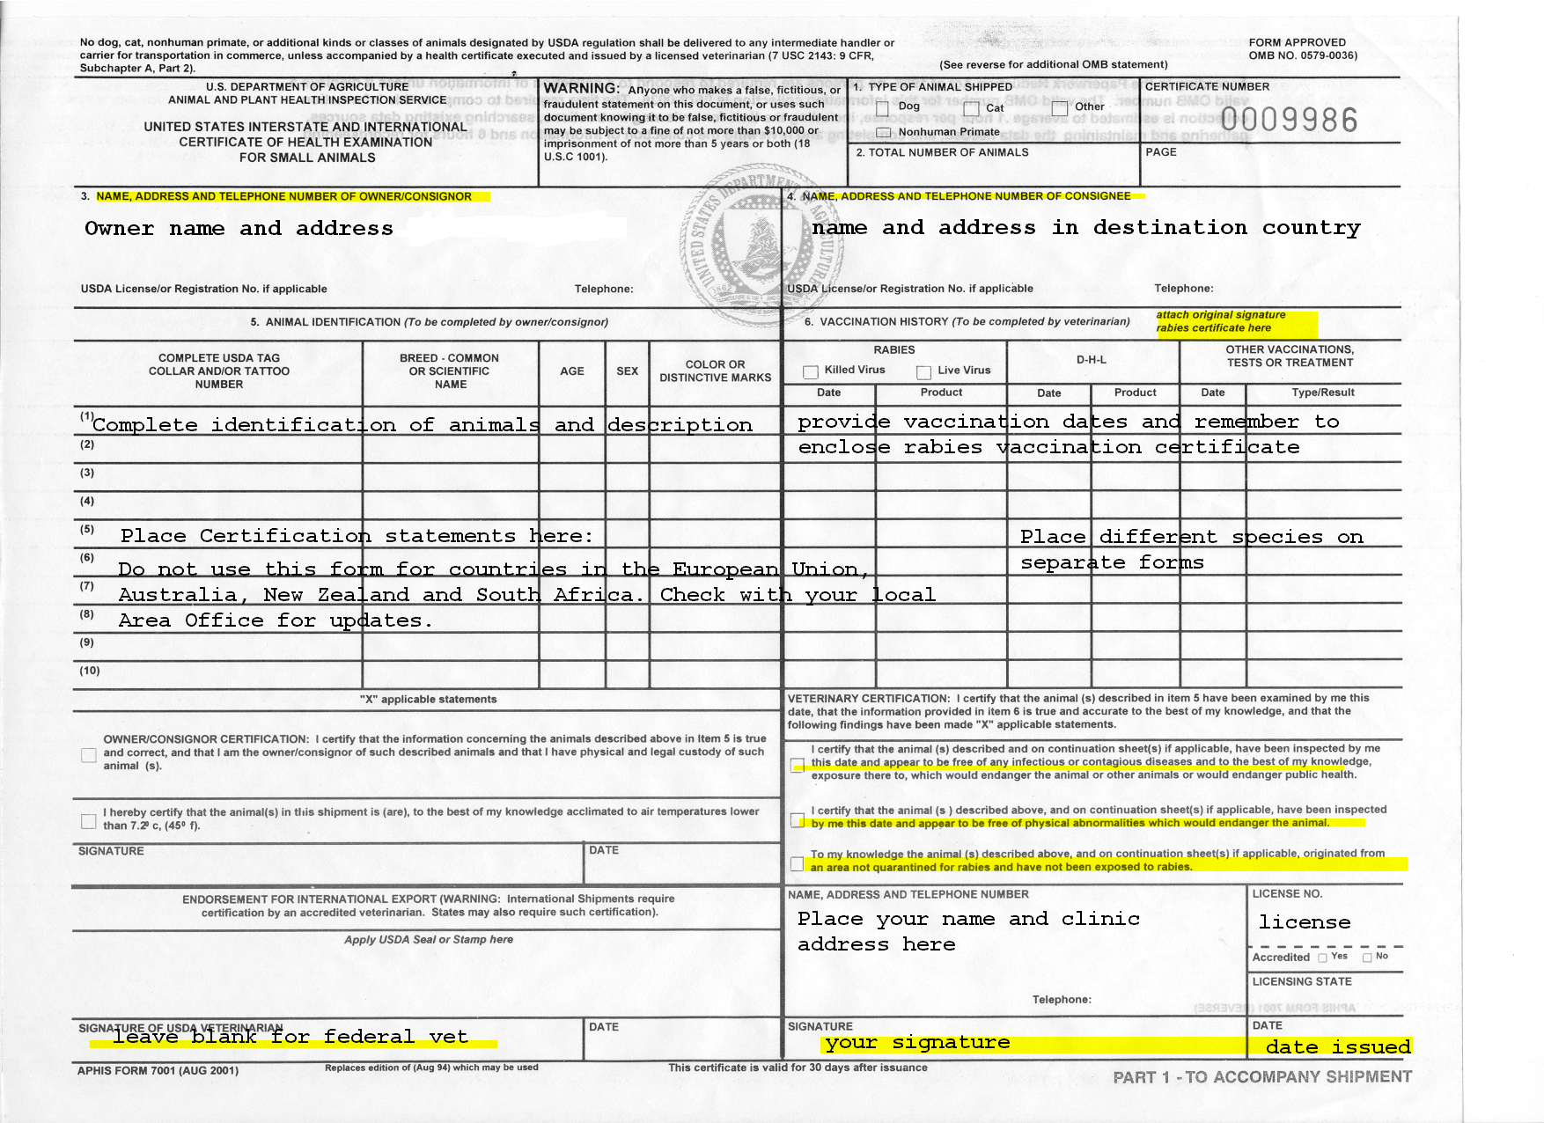
APHIS Form 7001
Notes:
APHIS Form 7001: United States Origin Health Certificate

Slide 40
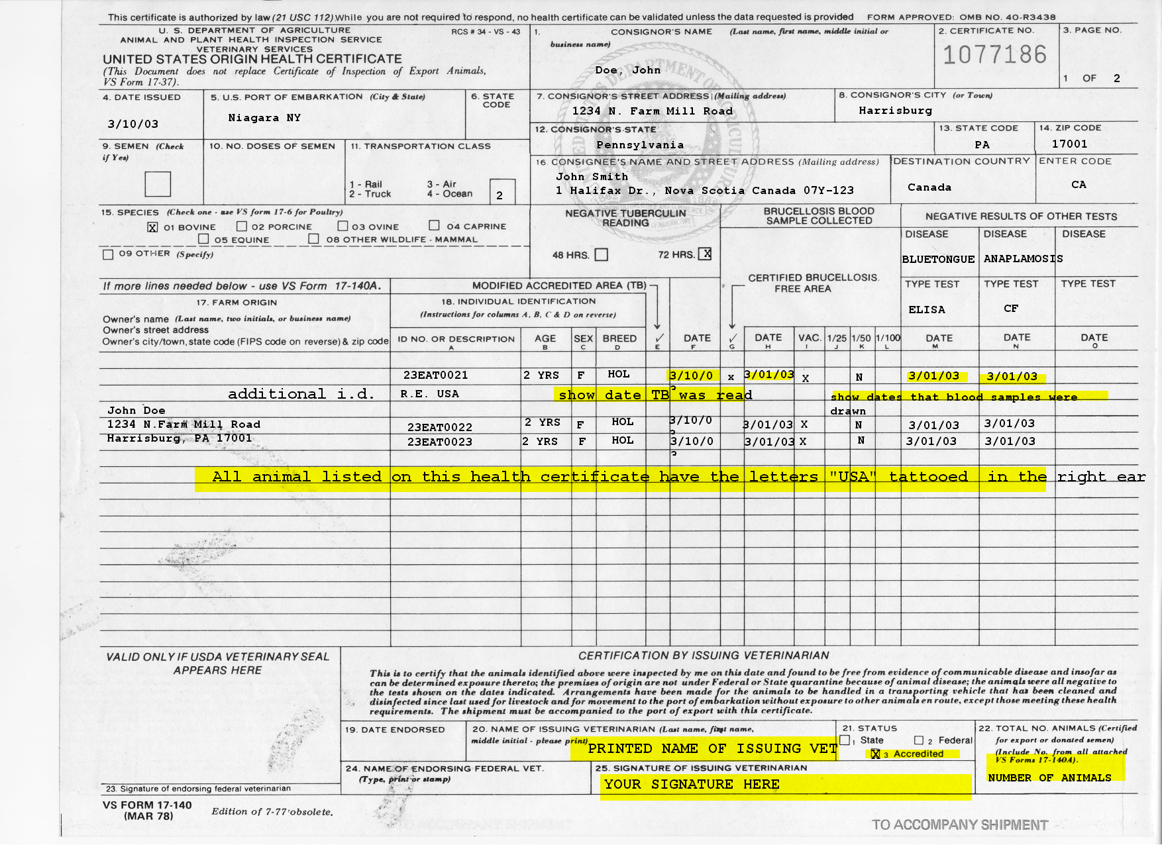
VS Form 17-140
Notes:
VS Form 17-140: United States Origin Health Certificate

Slide 41
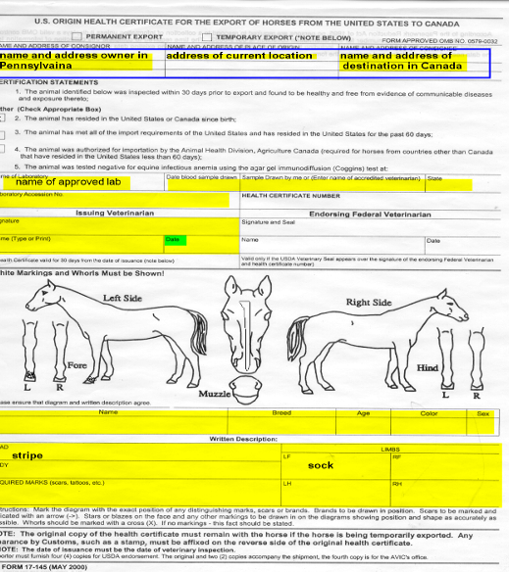
VS Form 17-145
Notes:
VS Form 17-145: U.S. Origin Health Certificate for Horses to Canada. This is a non-slaughter Health Certificate for horses going to Canada.

Slide 42
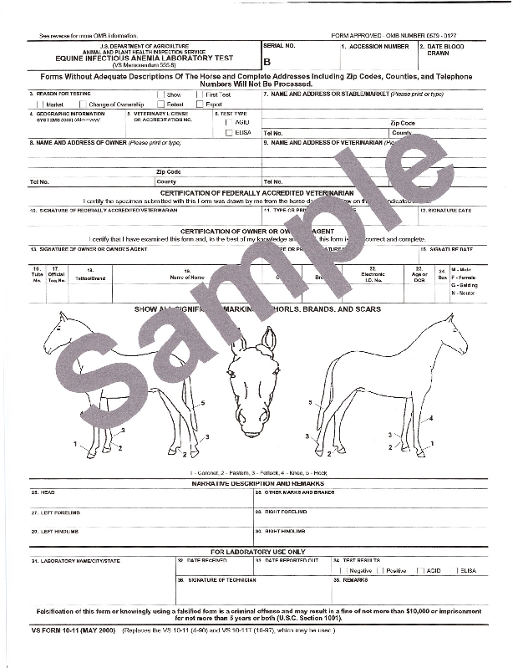
VS Form 10-11
EIA Test
Notes:
VS Form 10-11: EIA Test

Slide 43
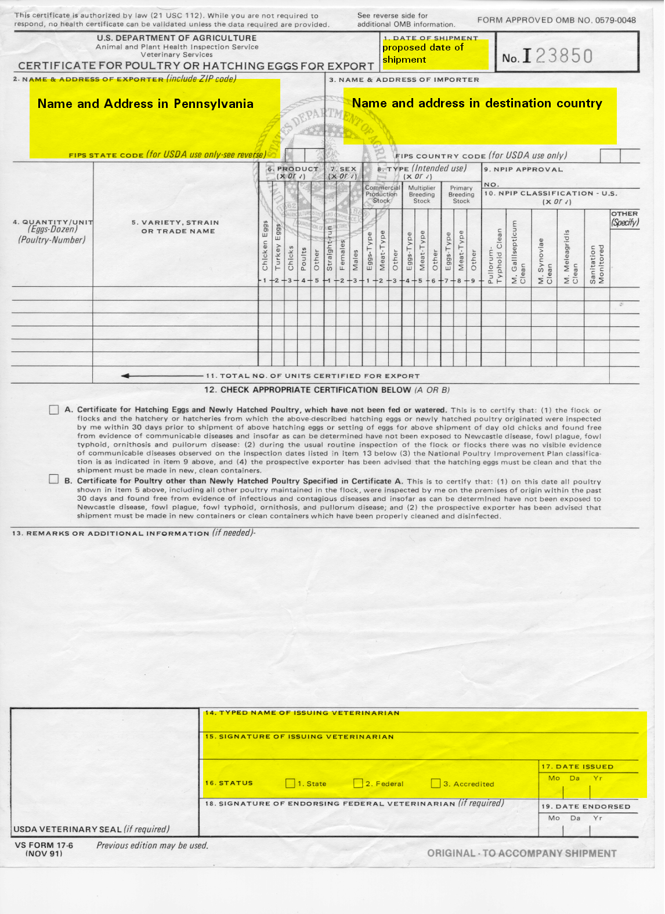
VS Form 17-6
Notes:
VS FORM 17-6: Certificate for Poultry or Hatching Eggs for Export

Slide 44
Import Information
Import Regulated by Several US Agencies
Public Health: Primates, dogs, cats, turtles
Fish and Wildlife: Rare/endangered species
USDA: Livestock, horses, poultry, related species AND any animal
Basic Import Requirements:
Import Docs, Tests, Treatments, Certificate
Entry via Designated Port & Quarantine
Notes:
The information on this slide is for information-purposes only. For the most part accredited veterinarians do not participate in import work.
Import Requirements for animals are regulated by several agencies:
The Department of Health and Human services through the Public Health Service has regulations on the importation of primates, dogs, cats and turtles.
The Department of the Interior through Fish and Wildlife regulates the import of rare and endangered species. This regulator effort is based on collaborative agreements reached with other nations.
The US Department of Agriculture regulates import livestock, horses, poultry and related species. The USDA also regulates tortoises. The USDA can also regulate the importation of any animal that may pose a danger to U.S. agriculture (e.g., screwworm). The above separation by agencies is only a rough guidance. Contact your local Area Office and NVAP website for specifics on the regulations about different species and sub-species.
All of the import requirements change regularly based on changes in the disease status of the country from which the animal is coming and changes in international negotiations and agreements with various countries.
Basic Import requirements :
Appropriate import documents, based on the species and country of origin. These could include permits
Specific tests and treatments according to the species and country of origin
Health certificates
Entry via designated ports
Quarantine at a USDA facility. Quarantine is not always needed, but if it is, it must be done at a USDA facility or USDA-approved facility. Quarantine requirements are dependent on the species or sub-species and the country of origin.

Slide 45
Section 3
USDA / VS
Animal Disease Programs

Slide 46
VS Programs
Types of VS Programs you might work on:
  Eradication Programs
  Monitoring & Surveillance Programs
  Control & Certification Programs
Your responsibilities in VS Program work
  Know basic program requirements
  Recognize official animal ID
  Know state/country requirements
Notes:
[Note to presenters: the slides following will address the three types of VS programs.]
Types of VS Programs you might work on:
Eradication Programs: Different types of work depending on the disease
Monitoring & Surveillance Programs: Little work available at the present for accredited veterinarians
Control & Certification Programs: Accredited veterinarians can work in these areas, but need additional certification to do so.
[Note to presenters: You might want to state that Accredited Veterinarians have an extensive role in Animal Movement, which will be discussed section 5 of this training.]
Accredited Veterinary Responsibilities for working with VS Program Diseases:
Know basic program requirements
Recognize official animal identification program goals and philosophy. Check with your VS Area Office or State Animal Health Office (state vet’s office is term in most states) for most up-to-date information.
Know requirements of other states and countries. Again check with VS or State offices.
If accredited veterinarians have questions about their roles in VS Program Diseases, they should contact their VS Area Office or State Animal Health Office.

Slide 47
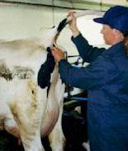
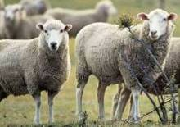
Current VS Eradication Programs
Tuberculosis (Bovines & Cervids)
Brucellosis (Bovines & Swine)
Pseudorabies
Scrapie
Notes:
[Note to presenters: The accredited veterinarian’s role in each of these eradication programs will be discussed in the following slides. The list of diseases officially on the list of VS Eradication Programs and the status of each of those diseases can be currently be found at:
http://www.aphis.usda.gov/animal_health/animal_dis_spec/downloads/eradication_status.pdf.
Have accredited veterinarians google “current VS eradication programs” rather than giving the website, as the addresses (like all web addresses) could change.]

Slide 48
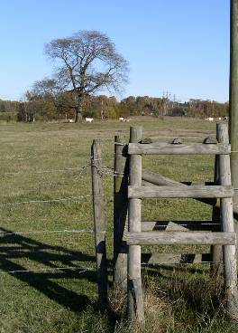
Your Role in TB in Cattle
Cattle: Caudal Fold Test (CFT)
Inspect injection site in 72 hrs
  What is a response?
  Injecting veterinarian must read
Immediately report any response
  CCT within 10 days of CFT
  Must wait 60 days to retest
  Expect 1-5% false positives
Notes:
Accredited veterinarians are essential to the detection and eradication of TB in the U.S.
Cattle: Caudal fold test or CFT. Get training in proper injection and practice reading an injection site before attempting this test.
Inspect the injection site 72 hours after injection, plus or minus 6 hours. Any lump, thickening, swelling, erythema, or any other visible change at the injection site constitutes a response to the caudal fold test and that animal is labeled as a “Suspect”. An animal classified as Suspect must be reported to your VS Area Office or State Animal Health Official’s Office. Indicate each animal’s classification (N for negative; S for suspect) on the TB test chart, VS Form 6-22, or State equivalent.
The veterinarian who injected the tuberculin MUST be the person who reads the injection site, except when special permission by the state animal health official or the AVIC. Plan your injection and reading, so that you will be available to read the response.
The injection site MUST be read within the timeframe. If the injecting veterinarian does not read the CFT at 72 +/- 6 hours, the test is not valid and the owner must wait 60 days before the animal or herd can be retested. Accredited veterinarians are monitored by local animal health officials for such things as timelines, accuracy of reports, and CFT responses rates.
Immediately report any response to the VS Area Office and/or the State Animal Health Official’s Office. If there is a response to the Caudal Fold Test, the Comparative Cervical Test (CCT) must be performed by a regulatory veterinarian within 10 days of the tuberculin injection. The CCT involves 2 injections in the neck and is read 72 +/- 6 hours later. If the CCT is not conducted within 10 days of the CFT injection the owner must wait 60 days to retest using the CCT. It is essential to report a response to the CFT immediately.
Because the specificity of the CFT is not 100%, expect 1 to 5% false responders. The rate of false responses may vary because of animal age, management practices, time of year, or other diseases in the herd (i.e., Johne’s).
Accredited Veterinarians may perform CFTs. Most vet students have had some training in CFT, but some may have only observed, not administered, the tests. If Accredited Veterinarians need practice or training in administering the test or reading the injection site, they should contact the VS Area Office or the Office of the State Animal Health Official.

Slide 49
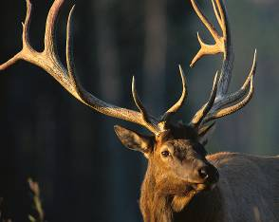
Your Role w/TB in Cervidae/Other
Captive Cervidae include:
  Whitetail, Mule, Fallow, Elk, Reindeer
Single Cervical Test (SCT)
  Only Designated AV can administer
  Wait 90 days to retest
DPP
Goats, swine, other species
Notes:
Captive cervidae include deer such as Whitetail, Mule, Fallow, Elk and Reindeer. All are initially tested with the SCT.
Single Cervical Test or SCT. SCTs are to be administered by Designated Accredited Veterinarians only.
Suspects will be secondarily tested by regulatory veterinarians. These secondary tests must be administered within 10 days of the SCT injection date or the owner must wait until 90 days after the SCT injection date for a retest.
Accredited Veterinarians may perform CFTs and Designated Accredited Veterinarians may perform both CFTs and SCTs. Accredited Veterinarians must be trained by VS or State VMOs to become Designated Accredited Veterinarians.
Goats: Goats are initially tested with the CFT which can be applied by any accredited veterinarian. Suspects must be reported to the VS Area Office or the State Veterinarian’s Office just as bovine Suspects are reported.
Swine: Swine are generally not tested except for overseas export markets. Accredited veterinarians may perform this testing, but as it is rather specialized, it is recommended that you contact your VS Area Office or Office of the State Animal Health Official for further details.
Other Species: Consult your Practitioner’s Guide or contact your the VS Area Office or Office of the State Animal Health Official for further details on Swine and for information on other species.

Slide 50
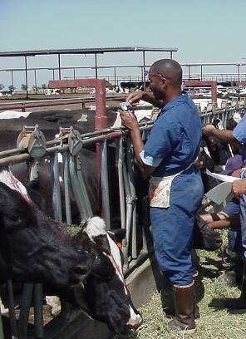
TB Testing Tips
Obtaining tuberculin and report forms
Don’t expose to light, air, temp extremes
  Tuberculin loses potency
  Do not store in syringe
  Discard partially filled vials
No meat/milk restrictions
Don’t test sick cattle
Don’t treat while testing
Notes:
Contact the VS Area Office or State Animal Health Official’s Office for information on obtaining the tuberculin (PPD – Purified Protein Derivative) and the tuberculosis testing forms, VS Form 6-22 or State equivalent.
Avoid exposing PPDs to light, air, high temperatures, and freezing
Tuberculin oxidizes and loses potency
Do not draw and store in syringe for long periods
Discard partially filled vials after 2 weeks
No meat or milk restrictions after PPD injection
Do not test obviously sick cattle!
Do not treat while testing
Drugs or hormones can alter the animal’s immune response.
Treat CFT Negative animals after reading.
Do not treat CFT responders. Treatment can interfere with secondary testing. Wait until the test is read before beginning treatment.

Slide 51
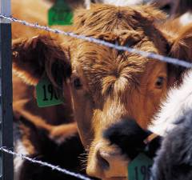
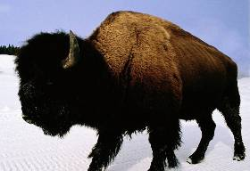
Cattle Brucellosis
A Zoonotic disease
Program status
  Class Free: 50 States, PR, VI (Sept 09)
  Greater Yellowstone Area still
  dealing with brucellosis
Notes:
A Zoonotic disease – Causes undulant fever in humans. It is one of the reasons we pasteurize milk in the U.S. Undulant fever is a major human health concern in the world, particularly in under-developed countries.
Program status
Class A <.25% infection rate in cattle and bison and more than 95% of cases are “successfully closed”
[Note to presenters: Montana had temporarily lost their Free status; they regained Free status in Sept 2009.
Class Free – 50 States & 2 territories *
(* as of Sept 2009)
The Greater Yellowstone Area (GYA), Yellowstone National Park (YNP) and the area surrounding it, is the last known remaining area of brucellosis in the country. Brucellosis is endemic in YNP and Grand Teton National Park bison, and in some GYA elk herds. GYA bison brucellosis prevalence is 40 - 50% or greater and GYA elk brucellosis prevalence varies depending upon the herd unit. The Interagency Bison Management Plan is used to mitigate transmission of brucellosis from YNP bison to cattle in Montana and a plan to mitigate brucellosis transmission from elk. Wyoming and Idaho also have plans to mitigate transmission of brucellosis from wild elk and bison to cattle.

Slide 52
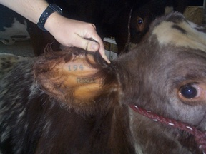
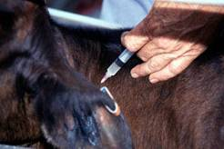
Your Role in Cattle Brucellosis
Vaccination, ear tagging, tattooing
Testing
Reporting
Notes:
The Accredited Veterinarian is paid by the livestock owner for routine brucellosis official calfhood vaccination (OCV) and brucellosis testing. In some cases, e.g. the Greater Yellowstone Area, VS may contract (with the prior approval of the Region Director) with the Accredited Veterinarian to perform brucellosis program activities (OCV, adult vaccination, and brucellosis testing). The brucellosis program requires the animals be officially identified when brucellosis tested or vaccinated. Identification for brucellosis vaccination includes identification of the animal with an official eartag and tattoo. Recording, on the vaccination certificate, of individual registered breed association tattoo or brand may be substituted for the official eartag.
Brucellosis testing occurs in Class A state First Point Testing (e.g. livestock markets), for movement from a Class A state, brucellosis-free herd certification, individual herd plans (e.g. GYA), and during brucellosis epidemiologic investigations.
The Accredited Veterinarian is required to promptly report all brucellosis testing and vaccination activity to the appropriate State Livestock Health Official and/or the VS Area Veterinarian in Charge. This is accomplished by submitting copies of the vaccination certificates or brucellosis test forms. Contact your local State Livestock Health Official and/or the VS Area Veterinarian in Charge for how soon they would like to have the paperwork submitted.

Slide 53
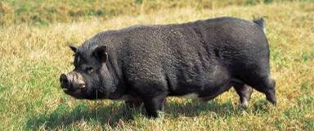
Your Role in Swine Brucellosis
All free except Texas
Feral swine impact total eradication
  >4 million feral swine
  Known herds in 39 states
Your responsibility
  Certificates
  Permits
  Sample collection
Notes:
As of September 2009, 49 states and the territories of Puerto Rico and the Virgin Islands are brucellosis free. Texas is in stage 2. No states or territories are in stage 1.
Total eradication affected by feral swine population.
The swine brucellosis eradication program recognizes feral swine as an infected reservoir that may potentially infect the commercial swine herd.
Swine brucellosis caused by Brucella suis is commonly found in feral swine and those herds allowing exposure to feral swine.
Estimates of the number of feral swine in the U.S. are thought to exceed 4 million.
Thriving feral swine populations are known to exist in at least 39 states.
The largest number of feral swine are believed to be in Texas, Florida and California.
As the numbers and geographic distribution of feral swine continue to increase, it is certain that the number of contacts between feral swine and domestic livestock will also increase.
What are the accredited veterinarian’s responsibilities in the swine brucellosis program?
issuance of certificates prior to interstate movement of swine not known to be infected with or exposed to swine brucellosis
issuance of permits to accompany all intrastate and interstate shipments of brucellosis-infected or -exposed swine
assisting State and Federal representatives in collecting blood or tissue samples, and ensuring that animals are appropriately identified

Slide 54
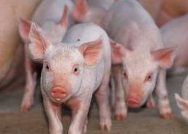
Pseudorabies
Pseudorabies: What is it?
How it is spread?
VS approach to pseudorabies
  Surveillance in domestic swine
  Disease control, including depopulation, to prevent spread
  Education
Notes:
Pseudorabies: the disease
Pseudorabies is a viral disease most prevalent in swine, often causing newborn piglets to die. Older pigs can survive infection, becoming carriers of the pseudorabies virus for life. Other animals infected from swine die from pseudorabies, which is also known as Aujeszky's disease and "mad itch." Infected cattle and sheep can first show signs of pseudorabies by scratching and biting themselves. In dogs and cats, pseudorabies can cause sudden death. The virus does not cause illness in humans.
How is it spread?
PRV is primarily spread through direct animal-to-animal (nose-to-nose) contact between an infected, shedding pig and a non-infected pig. If present on inanimate objects, such as boots, clothing, feed, trucks, and equipment, the virus can also spread from herd to herd and farm to farm.
VS approach to pseudorabies:
USDA established a voluntary eradication program for pseudorabies in the United States in 1989. The program is cooperative in nature and involves Federal, State, and industry participation.
No commercial production herds have been found to be infected with PRV since early 2003. Sporadic infections have been found in transitional production herds, those swine which are captured feral swine, or have the potential to come in contact with feral swine. Any infected transitional herds have been promptly depopulated when found, and intense epidemiological investigations have been conducted to ascertain that no viral spread to commercial production swine has occurred.
Education: Educate your clients about disease prevention and control measures

Slide 55
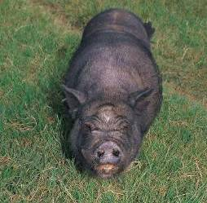
Your Role in Pseudorabies
Status in U.S.: All states in Free status
Your responsibility
  Certificates
  Permits
Feral swine effect
  Serological evidence
  All considered positive
  Depopulation approach
Notes:
Pseudorabies Status in U.S.: All states are in free status, with disease occurrences only when there is contact with infected feral swine. Focus is VS now is training and education on herd health and keeping pseudorabies out by eliminating contact with feral swine and by working with Wildlife Services to eliminate feral swine populations.
Accredited Veterinarian’s Role in Pseudorabies Eradication: As with the swine brucellosis program, accredited veterinarians are responsible for signing certificates that accurately reflect the health status (i.e., pseudorabies-free) of animals being transported. Indemnity Calculation Data is available on the Veterinary Services website.
Effect of Feral Swine on Eradication Efforts:
pseudorabies virus has been isolated from feral swine in Texas and Florida, and serologic evidence of pseudorabies has been demonstrated in several other states
the USDA assumes all feral swine to be positive for pseudorabies. ALL feral swine are assumed to be potentially infected with pseudorabies.
in FY2008, 12 ‘transitional’ U.S. herds were identified, investigated and depopulated because they were positive for pseudorabies and/or swine brucellosis

Slide 56
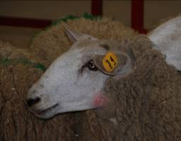
Your Role in Scrapie Program
Educate clients:
  To recognize clinical suspects
  To use official ID
    1-866-USDA-TAG
  To practice prevention strategies by:
    Breeding for genetic resistance in sheep
    Maintaining closed ewe flocks
    Enrolling in SFCP
Report all scrapie suspects!
Notes:
Current and prospective clients should be informed on how to:
To recognize and report clinical suspects. Recognizing suspects early helps them get government support for eliminating the disease more quickly.
To use official ID on their sheep and goat herds.
Official eartags are provided free to producers and accredited veterinarians and may be requested by calling 1-866-USDA-TAG.
Complete information on use of official ID is available at the National Institute for Animal Agriculture website.
To practice prevention strategies, such as:
Using genetic resistant sheep or selecting for genetic resistance in a current flock. Complete information on use of genotyping for producers is available at the National Institute for Animal Agriculture website.
Maintaining a closed ewe flock or purchasing only genetic-resistant stock.
Enrolling in the Scrapie Flock Certification Program (SFCP). Information on the SFCP is available from the Scrapie Program, VS Area Office, or State Animal Health Office.
Report all scrapie suspects to VS Area Office or State Animal Health Office. Recognition and reporting of clinical suspects by owners and accredited veterinarians is critical to eradicating scrapie form the United States. Failing to report a scrapie suspect is an accreditation violation.

Slide 57
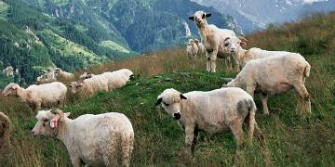
Your Role in Scrapie Program
Collect & submit samples to USDA-approved lab
  Live animals: Federal/State vet, usually
  Dead animals: Accredited vet
    brainstem, lymph nodes, tonsil
  Submission forms and instructions
Conduct genetic testing
Notes:
Collect and submit diagnostic samples to a USDA-approved lab. Contact the VS area office or the State Animal Health Official’s Office for information on USDA-approved labs if you have questions on that.
Generally once a suspect is reported, a State or Federal veterinary will be sent to investigate and sample clinical suspects. Accredited Veterinarians should not conduct rectal or third eyelid biopsy unless they have been trained in the procedure.
However, if the animal is dead, needs to be euthanized for humane reasons, or will not survive until a State or Federal veterinary can be dispatched, the accredited veterinarian should collect the entire brainstem, the retropharyngeal lymph nodes and the tonsils. One tonsil, one retropharyngeal lymph node, the obex, and half of the brainstem (split longitudinally) should be placed in formalin. The remaining tonsil, retropharyngeal lymph node, and other half of the brainstem should be submitted in separate bags chilled. As an alternative, the entire head may be chilled on ice until it can be picked up or delivered to a lab.
Contact the VS Area Office for submission forms and instructions.
Conduct official scrapie genetic susceptibility testing.
For a genotype test to be recognized as an official test by USDA it must be conducted by an AV, the sheep must be officially identified, an original VS Form 5-29 must be accurately completed and the sample and form submitted to a USDA approved lab. Contact the VS Area Office for VS Form 5-29 submission forms and instructions.

Slide 58
Surveillance Activities
Additional surveillance activities (examples):
  Infectious Salmon Anemia
  Screwworm
  Cattle Tick Fever
  Classical Swine Fever
  CWD
Goals of surveillance:
  Enhance current eradication efforts (for TB in bovines & cervids, Brucellosis in bovines & swine, Pseudorabies and Scrapie)
  Detect emerging diseases and FADs
  Improve marketability
  Reduce consumer & animal risk
  Monitor animal health trends
Notes:
Eradication programs include surveillance efforts
The VS eradication programs for TB in bovines & cervids, Brucellosis in bovines & swine, Pseudorabies and Scrapie include monitoring and surveillance efforts as part of those programs.
Sample Surveillance programs/activities:
In addition to continued monitoring and surveillance in those eradication programs, VS conducts monitoring and surveillance efforts on a number of other diseases. A partial list of current surveillance programs/activities includes:
High-path AI = Highly pathogenic H5N1 Avian Influenza
Infectious Salmon Anemia
Screwworm (Old World and New World)
Cattle Tick Fever – also called Texas Fever, Tick Fever, Piroplasmosis, Red Water (Bovine Babesiosis)
Classical Swine Fever or CSF
For a more complete listing see: http://www.aphis.usda.gov/vs/nahss/ (have students google NAHSS in case website address changes)
Surveillance plans have been developed for numerous animal diseases of significance. More information on these plans and other activities can be obtained on the web site.
Goals of Monitoring & Surveillance:
Enhance current eradication efforts (for TB in bovines & cervids, Brucellosis in bovines & swine, Pseudorabies and Scrapie)
Detect emerging diseases and FADs
Improve marketability
Reduce consumer & animal risk
Monitor animal health trends

Slide 59
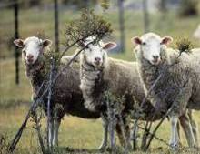
Certification Programs
What are Certification Programs?
Diseases with Certification Programs
Scrapie
What to do if you are interested?
Get certification training
Check with your state
Notes:
Certification Programs: Some of the diseases efforts are beginning to include certification programs as part of the tools used to monitor, control and/or eradicate that disease. Certification programs involve testing and paperwork to certify that a herd is disease-free herds and developing herd health plans.
Diseases with Certification Programs:
Scrapie: Scrapie Flock Certification Program (SFCP)
CWD: Chronic Wasting Disease. A Herd Certification Program (HCP) is being developed by APHIS in coordination with states, the farmed cervid industry, and the US Animal Health Association (USAHA) to support this effort.
Diseases that will possibly have certification programs in the future:
Johne's disease (pronounced "yo-knees") is a contagious, chronic and usually fatal infection that affects primarily the small intestine of ruminants. All ruminants are susceptible to Johne's disease. Johne's disease is caused by Mycobacterium avium subspecies paratuberculosis, a hardy bacteria related to the agents of leprosy and tuberculosis. The disease is worldwide in distribution.
Swine Health Protection Act / Trichinae: Will include garbage-feeding and other issues
Acquaculture:
Participation in Scrapie Flock Certification Program will be discussed in the next section under “Control and Certification Programs”, as it requires additional training.
What to do if you are interested?
Working in these programs will be open to Accredited Veterinarian but you will need to get additional training (most likely at your own cost) to become certified in a particular area. Once certified for these specialties, you will be able to do certification work.
Check with your State Animal Health Official or your AVIC to see if the state in which you are working is participating in a particular certification program.

Slide 60
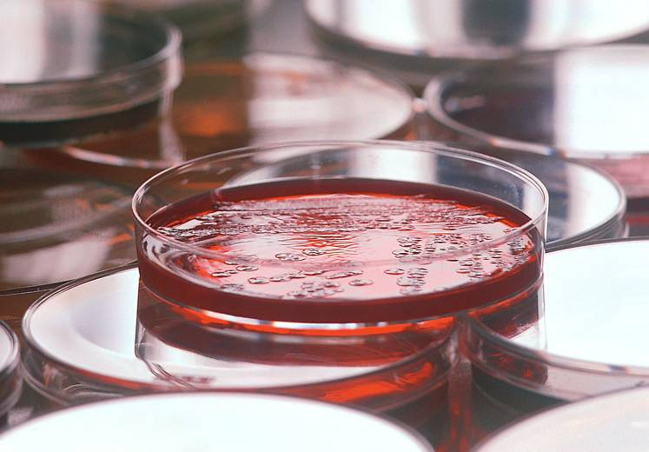
Other Types of Activities
Accredited Veterinarians also can assist with:
  Emerging Diseases & Issues
  State Programs
  National Poultry Improvement Plan
Notes:
Examples of Emerging Diseases and Issues
Epizootic Hemorrhagic Disease (EHD) in White-Tailed Deer and Cattle
Progressive Inflammatory Neuropathy in Swine Slaughter-Plant Workers
Swine Influenza Virus (SIV): Infection of Swine and People
Neurologic Cases of Equine Herpesvirus Type 1 (EHV-1)
Melamine Animal-Feed Adulteration Issue
Examples of State Programs
EIA: Equine Infectious Anemia (state program)
Commercial Industry Program (Administered by APHIS-VS)
National Poultry Improvement Program

Slide 61
Section 4
Animal Identification and Laboratory Support
For Movement and Disease Diagnosis

Slide 62
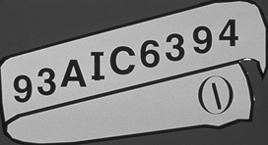




Traceability
Official ID Devices and Methods:
Eartags
  National Uniform Ear-tagging System (NUES)
  Animal Identification Number (AIN)
  Location-based number
Back tags & Brands
Breed association ID
Group/Lot ID
Many other ID systems
Notes:
Accredited veterinarians can assist with the goal of tracing animals involved in interstate movement by recognizing and/or applying official identification devices or methods to animals of all kinds. These unique identifiers allow animal testing, certification, vaccination, and movement to be documented, thus providing information about the animal and its whereabouts which is essential for effective animal disease traceability.
Your Role in assisting USDA with traceability goals:
There are many identification devices and methods that are considered official for interstate movement or disease program work including:
Official eartags
Official backtags
Brands registered with an official brand inspection agency and accompanied by an official brand inspection certificate (picture on bottom right is a sample of brands)
Identification devices and methods utilized by purebred breed associations for registration purposes (may include tattoos, eartags, color patterns, pictures, etc.) when accompanied by a valid registration certificate
Other devices or methods approved by the APHIS administrator
Group/Lot identification: The identification number used to uniquely identify a ``unit of animals'' of the same species that is managed together as one group throughout the preharvest production chain.
Official eartags use one of the following numbering systems:
National Uniform Eartagging System (NUES). Accredited veterinarians can order and apply National Uniform Eartagging System (NUES) tags. These metal tags are the standard ones used in Federal programs. Tag on center right of slide is a NUES tag. The first numbers on the tag indicate the state.Animal Identification Number (AIN): The AIN contains 15 digits, with the first 3 being the country code (840 for the United States), the alpha characters USA, or the numeric code assigned to the manufacturer of the identification device by the International Committee on Animal Recording. The AIN number is commonly used on visual bangle-like tags, radio frequency tags and with injectable transponders. The “840” prefix can only be used on animals born in the United States. A private practitioner can buy “840” tags to sell to clients, but then needs to adhere to the policy for managing those tags.
Location based numbering system: The location-based number system combines a location identification number with a producer's livestock production numbering system to provide a unique identification number. The location identifier and the production number must both appear on the official tag. An example of where this is used is in the scrapie program eartags.
Ordering and using official identification devices: Talk to your State Animal Health Official or AVIC; some of them carry tags for certain disease programs. They will also guide you in the proper use, handling, and record keeping requirements associated with official identification devices.
There are many other non-official Animal ID systems in use. While these identification devices or methods are not, by themselves, considered official for interstate movement or disease program use, they provide important information about the animal and should be recorded on movement certificates and test charts.
Some forms of Electronic ID, which would include RFI (radio-frequency identification) and microchips, are proprietary and not considered official. These are used on large & small animals.
Some Brands or Tattoos are not registered.
Unofficial backtags are used on animal processed through livestock markets. They are not limited to slaughter animals.
State Brands, tags and other forms of animal ID
Producer herd management Ear Tags
Leg Bands (Birds)
[Note to presenters: For more details on new USDA policy on traceability, see the APHIS website: http://www.aphis.usda.gov/traceability/.]

Slide 63

Accountable Property
Health Certificates, Tags, Bands, etc.
PREVENT . . .
Misuse of official
biologics, certificates,
tags, etc.
Notes:
It is your responsibility to secure and appropriately use all official biologics, certificates, tags etc that have been issued to you. Take this accountability seriously. You can face criminal, civil or administrative charges for violations.

Slide 64
Where should I send the sample?
Usually:
  State Diagnostic Laboratories
  Commercial Laboratories
Occasionally:
  National Veterinary Services Laboratories (NVSL)
Notes:
Where Should I send the Samples?
Usually:
Usually samples are sent to the State Diagnostic Laboratories and the commercial laboratories for most animal movement and most program disease work. Your practice, or neighboring practices if you are in a new practice, should have suggestions of labs you can use to perform the tests you need.
Occasionally:
NVSL (National Veterinary Services Laboratories) is the national reference lab. Before you send samples to NVSL, you need to check with the local AVIC. She or he will determine whether a sample needs to be sent to NVSL and if a sample needs to be sent, whether you or a federal/State veterinarian needs to collect and send in that sample. NVSL is National Veterinary Services Laboratories, and is located in Ames, Iowa.

Slide 65
Obligations for Sample Submission
You are responsible for proper collection, preparation, packaging, and shipment
of specimens.
Each sample should:
Be properly identified
Include completed lab submission forms
Follow postal regulations or approved shipper regulations
Notes:
You are responsible for the proper collection, preparation, packaging, and shipment of specimens.
Each sample should:
Be properly identified. Check on what form of animal identification is required and use whatever form is required.
Include completed lab submission forms.
Follow postal regulations or approved shipper regulations.

Slide 66
Laboratory Submissions to NVSL
Check with VS District Office
Visit NVSL website
Use VS 10-4 Specimen Submission Form
Package correctly and ship to NVSL
Pay user fee
Questions? Call NVSL 515-663-7530
Notes:
Laboratory Submissions to NVSL
Check with VS Area Office
AVIC will determine whether a sample needs to be collected, and if it does, whether you or a federal/State veterinarian will collect the sample.
Visit the NVSL Website
After you check with the VS Area Office, visit the NVSL website for details on packaging and shipping samples. Call them at 515-663-7530 if you have questions that aren’t answered on the website.
Submit the sample using 10-4 Laboratory Submission Form
Use VS 10-4 Laboratory Request Form & 10-4A continuation for additional pages
Forms and instructions are available on NVSL website: http://www.aphis.usda.gov/animal_health/lab_info_services/forms_publications.shtml
Package correctly and ship to NVSL
Packaging and shipping information on NVSL website: http://www.aphis.usda.gov/animal_health/lab_info_services/diagnos_tests.shtml
There are different instructions depending on which shipping company is used. Check with website.
Shipping address at Ames has changed due to the new building; check the website.
Pay user fee
Must be made in advance unless submitter has an account.
Pay by check, money order, bank draft, or credit card. Some tests may be billed to a USDA account.
Information on user fees and creating an account is available on the website.
If You Have Questions:
Contact the VS Area Office
Call NVSL at 515-663-7530

Slide 67
Section 5
Foreign Animal Diseases (FADs)

Slide 68
Reportable Diseases
What should you report?
    Diseases on Federal list
Whom should you notify?
  VS District Office
  State Animal Health Official
FADs and transboundary diseases
Notes:
You are our PRIMARY means of surveillance. You need to be aware of what diseases are REPORTABLE.
Accredited vets are responsible for reporting:
Diseases on the State’s list of reportable diseases: These are the diseases that the State requires that all veterinarians licensed in that State report. An accredited vet who neglects to report one of these diseases may risk censure or action by that State’s Veterinary Licensing Board. For a list of these diseases, contact your State Animal Health Official.
Diseases on Federal reportable list: These are the diseases which an accredited veterinarian is required to report as part of accreditation responsibilities. VS Memo 570.8, “VS Policy on Reportable Program Diseases” expands on CFR citation and provides lists of diseases. Contact your VS Area Office for information on which diseases need to be reported.
Whom should you notify?
VS Area Office. This depends on the disease and the state. Check with the AVIC’s Office and with the State Animal Health Official’s Office.
State Animal Health Official. In most states, this is the State Veterinarian’s office. But also can be State Dept of Agriculture, Board of Animal Health, or Livestock Commission.
9CFR, 161 defines disease-reporting responsibility.
"An accredited veterinarian shall immediately report to the Veterinarian-in-Charge and the State Animal Health Official all diagnosed or suspected cases of a communicable animal disease for which a APHIS has a control or eradication program in 9 CFR chapter I, and all diagnosed or suspected cases of any animal disease not known to exist in the United States as provided by §71.3(b) of this chapter.“
An FAD is a foreign animal disease, sometimes also called a transboundary disease (the name commonly used in journal articles and other countries). An FAD is disease which we do not have. A transboundary disease is a disease that crosses boundaries, one or more countries have that disease and one or more other countries do not want that disease to enter their country. These diseases can cause huge economic impact for the animal industries and governments both in the clean-up process if a disease enters a country or area that was free of the disease and the preventive measures taken to prevent the spread of those diseases.

Slide 69

When to Be Suspicious of FAD
What are the characteristics of an FAD?
Notes:
Ask the question: What are the characteristics of FAD’s? Have attendees respond. Below are the answers.
When should you be suspicious and think that what you are seeing might be an FAD?
High morbidity and/or high mortality
Doesn’t fit the classical picture of that disease. Remember that more extreme cases are used for the pictures so that the illustration of the disease is clear. Also, many FADs have a wide range in morbidity or mortality depending on other conditions. Reporting a suspicion and possibly being wrong is the route we want you to take.
Vesicular lesions anywhere on the body, but especially on the face, feet, and near reproductive structures
Abortion storms of unknown etiology
Pox or lumpy skin
Hemorrhagic septicemia
Severe respiratory conditions
Poor/no response to treatment when a response is expected
Suspicious necropsy findings that don’t look like what you have typically seen.
NOTE: Field strains may not be as virulent as “textbook” cases. This means that the symptoms of FADs are many times not as severe as the “textbook” cases, either in the way the disease looks and/or in the morbidity or mortality rate So, if it looks like it might be a mild version of an FAD, call your AVIC or State Animal Health Official.

Slide 70

When to Look for an FAD?
History of foreign travel, visitors, mail, gifts
Importation of animals, embryos, semen
Unusual/unexplained illness or symptoms
CNS diseases
Mucosal diseases
Larvae in wounds
Unusual ticks, mites, etc.
Notes:
When should you be suspicious and look for the possibility of an FAD?
History of foreign travel, visitors, mail, gifts
Importation of animals, embryos, semen
Central nervous system (CNS) diseases
Mucosal diseases
Larvae in wounds
Unusual (ornate) ticks; exotic ticks, mites, etc.
Unusual or unexplained illness or symptoms in other animals or in humans

Slide 71

And if FAD is Not Reported?
If you don’t RECOGNIZE and REPORT these clinical signs and symptoms, colossal devastation to US Animal Agriculture can result in this . . .
Notes:
Trade loss, economic devastation, food supply issues, US animal health devastation, etc.

Slide 72

And This . . .
Notes:
FMD in England.

Slide 73
If you suspect an FAD, CALL!
DON’T ignore it and hope it goes away!
CALL!!
USDA / VS District Office or
EM 24/7: 1-800-940-6524
Notes:
Call the area office of the state in which you are accredited. If you can’t find anyone, call Emergency Management Headquarters in Riverdale, Maryland. There is an 800 number that is available 24 hours a day, 7 days a week: 1-800- 940-6524.
Verbally tell the students your area office number. Give them your business card, a refrigerator magnet, etc. Put the AVIC number for your state (and maybe for all states) in the packet of information you provide them.

Slide 74
When You Call . . .
You suspect an FAD and call . . .
the USDA, VS District Office and
State Animal Health Office
What information should you provide?
Notes:
Ask the question to students – answers below.
When you call the Federal Area Office and the State Animal Health Office, you will need to provide the following information to assist with the FAD investigation.
Producer’s name, address, phone number
Directions to farm
Complete clinical history
Number & species of animals affected
Number & species susceptible
Treatments given and response noted
Your contact information

Slide 75
What Happens Next?
Foreign Animal Disease Diagnostician (FADD) is assigned
FADD investigates, places quarantine, collects and ships samples
Diagnosis usually within 3 days
FADD contacts owner and veterinarian with results
Notes:
What happens after you report a suspected FAD?
A Foreign Animal Disease Diagnostician (FADD) is assigned to the case.
The FADD investigates, places a quarantine, and collects and ships samples.
Diagnosis usually available within 3 days. Depends on the way testing method and whether must be cultured.
FADD contacts owner and veterinarian with results

Slide 76

FADs Eradicated from U.S.
1892: CBPP
1929: FMD
1929: Fowl Plague
1934: Glanders
1942: Dourine
1943: Texas Cattle Fever
1959: Swine VE
1959: Screwworm (SE US)
1966: Screwworm (SW US)
1971: VEE
1973: Sheep Scabies
1974, 1998, 2003: Exotic Newcastle Disease
1978: Classical Swine Fever
1985 & 2002: Highly Path Avian Influenza
Notes:
As, you can see we’ve been busy.
1892: Contagious Bovine Pleuropneumonia
1929: FMD
1929: Fowl Plague
1934: Glanders
1942: Dourine
1943: Texas Cattle Fever
1959: Vesicular Exanthema of Swine
1959: Screwworm (SE US)
1966: Screwworm (SW US)
1971: Venezuelan Equine Encephalitis
1973: Sheep Scabies
1974, 1998, 2003: Exotic Newcastle Disease
1978: Classical Swine Fever
1985 & 2002: Highly Path Avian Influenza

Slide 77
Nat’l AH Emergency Corps
National Animal Health Emergency Corps
Role for Private Practitioners & AHTs
USDA emergency response work:
Animal health emergencies
All-hazard emergencies
Collaboration
Notes:
National Animal Health Emergency Corps
Private practitioners and animal health technicians can assist with the response to exotic disease outbreaks and other disasters that affect livestock, poultry, wildlife and companion animals by becoming part of the National Animal Health Emergency Response Corps. As a temporary USDA employees, private practitioners and AHTs help meet a critical need for veterinary expertise during potential animal health crises. You do NOT need to be accredited to participate in the NAERC.
USDA, APHIS, VS is an emergency response organization that:
Takes the lead on Animal Health Emergencies: USDA has a long history of responding to traditional animal health emergencies such as the Exotic Newcastle Disease Outbreak in 2003 in California. Private practitioners are hired for these types of outbreaks.
Assists with All-Hazard Emergencies: In addition to protecting the health of livestock and poultry, USDA also works with DHS (Department of Homeland Security), FEMA (Federal Emergency Management Agency) to provide assistance during all-hazard emergencies. These emergencies could include a variety of events, such as hurricanes, floods or terrorist actions.
Collaborates via partnerships with federal agencies, states, tribes, universities, industries and private entities, APHIS develops strategies and policies for effective incident management and coordinates on-the-ground incident response.

Slide 78
Section 6
Disease Case
Scenarios

Slide 79

Case History #1
A dairyman calls to report:
  A sudden drop in milk production
  Several cows drooling profusely
  Many affected cows have fevers
Your exam reveals . . .

Slide 80


Case #1 Lesions
Notes:
Left picture: Erosions of the nasal mucosa
Right picture: Excess salivation
Differentials – toxicosis, malignant cataral fever (MCF), BVD, FMD

Slide 81


Case #1 Lesions
Notes:
Left picture: vesicles on the tongue
Differentials: toxicosis, FMD, Vesicular Stomatitis
Right picture: ruptured vesicle on oral mucosa of the lower jaw
Differentials: Rinderpest, toxicosis, FMD, Vesicular Stomatitis

Slide 82

Case #1 Lesions
Notes:
What’s in the picture: Ruptured vesicle and erosion of the tongue mucosa
[Question to ask students]: What would you collect for a sample to submit to the lab here?
[Answer]: Collect epithelium sloughing from the vesicle and take scrapings of the erosions.

Slide 83


Case #1 Lesions
Further evaluation reveals some lame cows . . .
Notes:
Left picture: Ruptured vesicles in interdigital spaces
Differentials: Trauma, foot rot, vesicular stomatitis, FMD
Right picture: Erosions in interdigital spaces
Differentials: Trauma, foot rot, vesicular stomatitis, FMD

Slide 84
Case #1 Differential Diagnoses
Infectious Bovine Rhinotracheitis (IBR)
Bovine Viral Diarrhea (BVD)
Bovine Papular Stomatitis
Chemical Irritant
Vesicular Stomatitis
Foot-and-Mouth Disease (FMD)
Malignant Catarrhal Fever (MCF)
Rinderpest
Notes:
If Rinderpest, we would expect to also see diarrhea, but might still be a concern.
Case #1 is FMD

Slide 85

Case #2 History
Owner presents a 9 year-old Greyhound with an infected prepuce
The family was recently transferred to CA from Panama

Slide 86



Case #2 Lesions
On physical exam you see inflammation of the prepuce
Closer examination of prepuce reveals . . .

Slide 87

Case #2 Differential Diagnosis
Screwworm Myiasis
Blowfly Myiasis
Notes:
Myiasis is the presence of fly larvae in a wound. It is possible that a wound where blowfly larvae are eating DEAD tissue could look very much like a wound where screwworm larvae are eating LIVE tissue.

Slide 88

New World Screwworm in US
1998 Alabama
  Ecotourist to Brazil
  Sores on his scalp
2000 Florida
  Cat from Guantanomo Bay, Cuba
  Abscess - 1 larva
  Called NVSL
  Treated with Ivermectin in Cuba
Notes:
The U.S. has had only one case of Old World Screwworm, in Massachusetts in 2008, in a dog from Southeast Asia.
All of the following cases are of New World Screwworm.
1998 Alabama
Ecotourist to Brazil
Sores on his scalp
2000 Florida
Cat from Guantanomo Bay, Cuba
Abscess - 1 larva
Called NVSL
Treated with Ivermectin in Cuba

Slide 89

New World Screwworm in US
2000 Florida
  Gelding imported from South America
  Preputial discharge - 50 to 100 larvae
  Called APHIS Office, sent FADD
2007 Florida-Miss
  Dog from Trinidad
  Larvae behind eyes
  Dog lived
Notes:
2000 Florida
Gelding imported from South America
Preputial discharge - 50 to 100 larvae
Called APHIS Office, sent FADD
2007 – 16-year-old dog entered Miami enroute to Mississippi
Dog was from Trinidad and Tobago
Veterinarian in Mississippi found larvae behind the eye; the dog was blind prior to this condition (probably glaucoma)
Flies had probably been drawn by weepy eyes
Larvae found behind ocular orbits.
Eyes removed and dog lived.
Traced the path the dog had taken in Florida and Mississippi. Treated premises and rental vehicle.
[Note to presenters: We’ve seen one instance of Old World Screwworm in 2008. A dog came from Southeast Asia via Amsterdam to Boston. It was on its way to California. In Boston, it was treated by a veterinarian for a wound with larva. This veterinarian suspected screwworm and treated the animal.]

Slide 90
Case #3
A client brings a chicken to your rural small animal practice
He believes his bird caught something from a neighboring flock
Notes:
[Note to presenters: In this case, the word “game” does not refer to “upland game birds such as pheasants, quail, and partridge”.]

Slide 91

Case #3 History
Bird has been sick for 2 days
2 other birds died last week
Owner has 52 birds
6 - 8 other birds may be sick
  Stopped laying
  Stopped eating
  Weak & off balance

Slide 92


Case #3
Being the only vet in the area, you pay a visit to his home to look at his birds . . .

Slide 93


Case #3 Lesions
You look at a few birds and see . . .
Notes:
Left picture: Conjunctiva and edema of eyelids
Right picture: Hemorrhagic cloaca and darkened skin

Slide 94

Case #3 What do you do?
Wish you stayed awake during the poultry lectures in vet school
Call the VS District Office
Submit some birds to your State or USDA Lab for diagnostic testing

Slide 95

Case #3
You’re not sure what is wrong, but it looks bad, so . . .
You call your local State or Federal Office
They dispatch an FADD
Notes:
FADD = Foreign Animal Disease Diagnostician

Slide 96




Case #3 Lesions
The FADD necropsies sick birds and finds . . .
Notes:
Clockwise starting in top left corner:
Facial edema
Hemorrhagic lesions, gizzard
Hemorrhage of mucosal trachea
Hemorrhagic proventriculus

Slide 97

Case #3 Differential Diagnosis
Laryngotracheitis (LT)
Fowl Cholera (Pasteurellosis)
Fowl Pox
Avian Influenza (AI)
Exotic Newcastle Disease (END)

Slide 98

Exotic Newcastle Disease 2002-2003
Backyard flocks & commercial
CA, NV, AZ, TX
18,435 premises quarantined
921 premises depopulated
4 million birds euthanatized
$165 million cost to USDA
Additional $165 million for industry
Trade embargos on poultry, eggs, birds
Notes:
This was the latest outbreak. We also had outbreaks of Newcastle in 1971 and 1998.

Slide 99

Don’t ignore your concerns!
CALL!!
AD’s Office
State Vet’s Office
Don’t get an outbreak
named after you!
Notes:
If you have concerns that a disease you are seeing might be a foreign animal disease, call the Area Office of the State in which you are accredited and call the Office of the State Animal Health Official. If you can’t find anyone, call Emergency Management Headquarters in Riverdale, Maryland, 24 hours a day, 7 days a week: 1-800- 940-6524.

Slide 100
Wrapping Up
As an Accredited Veterinarian, you:
  Facilitate interstate and international animal movements
  Provide early detection for FADs
  Help control program diseases
Act with professional integrity!
Take your accreditation seriously!
Notes:
As an Accredited Veterinarian, you:
Facilitate interstate and international animal movements by communicating with clients, examining animals, taking samples for testing, and writing certificates.
Provide early detection for FADs by recognizing and reporting them to the VS Area Office.
Help control program diseases by testing and providing other treatment to animals included in program disease control efforts
So, act with professional integrity and take your accreditation seriously. Remember that we take your accreditation seriously.

Slide 101
Wrapping Up
Completion of this orientation and holding a veterinary license do not make you an accredited veterinarian.
Notes:
To become accredited, you still must complete VS Form 1-36A, be licensed or legally able to practice, and be approved by the AVIC for each State in which you wish perform accredited duties.

Slide 102
Wrapping Up
Get licensed in a state
Submit application for accreditation (along with a copy of the document that proves you attended this core orientation) to the VS District office
Meet one-on-one with a state or federal veterinarian in the state (today’s session covers this for Wisconsin)

Slide 103
Wrapping Up
Complete the form documenting your attendance (include your email address) and drop it off at the front of the room
Take a CD of useful resources for accreditation
Remember to call Valencia Watts at 517-337-4700 (USDA, APHIS, VS in Michigan) or 515-284-4140 (IA USDA, APHIS, VS) anytime you have veterinary accreditation questions

