Slide 1
Structured Dairy Pricing Program
Two Tier Pricing

Slide 2
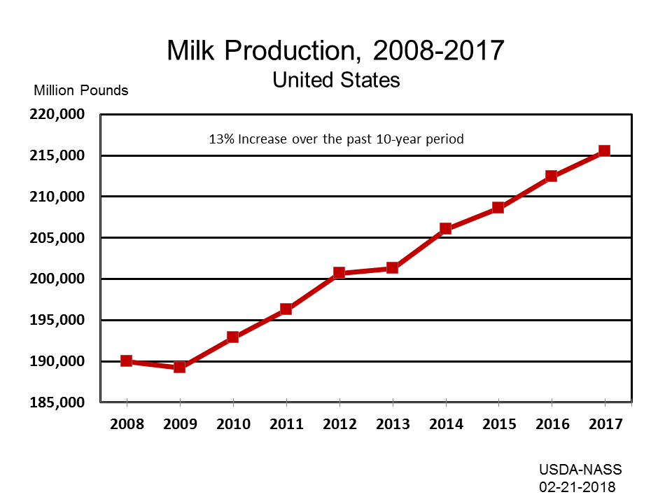
Milk: Production by Year, US

Slide 3
670,000 dairy farmers in the US
less than 40,000 dairy farmers left
2036 USDA projects fewer than 18,000
94%Fewer farms in 48 years & more milk ??????

Slide 4
Source : “We Need New Policies to Protect Family Sized Dairies” – Dr. Richard A. Levins professor of Applied
Economics – University of Minnesota
About the same number of cows in 1997 and 2012
1997 - 3.6 million head on farms of 100 cows or less
- 1.6 million head of farms of over 1000 cows
- 1.6 million head on farms of 100 or less cows
- 4.5 million head on farms over 1000 cows
In just 15 years we lost 2 million cows on small farms
we gained 3 million cows on large farms

Slide 5
Number of Cow on Dairy Farms
2012 2017
Less than 100 head herds 1,590,000 1,310,000 17.6% reduction
Over 1000 head herds 4,305,000 4.955,000 15.1% increase
Total head 9,237,000 9,392,000 1.7% increase
53% of cows on farms of over 1000
Estimates by Dr. Peter Vitaliano
Economist – National Milk Producers Federation

Slide 6
Estimated by Dr. Pete Vitaliano = Economist – NMPF
 | 2012 | 2017
 | # cows | # cows | 2012 | 2017
 | x1000 | x1000 | Percentage of milk | Percentage of milk | change
50 or less | 545 | 454 | 5.90% | 4.83% | -16.70%
50-99 | 1,044 | 857 | 11.30% | 9.12% | -17.91%
100-199 | 1,090 | 1,006 | 11.80% | 10.71% | -7.71%
200-499 | 1,155 | 1,056 | 12.50% | 11.24% | -8.57%
499- 999 | 1,099 | 1,064 | 11.90% | 11.33% | -3.18%
1000-1999 | 1,293 | 1,384 | 14.00% | 14.73% | 7.04%
2000+ | 3,011 | 3,572 | 32.60% | 38.03% | 18.63%
Totals | 9,237 | 9,393 | 100.00% | 100.0% | 1.69%

Slide 7
USDA - Milk Production Costs and Returns per Hundreweight - 2017
Less 50
100
200
500
1000
1000-1999
2000 +
Ave # Cows
34
67
136
303
686
1339
3673
Feed and Direct Cost
16.03
14.84
13.9
12.87
11.87
11.6
11.4
Hired labor
0.45
0.74
1.39
2.21
2.28
2.36
1.82
Taxes & Insurance
0.28
0.28
0.27
0.25
0.16
0.15
0.12
General& Overhead
1.11
0.98
0.72
0.65
0.54
0.5
0.32
Total Operating Cost
$
17.87
$
16.84
$
16.28
$
15.98
$
14.85
$
14.61
$
13.66
EXCLUDES
Opportunity cost unpaid labor
11.78
6.46
3.36
1.29
0.6
0.26
0.09
Capital Recovery on Machinery
4.92
4.59
4.35
4.22
3.93
3.71
3.5
Opportunity Cost- Land rent
0.16
0.08
0.06
0.03
0.01
0
0
Total Cost
$
34.73
$
27.97
$
24.05
$
21.52
$
19.39
$
18.58
$
17.25
$21.52 - $17.25 = $4.21

Slide 8
With no action – conversion to large mega dairies
will continue
Supply management – Buy outs, herd reduction,
diversions programs are utilized by smaller farms as
an exit strategy
Do we need supply controls or a
structure change

Slide 9
The Federal Order System recognizes the different values
of dairy products. Class I Milk – bottled milk has always
been higher priced than milk used to make powder or
cheese. If we can recognize the different values in finished
products why not recognize the different cost on different
sized farms?
Income Distribution
Class I Highest price Tier I Highest cost
Class II Next highest price Tier II lowest cost
Class III Lower price
Class IV Normally lowest

Slide 10
Pay an extra $4.00 amount on the first 1,000,000 pounds produced each month .
Reallocate the remaining amount equally
Does not increase cost to consumers

Slide 11
 |  | Jun-18
 |  | Central Order #32 Pool
 | Percent | Pounds | Value
Class I Milk | 24.2 | 357,158,072 | $ 49,319,773.10
Class II | 9.62 | 142,004,142 | $ 40,656,773.56
Class III | 45.22 | 667,228,055 | $ 106,508,335.27
Class IV | 20.96 | 309,332,007 | $ 46,090,321.28
Totals | 100 | 1,475,722,276 | $ 242,575,203.21
Overages, Inv reclass, & Adjustment |  |  | $ 55,874.31
Class I Receipts from Unregulated Plants |  |  | $ -
Somatic Cell Adjustment - Class II,III,IV |  |  | $ 1,432,789.83
Handler's use value of milk |  |  | $ 244,063,867.35
Subtract Value of Protein in Producer Milk |  |  | 78,692,317.99
Value of other solids in Prodcuer Milk |  |  | 9,624,803.05
Value of Butterfat in Prodcuer Milk |  |  | 146,750,776.92
Value of Somatic Cell in Prodcuer Milk |  |  | 1,787,625.62
Producer Location Adjustment |  |  | 2,421,050.96
Add 1/2 Unobligated Prodcuer Settlement Fund |  |  | 624,180.49
Subtract Prodcuer Settlement reserve |  |  | 689,162.01
PPD |  | 1,475,722,276 | $ 4,722,311.29 | $0.32
subtract $4.00 Tier #1 adjust |  | 721,927,737 | $ 28,877,109.48 | $ 4.00
New PPD |  | 1,475,722,276 | $ (24,154,798.19) | -1.64

Slide 12
Using a 1 million pounds Tier #1 Adjuster
 | 2 tier system |  | $4.00
Farm # 1 |  | units | price | dollars
120 cows | Pounds | 225,000 | $ (1.6400) | $ (3,690.00)
3.8% butterfat |  | 8,550 | $ 2.6692 | $ 22,821.66
3.2% protein |  | 7,200 | $ 1.7478 | $ 12,584.16
SCC $.1211 |  | 225,000 | $ 0.1211 | $ 272.48
other solids 5.78 |  | 13,005 | $ 0.1128 | $ 1,466.96
Tier 1 price |  | 225,000 | $ 4.0000 | $ 9,000.00
Net dollars |  |  |  | $ 42,455.26
per CWt |  |  |  | $ 18.8690
Farm #2 |  | units | price | dollars
500 cows | Pounds | 952,083 | -1.64 | $ (15,614.16)
3.8% butterfat |  | 36,179 | 2.6692 | $ 96,569.40
3.2% protein |  | 30,467 | 1.7478 | $ 53,249.62
SCC $.1211 |  | 952,083 | 0.1211 | $ 1,152.97
other solids 5.78 |  | 55,030 | 0.1128 | $ 6,207.43
Tier 1 price |  | 952,083 | 4 | $ 38,083.32
Net dollars |  |  |  | $ 179,648.58
per CWt |  |  |  | $ 18.8690
Farm # 3 |  | units | price | dollars
1000 cows | Pounds | 1,904,167 | -1.64 | $ (31,228.34)
3.8% butterfat |  | 72,358 | 2.6692 | $ 193,138.90
3.2% protein |  | 60,933 | 1.7478 | $ 106,499.30
SCC $.1211 |  | 1,904,167 | 0.1211 | $ 2,305.95
other solids 5.78 |  | 110,061 | 0.1128 | $ 12,414.86
tier 1 price |  | 1,000,000 | 4 | $ 40,000.00
Net dollars |  |  |  | $ 323,130.67
per CWt |  |  |  | $ 16.9697
Farm #4 |  | units | price | dollars
2400 cows | Pounds | 4,500,000 | -1.64 | $ (73,800.00)
3.8% butterfat |  | 171,000 | 2.6692 | $ 456,433.20
3.2% protein |  | 144,000 | 1.7478 | $ 251,683.20
SCC $.1211 |  | 4,500,000 | 0.1211 | $ 5,449.50
other solids 5.78 |  | 260,100 | 0.1128 | $ 29,339.28
Tier 1 price |  | 1,000,000 | $ 4.0000 | $ 40,000.00
Net dollars |  |  |  | $ 709,105.18
per CWt |  |  |  | $ 15.7579

Slide 13
Size farm original pay price two tier price operating cost
$4.00 adjuster _________________________________________________________
120 cows $16.829 $18.869 $16.84
1000 cows $16.829 $16.970 $14.61
2400cows $16.829 $15.760 $13.66
Total Margin $ Margin per cow
120 cows $4,565 $38.04
1000 cows $44,930 $44.93
2400 cows $94,500 $ 39.38
Significantly more in balance

Slide 17
Can it be done?
Would require all milk in the US to be
pooled all the time – no depooling when
advantageous to do so.
Would require all areas of US to be in
a Federal Order or a new Nation wide
Federal Order

Slide 18
This would require a action by Congress.
Current FMMA offices could administrate this
With virtually no additional cost.
No additional cost to consumers – prices still
Based on the supply and demand value of milk.

Slide 19
“All great changes are preceded by chaos.”
Deepak Chopa
“ I didn’t get there by wishing for
change, or hoping for it, but by
working for it.”
Estee Lauder

