Slide 1
Biosecurity for Agricultural Service Providers
Presenter Name, Title
Wisconsin Department of Agriculture, Trade and Consumer Protection (DATCP)

Slide 2
What is Biosecurity?
Precautions taken to minimize the risk of introducing an infectious disease.
Somewhere in between these two scenarios.

Slide 3
Purpose of Biosecurity
To prevent the introduction of disease organism(s) to a susceptible herd or flock of animals.
To prevent spread of disease within a group of animals.

Slide 4
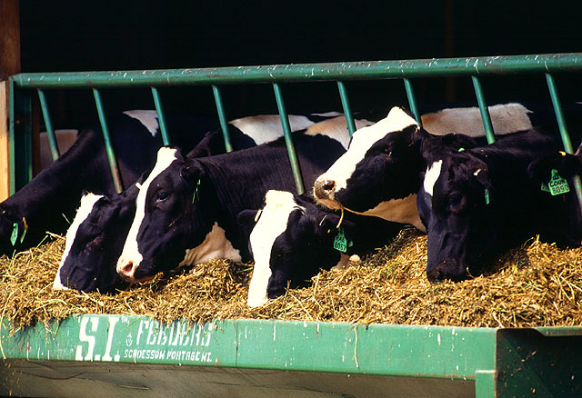
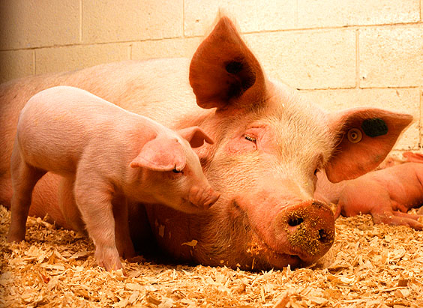
Why Biosecurity is Important
To protect animal health

Slide 5
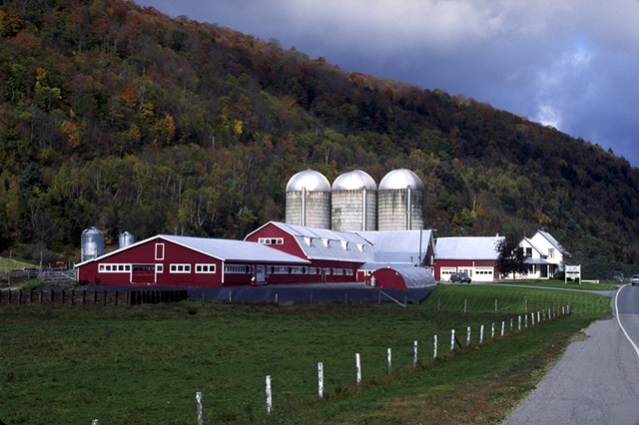
Why Biosecurity is Important
To protect the owner’s investment

Slide 6
Why Biosecurity is Important
To protect our food supply and human health

Slide 7
Examples of livestock diseases that can be transmitted by human movement

Slide 8
Paratuberculosis (Johne’s Disease)

Slide 9
Avian Influenza

Slide 10
Transmissible Encephalopathies (Mad Cow or BSE/CWD)

Slide 11
Routes of Disease Transmission
Direct (Physical contact)–Biting, nose-to-nose, open wounds, reproductive
Fomites (Inanimate objects)–Equipment, clothing, boots, vehicles, trailers
Aerosol–Inhalation of droplets with disease agent
Oral/Ingestion (disease agent consumed) –Contaminated feed or water, licking/ chewing on contaminated object

Slide 12
Precautions you can take to prevent disease transmission

Slide 13
When parking your vehicle
First choice is a designated parking area
Second choice is the cleanest spot available

Slide 14
When working inside a livestock housing building
Minimum biosecurity levels
Have animals moved away from the work site
Have organic matter (manure) removed from work site
Wear protective footwear (rubber boots or disposable shoe coverings)
Wear disposable or cloth coveralls

Slide 15
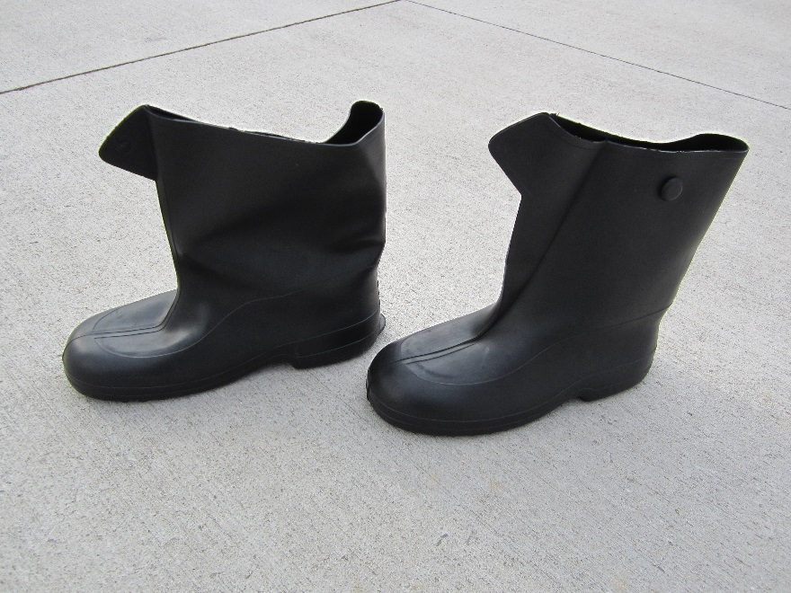
When working outside
Wear protective footwear (rubber boots or disposable shoe coverings)
Avoid wearing disposable shoe coverings in some conditions
Slippery conditions—ice or snow
Extended work or work on rough surfaces—shoe coverings will wear through

Slide 16
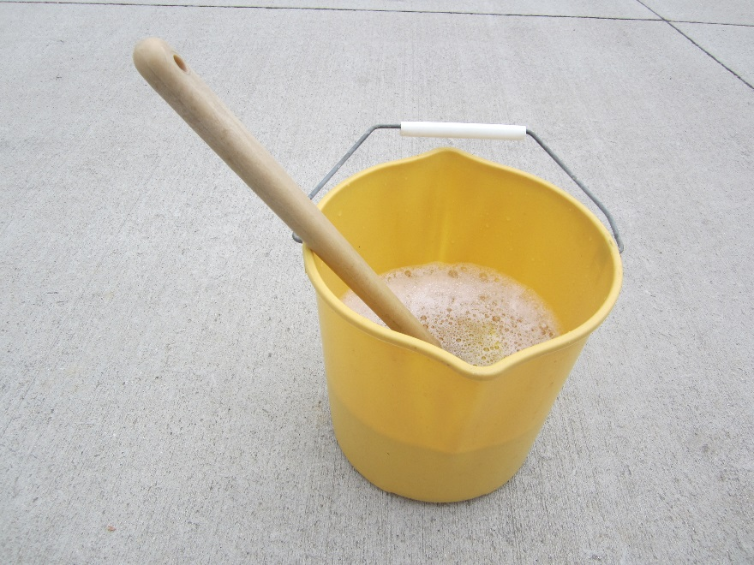
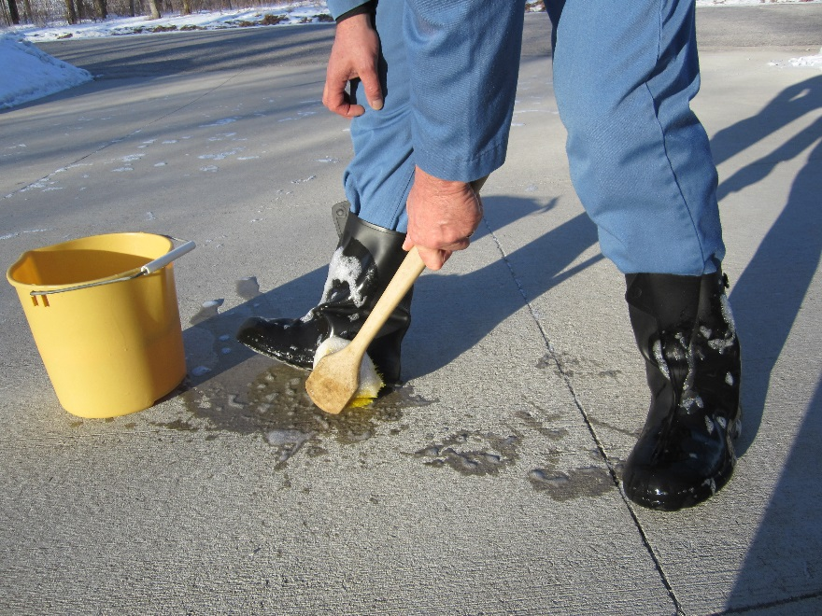
Disinfecting rubber boots
Follow proper cleaning and disinfection procedures
Remember to first clean all residue (dirt/manure) from surfaces, then disinfect

Slide 17
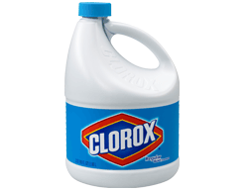
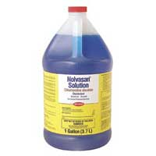
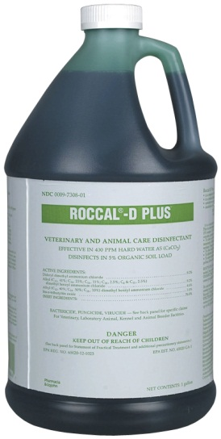
Use Disinfectants*
One-Stroke Environ®
½ oz/gallon of water
Roccal® **
½ oz/gallon of water
Nolvasan® **
3 oz/gallon of water
Household bleach
¾ cup/gallon of water
Lysol ® spray for footwear
Purell® hand sanitizer
*Follow label directions regarding use and safety precautions
**available from farm stores

Slide 18
When working outside
Keep equipment clean

Slide 19
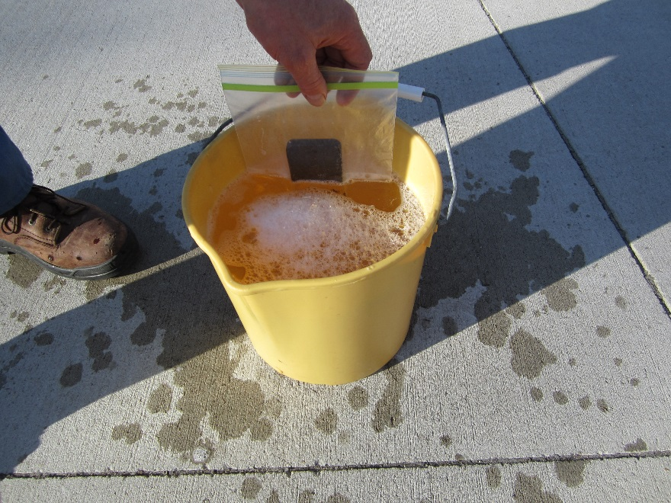
Protect your electronic equipment
It’s best to leave cell phones, tablets and cameras in your vehicle.
If you need to have your cell phone with you, protect it.

Slide 20
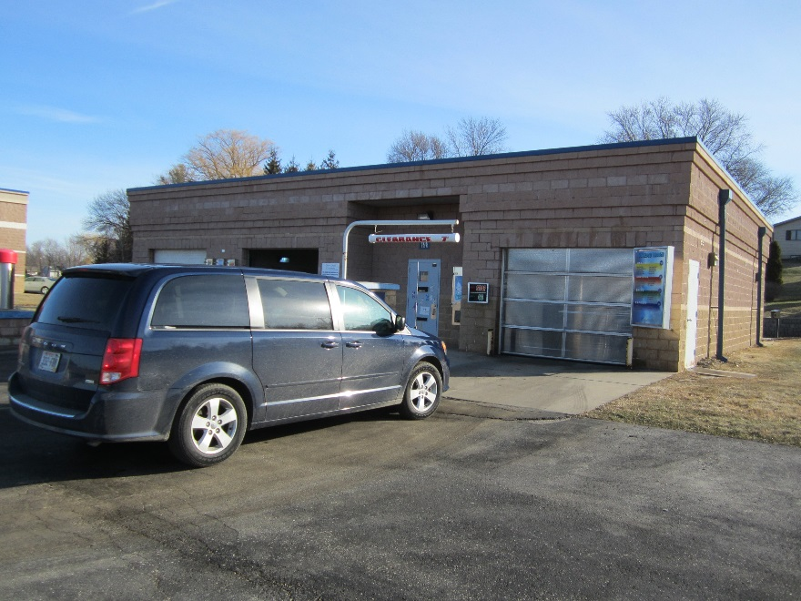
What to do when your equipment becomes contaminated
Clean and disinfect prior to returning them to your vehicle,
OR
Bag equipment for later disinfection
AND
Disinfect bag prior to returning to your vehicle
May be necessary to use a car wash
Pay special attention to contaminated areas
Don’t forget tires and undercarriage

Slide 21
So what does this all mean?
The agricultural service provider is not the means of transmission of infectious agents from one livestock premises to another.
Biosecurity relies on:
Protective Wear
Sanitation
Disinfection

Slide 22
Boiling it down to basics
Remember!
Germs hitch rides on dust, drool, droppings (large and small) and debris.
All those things hitch rides on people, animals, equipment, and tires.

Slide 23
Cow’s idea of biosecurity

Slide 24
Questions?

