Slide 1

State Accreditation and Certification
Division of Animal Health

Slide 2

AGENDA
Division Overview
Official Identification
Interstate Movement
Intrastate Movement
Rabies Control
Resources

Slide 3
Division of animal Health
Certification/ Accreditation of private veterinarians
Disease monitoring, surveillance and response
Animal disease traceability
Licensing
Inspections and Investigations
Premises registration
Emergency preparedness

Slide 4
Wisconsin veterinary certification
Covers areas that federal accreditation does not:
  Intrastate movement

Slide 5
Additional approvals required
  Caudal fold TB testing for cattle and bison
  TB and CWD testing for cervids
  Aquaculture health certificates
  Johne’s herd health plans

Slide 6
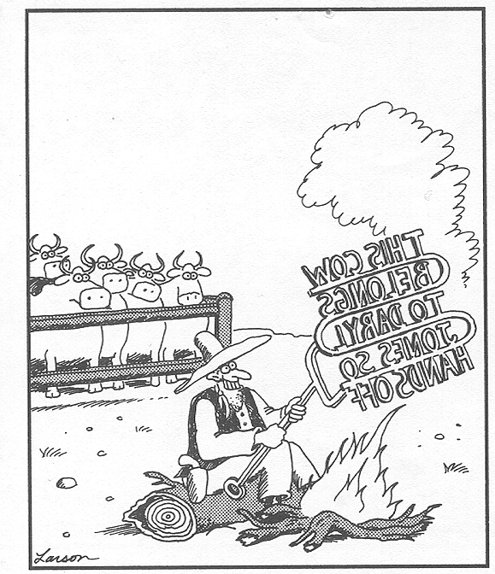
Animal identification
Official OR Not?

Slide 7
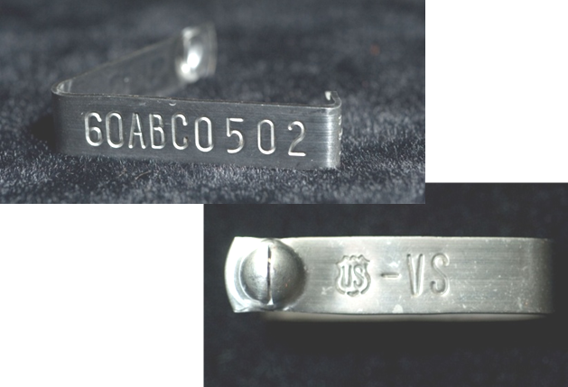
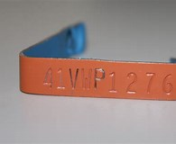

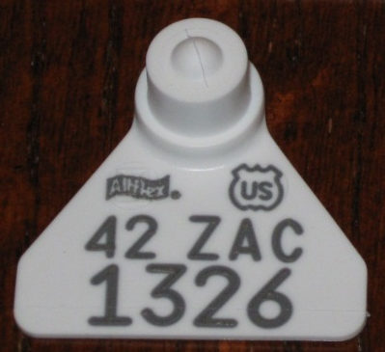

NUES Tags
9-characters (e.g., 35ABC1234)
8-characters (e.g., 35AB1234)
  Mostly seen for cervids
  Not approved for cattle
Starts with two-digit state code (35=WI)
US Shield
USED IN:
Cattle (If applied prior to November 5, 2024)
Swine
Cervids
Other
NOT Sheep or Goats

Slide 8
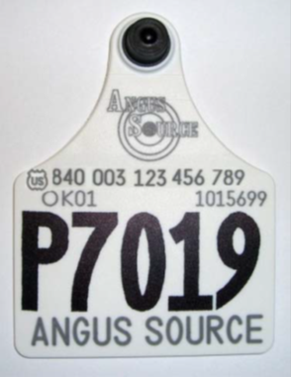
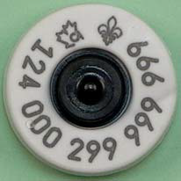
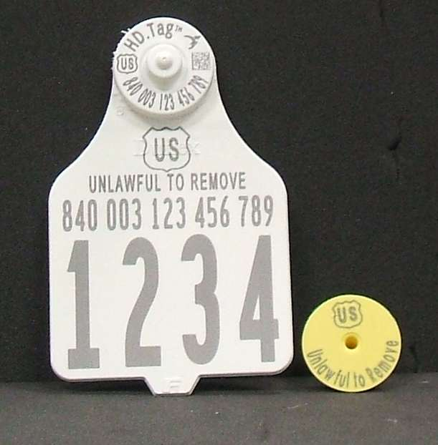
Animal Identification Numbers
840 Tags
15-digit number
Starts with “840” for US (“124” Canada)
RFID or visual
Should have US Shield (or CA – usually in a Maple Leaf for Canada)
USED IN:
Cattle
  If applied after November 5, 2024, must be RFID
Swine
Cervids
Sheep/Goats
Other

Slide 9
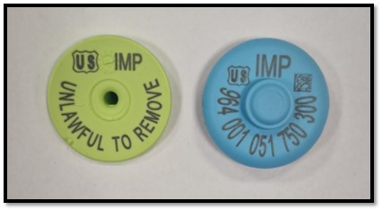
Animal Identification Numbers
IMPORT Tags
15-digit number
Starts with “964”
Lime Green and Blue
Half Duplex (HDX) Low Frequency (LF) RFID
Datamars tags – use Datamars tagger
IMP and US Shield
USED IN:
Cattle from other countries that have lost their country’s official ID AND need to be officially identified
DATCP Veterinary Supply Catalog to order

Slide 10
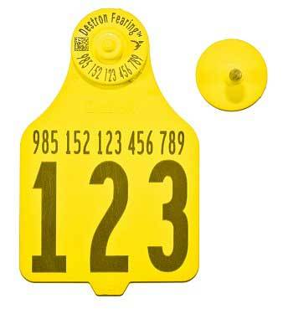
Animal Identification Numbers
Manufacturer Coded Tags
15-digit number
Starts in “900” series
RFID
Will not have US Shield
Only approved in animals tagged prior to March 11, 2015

Slide 11
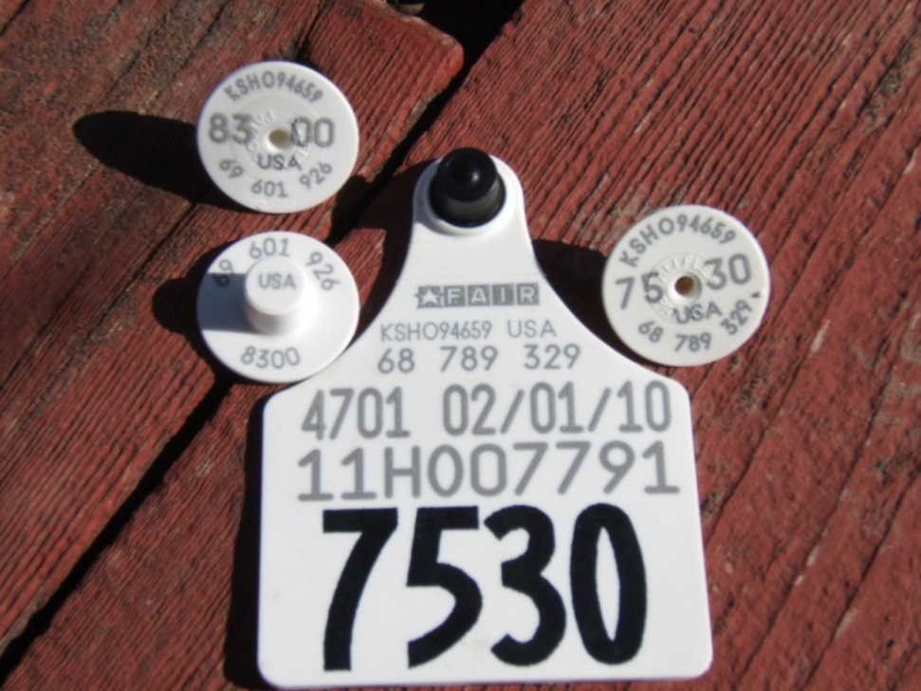
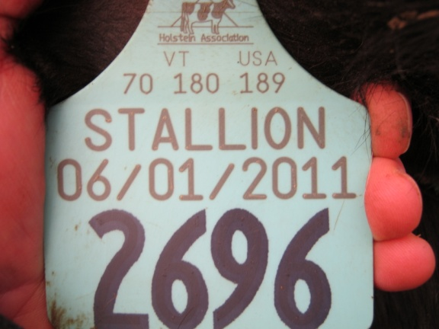
Animal Identification Numbers
American ID
8- to 12-digit number
Preceded by “USA”
Visual only
Will not have US Shield
Only approved in animals tagged prior to March 11, 2015

Slide 12
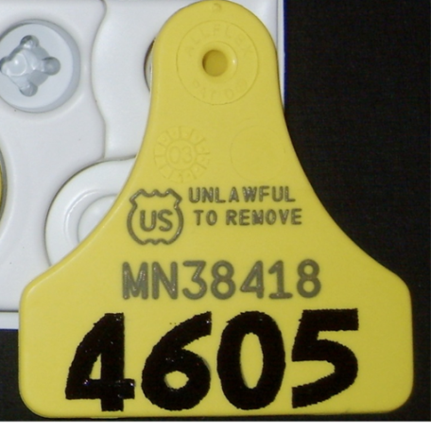
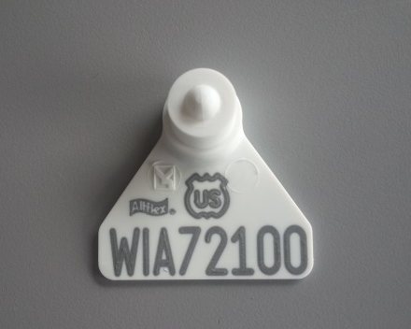
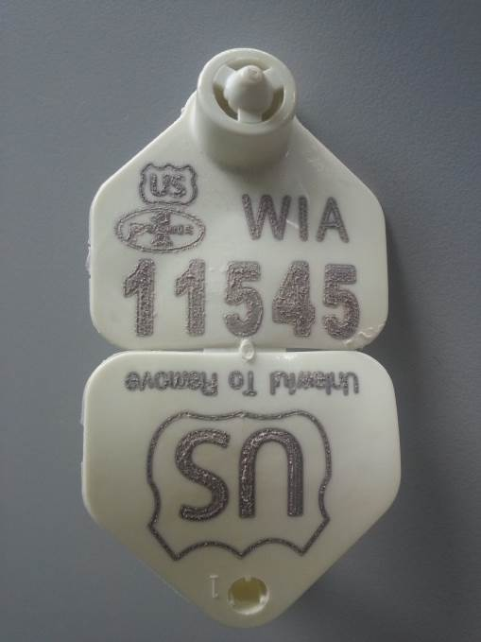
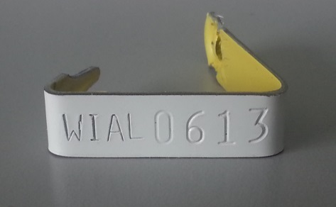
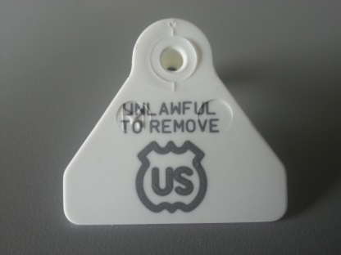
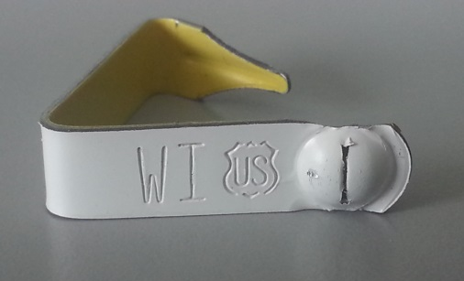
Scrapie tags – sheep and goats
Serial Tags
8 digits
Start with state’s postal code
Flock Tags
Flock number
Individual animal number

Slide 13
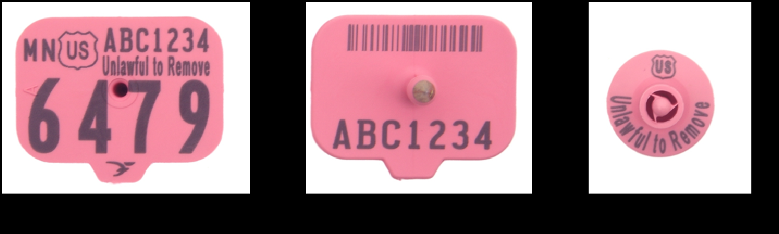
Premises tags - swine
Premises Tags
Premises number
Individual animal number
For feeder pigs and slaughter swine can just have premises number

Slide 14

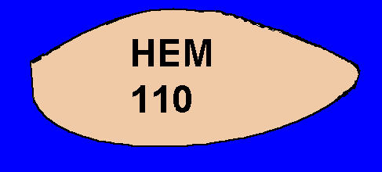
Cattle registration numbers & tattoos
Vaccination Tattoo
Right ear
Registration Tattoo
Left ear
No longer accepted as official ID!

Slide 15
Legible tattoos
Legible Tattoos are accepted as official ID for:
Swine
  Registered in breed registry
Sheep and Goats
  Registered in breed registry -OR-
  Flock ID + individual animal ID
  Not for movement to markets or slaughter
CHECK BOTH EARS

Slide 16
description – official identification for horses
For Horses:
Digital photographs
  Incorporated into health certificates/Coggins paperwork
A written description which includes all identifying characteristics present including:
  Color
  Leg/Face/Body markings
  Brands
  Tattoos
  Scars
  Hair whorls (cowlicks)
  Blemishes

Slide 17
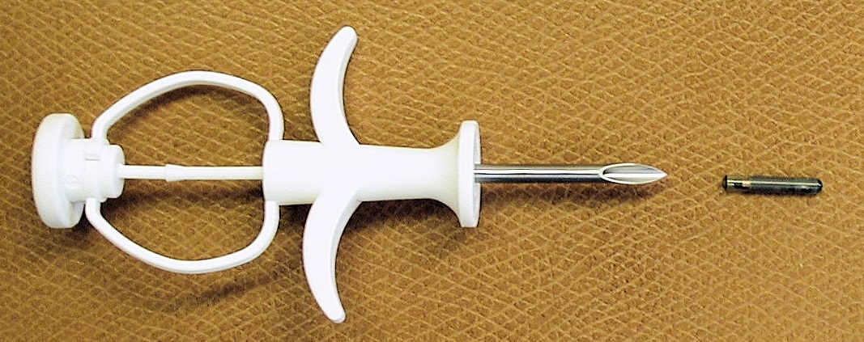
Microchips
Conditions apply for most livestock species
When conditions met approved in:
  Horses
  Cervids
  Sheep/Goats
  Other

Slide 18
animal identification
Accountable property
Keep records
  Date applied
  ID numbers applied
  Name/address where applied
  Keep for five years
Only apply one official ID tag

Slide 19
animal identification – Accountable property – Resource page
9 CFR 161.4(j)
(j) An accredited veterinarian shall be responsible for the security and proper use of all official certificates, forms, records, and reports; tags, bands, or other identification devices; and approved digital signature capabilities used in his or her work as an accredited veterinarian and shall take reasonable care to prevent the misuse thereof. An accredited veterinarian shall immediately report to the Veterinary Official the loss, theft, or deliberate or accidental misuse of any such certificate, form, record, or report; tag, band, or other identification device; or approved digital signature capability.

Slide 20
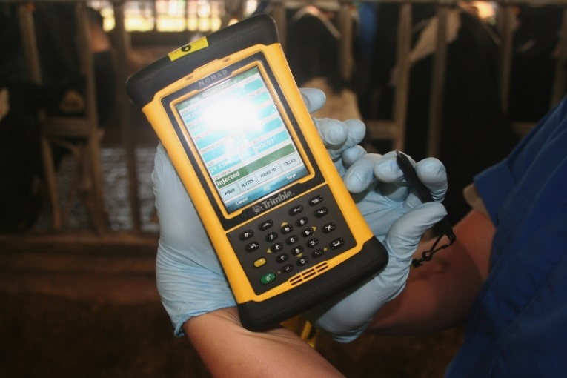
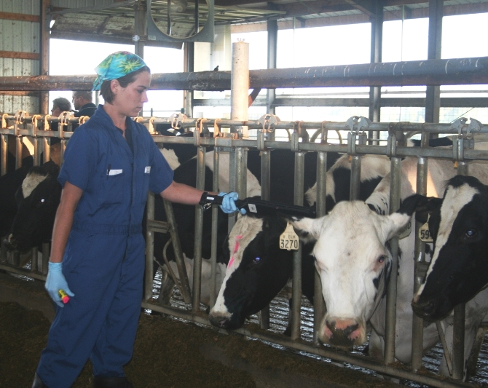
Electronic records and tags (RFID)
Electronic Records
MIM
  Brucellosis Vaccination
  Tuberculosis testing
Certificates of Veterinary Inspection
  Some states are transitioning to only accept electronic CVIs

Slide 21
Animal movement
Certificate of veterinary inspection

Slide 22
Certificate of veterinary inspection (CVI)
Important tool for disease protection
Establish documentation for monitoring shipments and more rapid tracing if necessary
Certifies animals have been inspected and are not showing signs of contagious or infectious disease

Slide 23

animal identification
Accredited veterinarians are responsible for the materials (for example forms, identification, digital signatures) used for accredited veterinary work.

Slide 24
CVIs – Accountable Property – Resource page
9 CFR 161.4(j)
(j) An accredited veterinarian shall be responsible for the security and proper use of all official certificates, forms, records, and reports; tags, bands, or other identification devices; and approved digital signature capabilities used in his or her work as an accredited veterinarian and shall take reasonable care to prevent the misuse thereof. An accredited veterinarian shall immediately report to the Veterinary Official the loss, theft, or deliberate or accidental misuse of any such certificate, form, record, or report; tag, band, or other identification device; or approved digital signature capability.

Slide 25
Issuing CVIs
9CFR161.4(a) and (b) – see Resource Page
  CVIs can be issued up to 10 days after the date of inspection.
  For herds/flocks in a regular health maintenance program (after third inspection):
    CVIs can be issued up to 30 days after the date of inspection.
    CVIs are current for 30 days from the date of inspection.

Slide 26
Issuing CVIs
9CFR160.1
Regular health maintenance program. An arrangement between an accredited veterinarian and a livestock producer whereby the veterinarian inspects every animal on the premises of the producer at least once every 30 days.

Slide 27
Issuing CVIs – Resource Page
9CFR161.4(a)
(a) An accredited veterinarian shall not issue a certificate, form, record or report which reflects the results of any inspection, test, vaccination or treatment performed by him or her with respect to any animal, other than those in regular health maintenance programs, unless he or she has personally inspected that animal within 10 days prior to issuance. Inspections under this paragraph must be conducted in a location that allows the accredited veterinarian sufficient space to observe the animal in such a manner as to detect abnormalities related to areas such as, but not limited to, locomotion, body excretion, respiration, and skin conditions. An accredited veterinarian shall examine such an animal showing abnormalities, in order to determine whether or not there is clinical evidence compatible with the presence or absence of a communicable disease.

Slide 28
Issuing CVIs – Resource Page
9CFR160.1 Definitions
Inspect, inspection. Visual study of the physical appearance, physical condition, and behavior of animals (singly or in groups) that enables an accredited veterinarian to determine whether any abnormality in physical condition or bodily function is evident.
Examine, examination. Physical study of an individual animal that enables an accredited veterinarian to determine if any abnormality in physical condition or bodily function is suggestive of clinical signs of communicable disease.

Slide 29
Issuing CVIs - Resource Page
9CFR161.4(a)(2)
(2) Following the third and subsequent inspections of a herd or flock in a regular health maintenance program, an accredited veterinarian shall not issue a certificate, form, record or report which reflects the results of any inspection, test, vaccination or treatment performed by him or her with respect to any animal in that program, unless he or she has personally inspected that animal within 30 days prior to issuance.

Slide 30
Issuing cvis Resource Page
9CFR161.4(b)
(b) An accredited veterinarian shall not issue, or allow to be used, any certificate, form, record or report, until, and unless, it has been accurately and fully completed, clearly identifying the animals to which it applies, and showing the dates and results of any inspection, test, vaccination, or treatment the accredited veterinarian has conducted, except as provided in paragraph (c) of this section, and the dates of issuance and expiration of the document. Certificates, forms, records, and reports shall be valid for 30 days following the date of inspection of the animal identified on the document, except that origin health certificates may be valid for a longer period of time as provided in §91.3(a) of this chapter. The accredited veterinarian must distribute copies of certificates, forms, records, and reports according to instructions issued to him or her by the Veterinary Official.

Slide 31
Basic CVI requirements
CHECK WITH STATE OF DESTINATION
Origin and destination name/address
  Phone number/mailing address and premises ID if available
  The address should be ANIMAL LOCATION
Number of animals
Species
Breed/sex/age
Purpose of movement
CHECK WITH STATE OF DESTINATION
Official ID when required
Test results when required
Statements when required
Vaccination information when required
Permit numbers when required
Electronic CVI when required

Slide 32
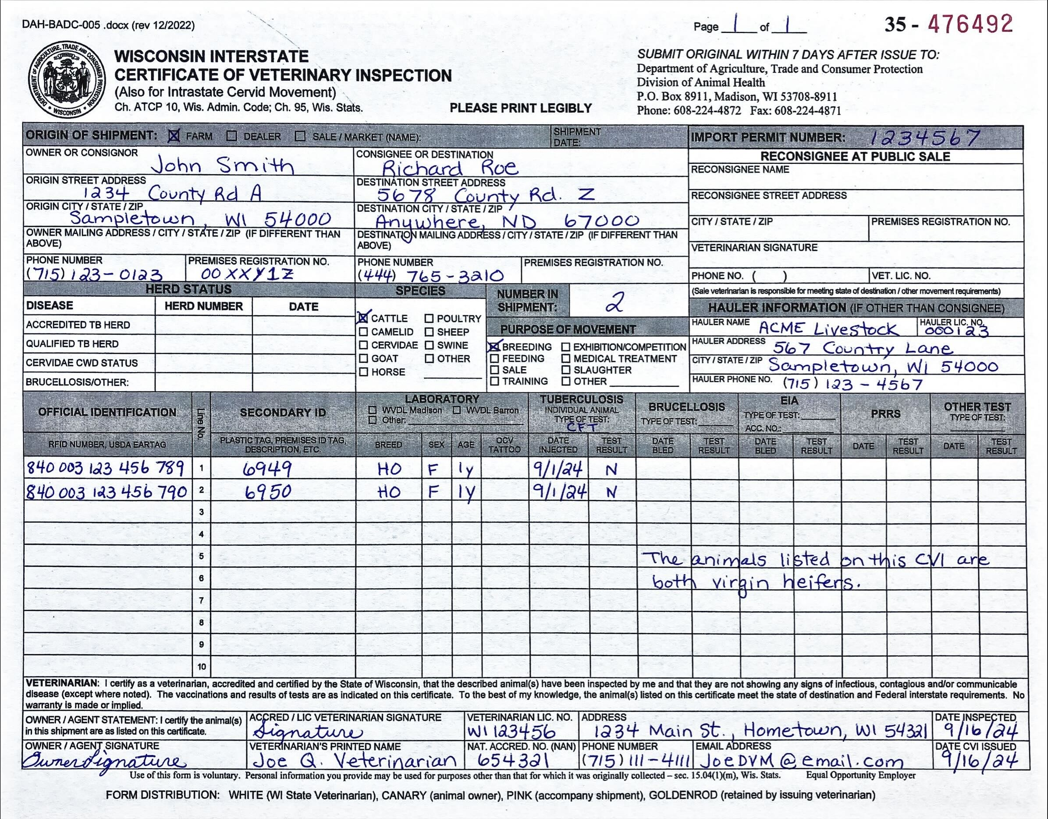

Cattle

Slide 33
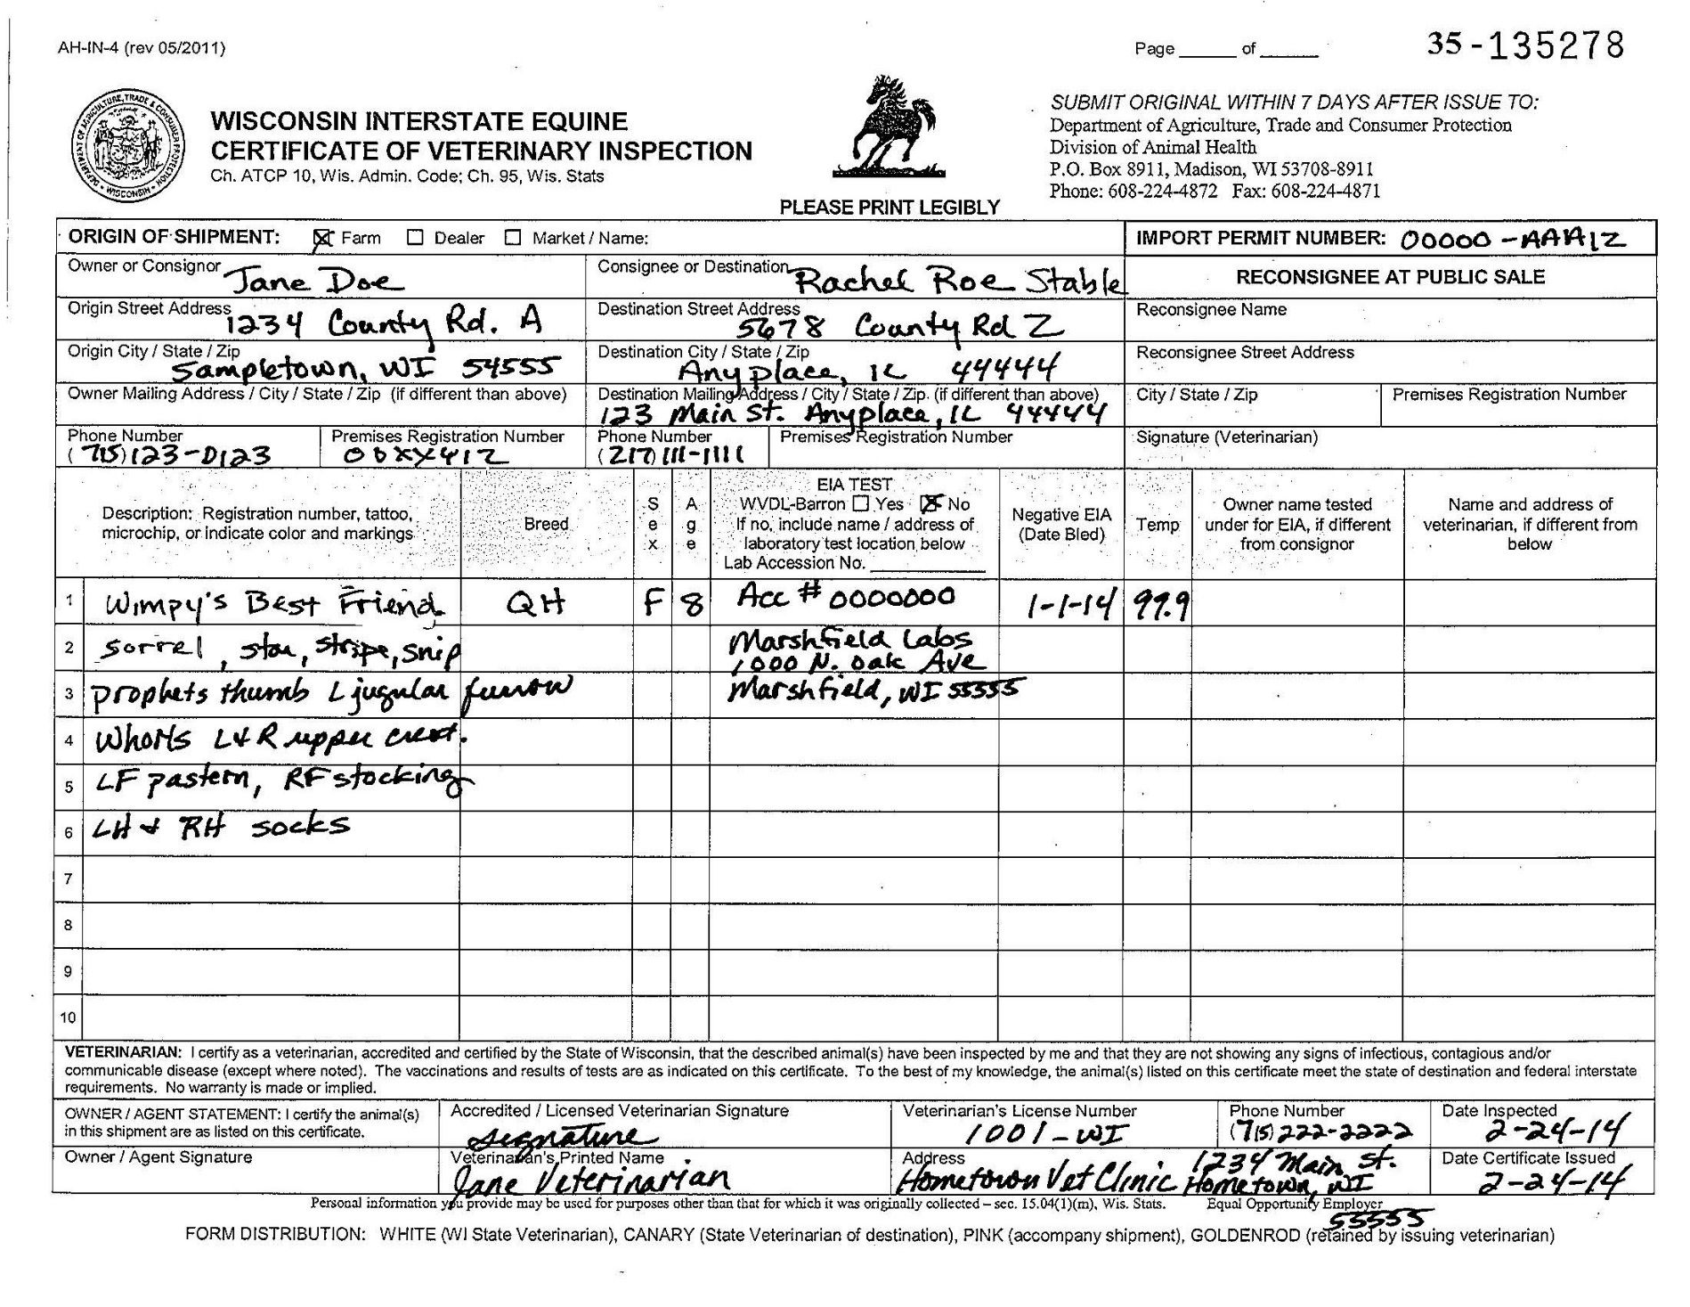

Equine

Slide 34
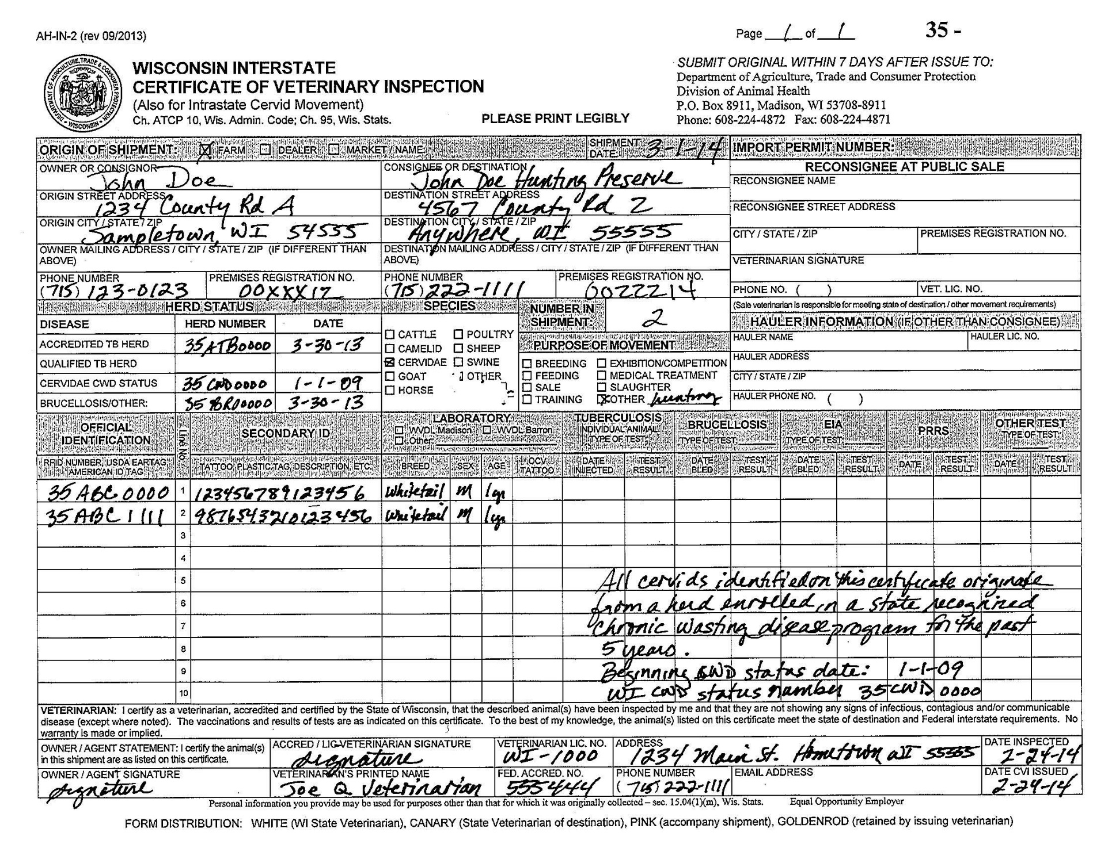
Cervids

Slide 35
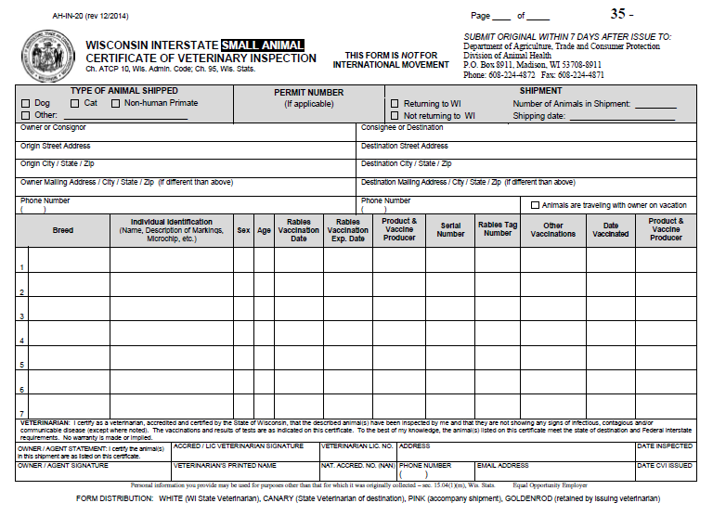
Small Animals

Slide 36
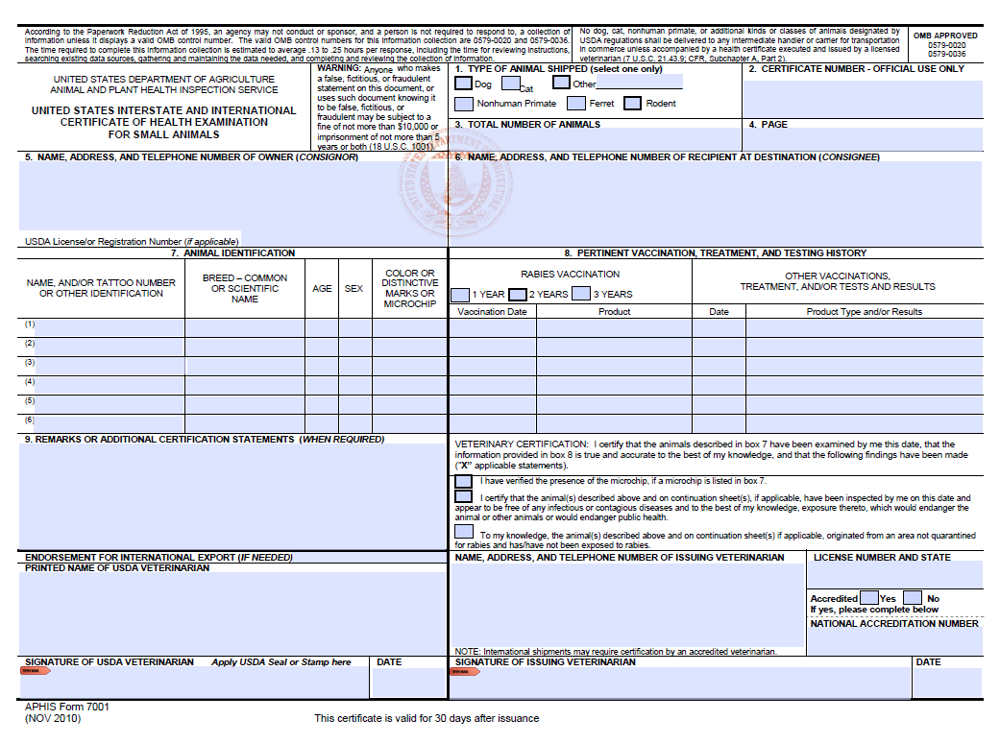
No Online aphis 7001 form for intra/interstate movement

Slide 37
Be Cautious with vaccination and testing information!
Contact destination state for their import requirements.
  Do not assume that if a pet is current on their rabies vaccination for Wisconsin that it will meet other states’ requirements.
If no rabies immunization data because too young, write:
  “Too young for rabies vaccination” and include animal’s age.

Slide 38
Be Cautious with vaccination and testing information!
When using test or vaccine information provided by another veterinarian (See Resource Page 9 CFR 161.4(c)):
  Do not accept owner’s word alone.
  Demand copies of test report/valid rabies certificate issued by veterinarian who tested/vaccinated animal
  Add the other veterinarian’s name and date and place of test/vaccination on CVI.
  Keep copies of these documents in your records with the CVI.

Slide 39
Using results from another veterinarian
9CFR161.4(c) – RESOURCE PAGE
(c) An accredited veterinarian shall not issue any certificate, form, record, or report which reflects the results of any inspection, test, vaccination, or treatment performed by another accredited veterinarian, unless:
(1) The signing accredited veterinarian has exercised reasonable care, that is, a standard of care that a reasonably prudent person would use under the circumstances in the course of performing professional duties, to determine that the certificate, form, or report is accurate;
(2) The certificate, form, or report indicates that the inspection, test, vaccination, or treatment was performed by the other accredited veterinarian; identifies the other accredited veterinarian by name; and includes the date and the place where such inspection, test, or vaccination was performed; and,
(3) For a certificate, form, or report indicating results of a laboratory test, the signing accredited veterinarian shall keep a copy of the certificate, form, or report and shall attach to it either a copy of the test results issued by the laboratory, or a written record (including date and participants' names) of a conversation between the signing accredited veterinarian and the laboratory confirming the test results.

Slide 40
Common CVI Mistakes
Insufficient animal identification
  Need individual ID
  Name, age, breed, color and markings, sex, spayed/neutered
  Animals not amenable to tagging, banding, tattooing, etc. (reptiles) require complete description
Outdated
  Valid for 30 days from date of inspection
  Commercial airlines require certificates be issued by veterinarian who examined animal within 10 days of transport
Illegibility
May result in animal becoming “lost luggage”
No signature
  Signature stamps are
  unacceptable
No date
  Need to validate time of exam
No consignee information
  Need name and address to
  be sure health requirements
  are met and prevent “lost luggage”
  “Traveling with owner”

Slide 41
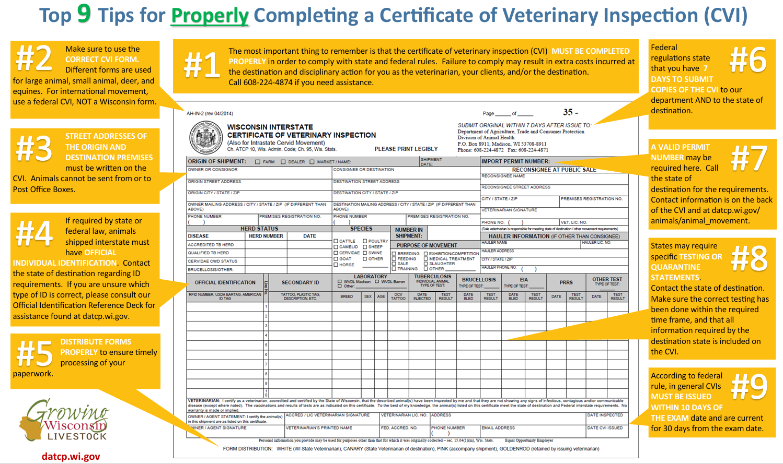


Slide 42
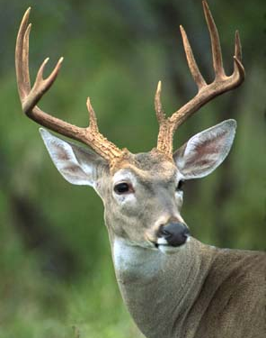
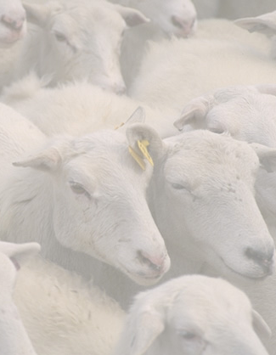
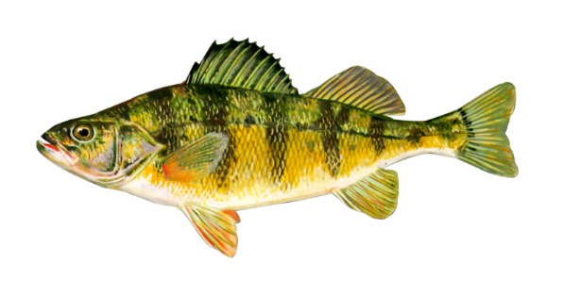
Intrastate Movement
Cervid Requirements (ATCP 10.45-10.58)
  CWD monitoring program (ATCP 10.52)
  TB testing (ATCP 10.055)
  Certificate of Veterinary Inspection (ATCP 10.56)
Goat and Sheep Identification (ATCP 10.70 & 10.77)
Aquaculture Requirements (ATCP 10.60-10.67)

Slide 43
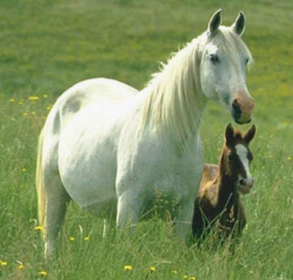
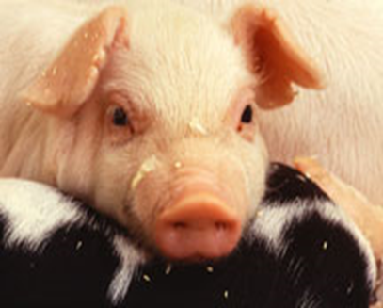
Intrastate Movement
Equine Requirements (ATCP 10.35 &10.87)
  EIA tests
Swine Requirements (ATCP 10.291 & 10.87)
  PRRS/PEDv testing waiver
  CVIs for movement to fairs/show/exhibitions
    ALL SWINE have been inspected and found to be free of infectious or contagious disease.

Slide 44
Questions?

Slide 45
RABIES control
Dr. Yvonne Bellay, Animal welfare programs manager/epidemiologist

Slide 46
Statutory Authority
Wisconsin Statute Chapter 95—Animal Health
  S.95.21 Rabies Control Program

Slide 47
Definitions
Quarantine
  Means the restriction of the activities of well persons or animals who have been exposed to a case of communicable disease during its period of communicability to prevent disease transmission during the incubation period if infection should occur
Isolation facility
  Means a humane society shelter, veterinary hospital, municipal pound or other place specified by an officer which is equipped with a pen or cage which isolates the animal from contact with other animals
Officer
  Means a peace officer, local health officer, as defined in s.250.01(5), humane officer, warden, an employee designated by the department or other person designated by the governing body of the county, city, village or town

Slide 48
Definitions
Owner
  Includes a person who owns, harbors, keeps or controls an animal
Veterinarian
  Has the meaning designated under s.89.02(7)
Veterinary Technician
  Has the meaning designated under s.89.02(12)
  Person duly certified by the examining board to work under the direct supervision of a licensed veterinarian

Slide 49
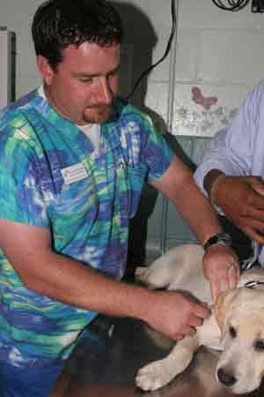
Rabies Vaccination
Required for dogs
  Municipalities may require for cats
Administered by veterinarian or veterinary technician
No later than 5 months of age
  Coincides with licensing requirement
Minimum age determined by vaccine licensing

Slide 50
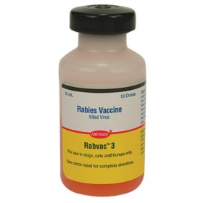
Rabies Vaccination
Revaccinate within one (1) year of initial vaccination
  Regardless of age of initial vaccination or vaccine used
Subsequent vaccinations per manufacturer licensing recommendations
  One or three-year licensed products
  No two-year products
  Titers not acceptable in lieu of vaccination

Slide 51
Rabies Re-vaccination
If a previously vaccinated animal is overdue for a booster it should be revaccinated with a single dose of vaccine
Immediately following the booster, the animal is considered currently vaccinated
  Rapid, strong anamnestic response
Current for duration of vaccine approval
No need to “start over”

Slide 52
Currently, a non-veterinarian may buy rabies vaccine and administer the vaccine. However, the vaccination is not valid or recognized for purposes of rabies control or licensing.

Slide 53
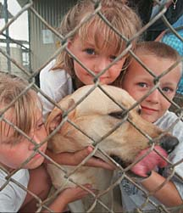
Quarantine for Dog or Cat (Ferret)
Officer shall order, not veterinarian or
humane society
Reason to believe animal:
  Bit a person
  Infected with rabies or
  In contact with a rabid animal
Owner shall deliver within 24 hours of original order

Slide 54
Sacrificing an Animal
Dog, Cat, or Ferret
Other Animals
Cannot be captured
  Last resort or
  Owner agrees
Owner violates quarantine
Reason to believe that animal
  Bit a person or
  Is infected with rabies
Note: there is no provision for quarantine
Livestock cases dealt with on a case-by-case basis

Slide 55
Bite Reporting
State law does not mandate
Reporting may be required by local ordinance
Failure to report may make case management difficult

Slide 56
Quarantine: Human Exposure
Under strict isolation
Owner premises if currently immunized
  Valid certificate of rabies vaccination
    Not because the owner says so
Isolation facility if not currently immunized
At least 10 days
  Veterinarian may extend if clinical signs warrant
Veterinary supervision
  Three (3) exams by veterinarian
  Day one, day ten, & intervening day
    Problems when not presented as ordered
  No vaccinations during quarantine
Veterinarian certifies animal shows no signs of rabies
Quarantine released by officer who issued

Slide 57
10-Day Quarantine
No method to diagnose ante-mortem
Applies only to dogs, cats, and ferrets
  Viral shedding period for dogs, cats, and ferrets is known
Concern about whether biting animal was shedding rabies virus in saliva at time of bite
Observation of normal animal to determine changes in health or behavior
Allows sufficient time to determine health of animal
Once virus enters brain, animal will show signs and die within few days
If animal is healthy after 10 days, it was not shedding virus at time of bite
Provides safe “window” in which to begin PEP if necessary
Has withstood test of time

Slide 58

10-Day Quarantine
Puppies, kittens, kits
May bite before old enough to vaccinate
Quarantine provisions apply
Quarantine provisions due to public health concerns--not punitive
Positive cases have resulted in multiple human exposures

Slide 59

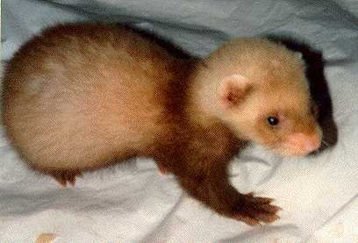
10-Day Quarantine
Must take precautions when quarantining young
  Not fully vaccinated
  Socialization issues

Slide 60
Quarantine: Animal Exposure
May be kept on owner premises regardless of vaccination status, if quarantine provisions are met
Must be leashed or confined
Currently immunized
  60 days
  Revaccinate immediately after exposure
Not currently immunized
  Recommend immediate euthanasia, but if owner refuses:
    180 days
    Vaccinate between 155-165 days of quarantine
    Current recommendation is to vaccinate immediately

Slide 61
60-Day Quarantine
Owner can provide proof animal is currently immunized
    Certificate of rabies vaccination
Rabies vaccine provides excellent protection; however, no vaccine is 100% effective
Rabies is always fatal once signs are evident
Animal is boosted immediately after exposure to enhance immune response
Quarantine requirements less strict due to vaccination status

Slide 62
180-Day Quarantine
Exposed animal is not protected by immunization
Exposed, unprotected animal presents a significant public health risk
Quarantine requirements strict due to risk of exposure to people and other animals
Incubation period for animals may be as long as six months in animals
Euthanasia should be first recommendation
No acceptable protocol for PEP in animals

Slide 63
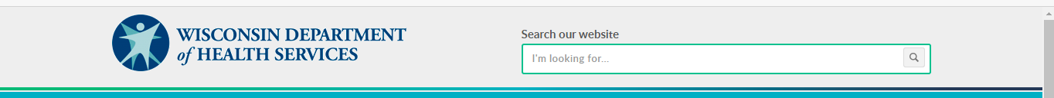
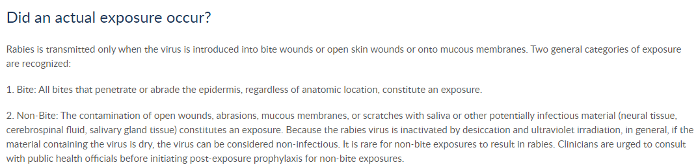
Algorithm for Rabies Exposure
http://www.dhs.wisconsin.gov/communicable/Rabies/RabiesAlgorithm/AlgorithmCategories.htm

Slide 64
Animals Exhibiting Symptoms
Veterinarian determines
Veterinarian notifies owner and officer that issued quarantine
Kill animal humanely
Avoid damage to head
Submit to State Laboratory of Hygiene

Slide 65

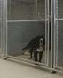
Tissue Sampling
Inadequate sample
Tissue sampling for diagnosis
  Send the full brain
Protect head when killing animal
  Don’t smash bats
  Don’t shoot other animals in head
Equivocal result
Unnecessarily?

Slide 66
Documentation Problems
Multiple specimens in the same shipper with no indication on requisition
Multiple unassociated specimens in the same shipper
Submitter not indicated
Physician not indicated

Slide 67
Mode of Shipment
Hand delivery
  Ideal
  Distance consideration
Priority mail
UPS
Guaranteed overnight delivery
Bus

Slide 68
Questions?

Slide 69
Information resources

Slide 70
Important Contact Information
Interstate
DATCP Division of Animal Health
AnimalMovement.datcp.wi.gov - (608) 224-4872
DATCP Website
datcp.wi.gov
Select Animal Health under the Programs/Services drop-down menu
Contacts for other states: https://datcp.wi.gov/Documents/AHContactAcrossUS.pdf

Slide 71
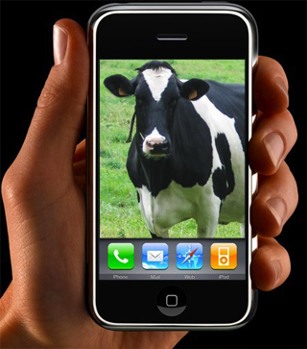
Important Contact Information
International
USDA-APHIS-VS
http://www.aphis.usda.gov/regulations/vs/iregs/animals/
(608) 662-0630
USDA APHIS Website
www.aphis.usda.gov
Remember, when in doubt, CALL!

Slide 72
Important Contact Information
Accreditation:
NVAPWI@usda.gov - (517) 337-4701
Import/Export Questions:
Live Animals - VSPSWI@usda.gov
Animal Products - SCGLproducts@usda.gov
(608) 662-0630
Ordering accountable VS forms and seals:
VSWI@usda.gov

Slide 73
Federal and state regulations
Code of Federal Regulations
eCFR :: Home
Wisconsin Statutes – Chapter 95
https://docs.legis.wisconsin.gov/statutes/prefaces/toc

Slide 74
Additional State Regulations
Wisconsin Administrative Rules
Chs. ATCP 10-19; Animal Health (wisconsin.gov)
Chapter 10 for Animal Diseases and Movement
Chapter 16 for Dog Sellers information
Chapter 17 for Premises Registration

Slide 75
certification

Slide 76
Applying for Certification
Complete state-specific orientation, which you’ve now done for Wisconsin
  If you’re going to practice in another state, you need to contact that state for further information.
Graduate
Get your license in the state where you’ll be practicing
Submit a VS Form 1-36A to the VS office in the state where you’ll be practicing.
  Available at the office or at www.aphis.usda.gov/nvap/
You’ll also need to complete online training at ww.aphis.usda.gov/nvap/
You will be notified by mail when you have been accredited and authorized to do accreditation work. Until then, you cannot perform any accreditation duties.
If you have questions: Valencia Watts, USDA-APHIS-VS, (517) 337-4701 or valencia.t.watts@aphis.usda.gov
http://www.aphis.usda.gov/animal_health/vet_accreditation/index.shtml

Slide 77
Renewing Accreditation
You will need to complete online training within three years to renew your accreditation.
  http://www.aphis.usda.gov/animal_health/vet_accreditation/renew.shtml
  Or Google NVAP
  Do it sooner rather than later – it helps pull all this together
If you start practicing in one state and move to another, you will need to get authorization in that state.

Slide 78
After You Leave Today
Visit https://datcp.wi.gov/Pages/Programs_Services/VeterinarianTraining.aspx for further required training information if you will be performing:
TB testing (any species)
CWD testing
  You’ll need to work with your district veterinarian to get certified.

Slide 79
Thank You!
Division of Animal Health
(608) 224-4872 - DATCPAnimalImports@wisconsin.gov - https://datcp.wi.gov
June 2026

