Slide 1
Bureau Director Updates
Office Hours
Paul Humphrey – DFRS – BMPB
Department of Agriculture, Trade and Consumer Protection
August 20, 2026

Slide 2

Agenda
Label Record Update
Reminders
  Pest Control
  FD&C Red No. 3
Upcoming Training Opportunities
Additional Resources

Slide 3

Update – Label Records
Mid-June 2026: Memo titled “Requirements for Maintaining Label Records” sent to all official meat establishments
June-July 2026: Inspection personnel documented a Memorandum of Interview (MOI) on the topic.
Establishments will have until December 31, 2026, to go through their files and assemble copies of all current labels, approved formulas when required, any documents to substantiate label claims, temporary label approvals, etc.

Slide 4
Updates – Label Records
Approved formulas and associated labels for products no longer being produced should be discarded to avoid confusion.
BMBP will be referring to the establishment’s formula and labeling records when performing inspection tasks such as General Labeling and Product Standards, so it is imperative these are accurate and kept up to date.
Best practice is to periodically review these files, paying special attention to any changes in ingredient formulations that impact the finished product ingredient statement, such as new or differing allergens.
  Two recent public health alerts were the result of products being produced without a current, approved formula with proper disclosure of allergens.

Slide 5
Reminder: Pest Control
§ 416.2 Establishment grounds and facilities.
(a) Grounds and pest control. The grounds about an establishment must be maintained to prevent conditions that could lead to insanitary conditions, adulteration of product, or interfere with inspection by FSIS program employees. Establishments must have in place a pest management program to prevent the harborage and breeding of pests on the grounds and within establishment facilities. Pest control substances used must be safe and effective under the conditions of use and not be applied or stored in a manner that will result in the adulteration of product or the creation of insanitary conditions.
Notes:
Over the past year, BMPB has noted a trend concerning pest control. This discussion is a reminder regarding the regulatory requirements, but also a call to action to be proactive in managing the pest control program within meat establishments.
Establishments are required to have a pest management program, though it does not have to be written. Some establishment may elect to develop its pest management program under its Sanitation SOP or work with a 3rd party for pest control services.
Documentation regarding the use of pest control substances and their safety and any records generated by the pest control company are to be provided to inspection personnel upon request.

Slide 6
Reminder: Pest Control (cont.)
(b) Construction.
(1) Establishment buildings, including their structures, rooms, and compartments must be of sound construction, be kept in good repair, and be of sufficient size to allow for processing, handling, and storage of product in a manner that does not result in product adulteration or the creation of insanitary conditions.
(2) Walls, floors, and ceilings within establishments must be built of durable materials impervious to moisture and be cleaned and sanitized as necessary to prevent adulteration of product or the creation of insanitary conditions.
(3) Walls, floors, ceilings, doors, windows, and other outside openings must be constructed and maintained to prevent the entrance of vermin, such as flies, rats, and mice.

Slide 7
Reminder: Pest Control - Noncompliance
There are areas around or within the establishment that allow harborage or breeding of pests. These might include tall weeds, discarded equipment, poorly maintained trash receptacles, or similar situations close to the establishment.
There is evidence of pests or pest activity within the establishment (e.g., rodent droppings or flies in production areas).
Establishment management is unable to demonstrate that pest control substances are safe under the conditions of use.
Establishment employees do not use pest control substances in accordance with label directions.
Pest control substances are used or stored in a manner that results in insanitary conditions.
There is any other condition on the grounds of the establishment that results in insanitary conditions within the establishment.
Notes:
One or more of the following findings provide evidence that the establishment does not comply with 9 CFR 416.2(a):

Slide 8
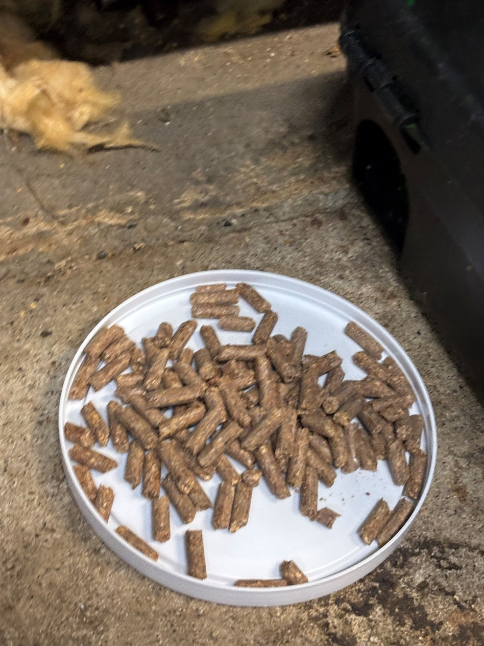
Uncontained rodent bait is not permissible in meat establishments

Slide 9
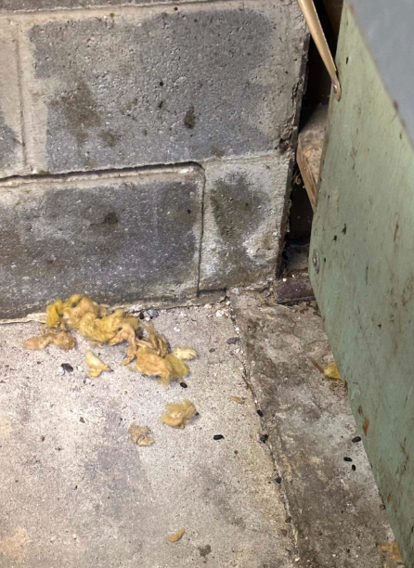
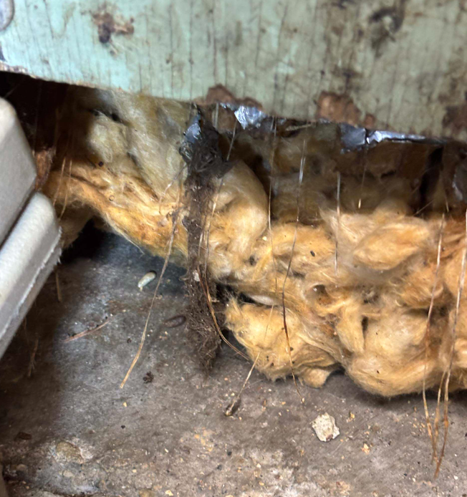
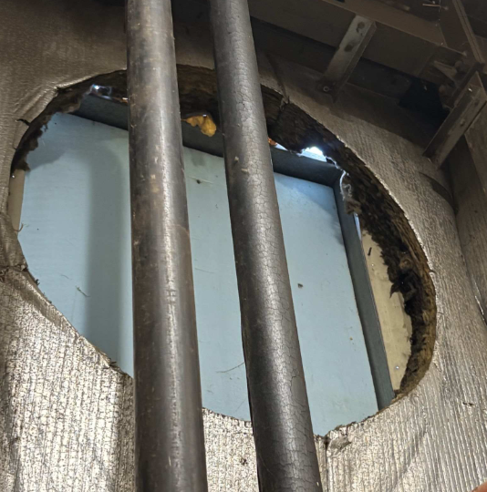
Notes:
Inspect structure for deficiencies, points of entry, nesting materials, and harborage areas
Repair holes and gaps with suitable materials

Slide 10
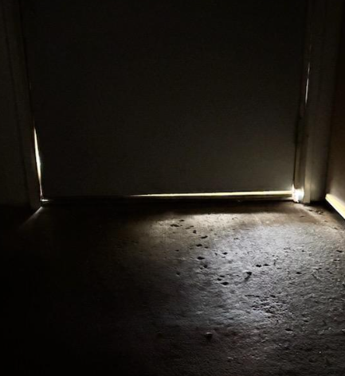
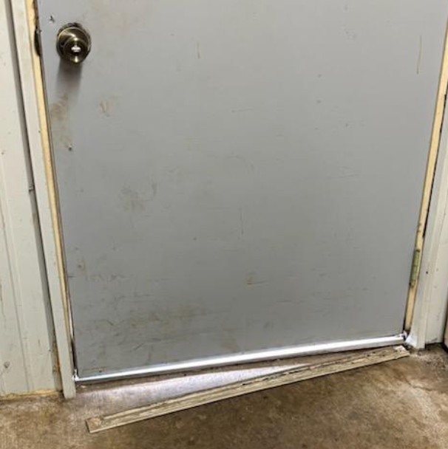
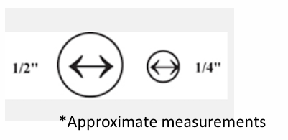
Remember: Rats can enter a building through a hole ½” in size. Mice can enter a space ¼“ in size.

Slide 11
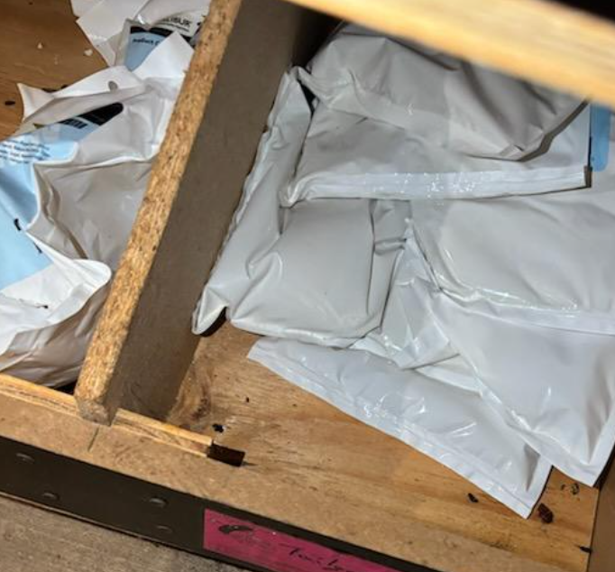
Cover or seal open containers in the spice room.
Inspect for evidence of rodents such as chew marks or droppings

Slide 12

Reminder: Removal of FD&C Red No. 3
January 15, 2025, FDA issued a final order revoking the color listing for FD&C Red No. 3
Previously used to color collagen casings and to impart a pink color in meat curing mixes.
Compliance date is January 15, 2027
Coloring agents added directly to a formulation are to be declared on the ingredient statement
When uses within the established limits, coloring agents added to curing mix are considered processing aids
For state-inspected establishments:
  Review formulations and resubmit for approval as needed
FD&C Red No. 40 has not officially been banned (yet); however, FDA is encouraging the elimination of petroleum-based synthetic dyes.

Slide 13
UW Short Courses & Workshops
Basic HACCP Workshop – September 9-10, 2026 (Closes 8/26)
  New: HACCP in Practice – September 11, 2026 (Closes 8/28)
Basic Meat Processing Workshop – September 22-24, 2026 (Closes 9/8)*
Innovation & New Technology Short Course – October 20-22, 2026 (Open 8/11)
Thermal Processing Workshop – November 17-19, 2026 (Opens 9/8)
Short Courses & Workshops – Meat Science
* Reduced rate for state affiliates
Notes:
* = Reduced rate for state affiliates

Slide 14
UW Short Courses & Workshops
HACCP in Practice Workshop – September 11, 2026 (Closes 8/28)
Topics include:
  Approaches to Develop and Implement Effective Pre-requisite Programs (GMPs, Humane Handling, Allergen, Food Defense, and Pre-operational and Operational SSOPs)
  Pre-Operational Inspection Exercise (Harvest & Fabrication Rooms)
  Animal Harvest/Production & Sanitation Demonstration
  Microbial Sampling and Sampling Procedure Demonstrations
  Important Monitoring Tools Used for Food Safety
Register Here
Notes:
This program is designed for individuals who have completed the previous day’s or a prior Basic HACCP short course, or anyone who serves a food safety role in your organization.
$100 for the day workshop or $50 to add on to the 2-day Basic HACCP course
Space is limited to 15 people

Slide 15
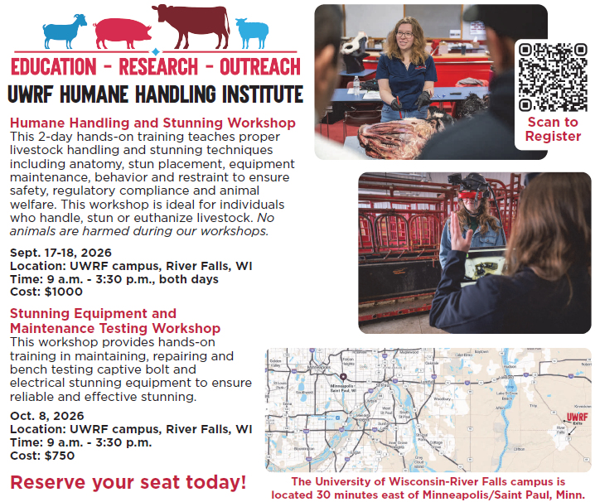
Humane Handling Institute Workshops

Slide 16
Additional Resources
Meat and Poultry Raffle Fact Sheet
Wild Game Processor Licensing and Regulatory Requirements
Transitioning Ownership of a Licensed Meat Establishment
Considerations When Purchasing a Licensed Meat Establishment

Slide 17
Paul Humphrey
BMPB - DFRS
(608) 400-1847 paul.humphrey@wisconsin.gov
August 20, 2026

