Slide 1


Wisconsin’s green Gold:
American Ginseng
Will Hsu
Hsu’s Ginseng Enterprises, Inc. & Hsu Ginseng Farms LLP
DATCP Board Meeting – July 10, 2025

Slide 2

American ginseng – 300 year History
American ginseng and fur traded with China since colonial era
The Empress of China was one of the first American ships to reach Canton (Guangzhou), setting sail in 1783, holding ginseng
Ginseng cultivation began in Marathon County in the late 1800s
By 1990 over 1,500 family farms in WI were growing ginseng
Demand for ginseng grew as Chinese consumer power rose
Wisconsin is still the premier region for ginseng cultivation but we are facing greater international competition and trade barriers

Slide 3
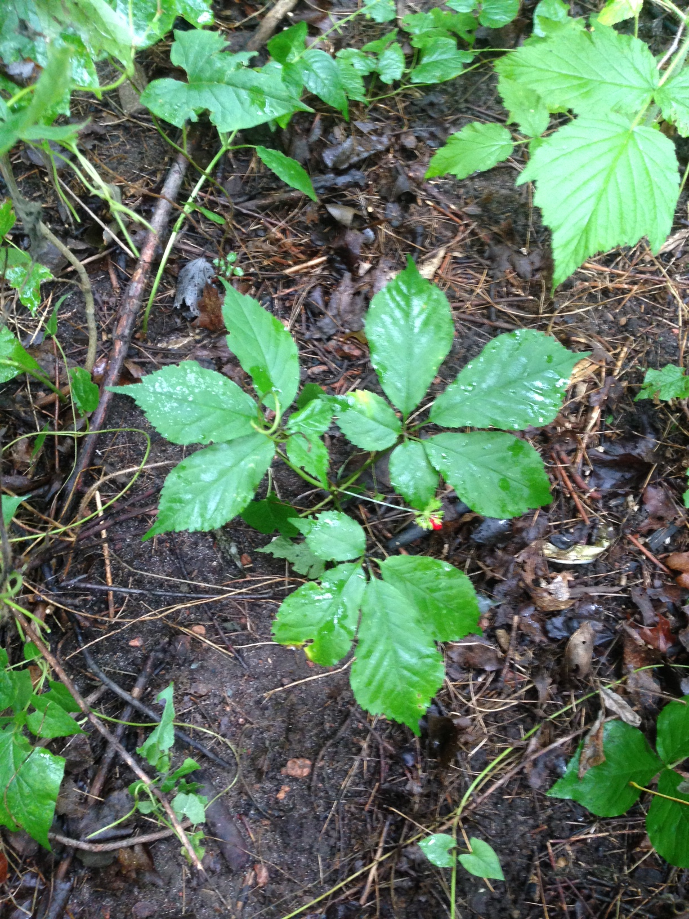

Slide 4
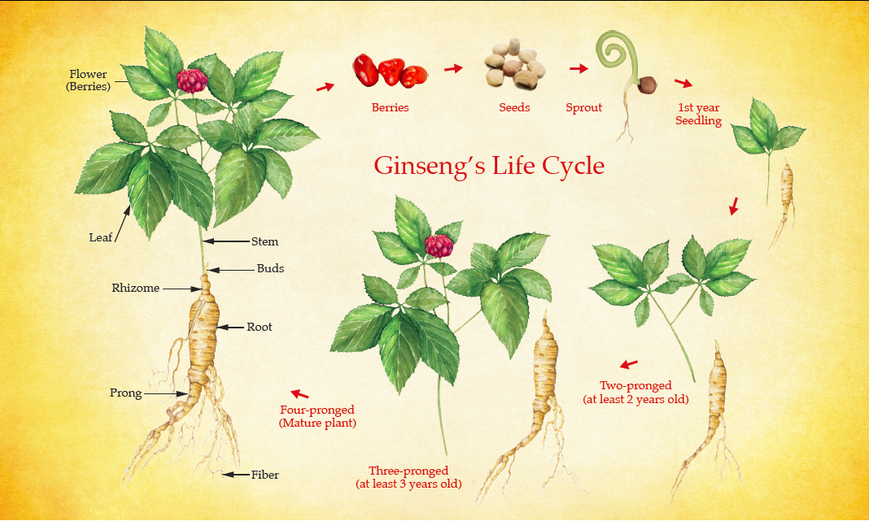
Ginseng life cycle

Slide 5
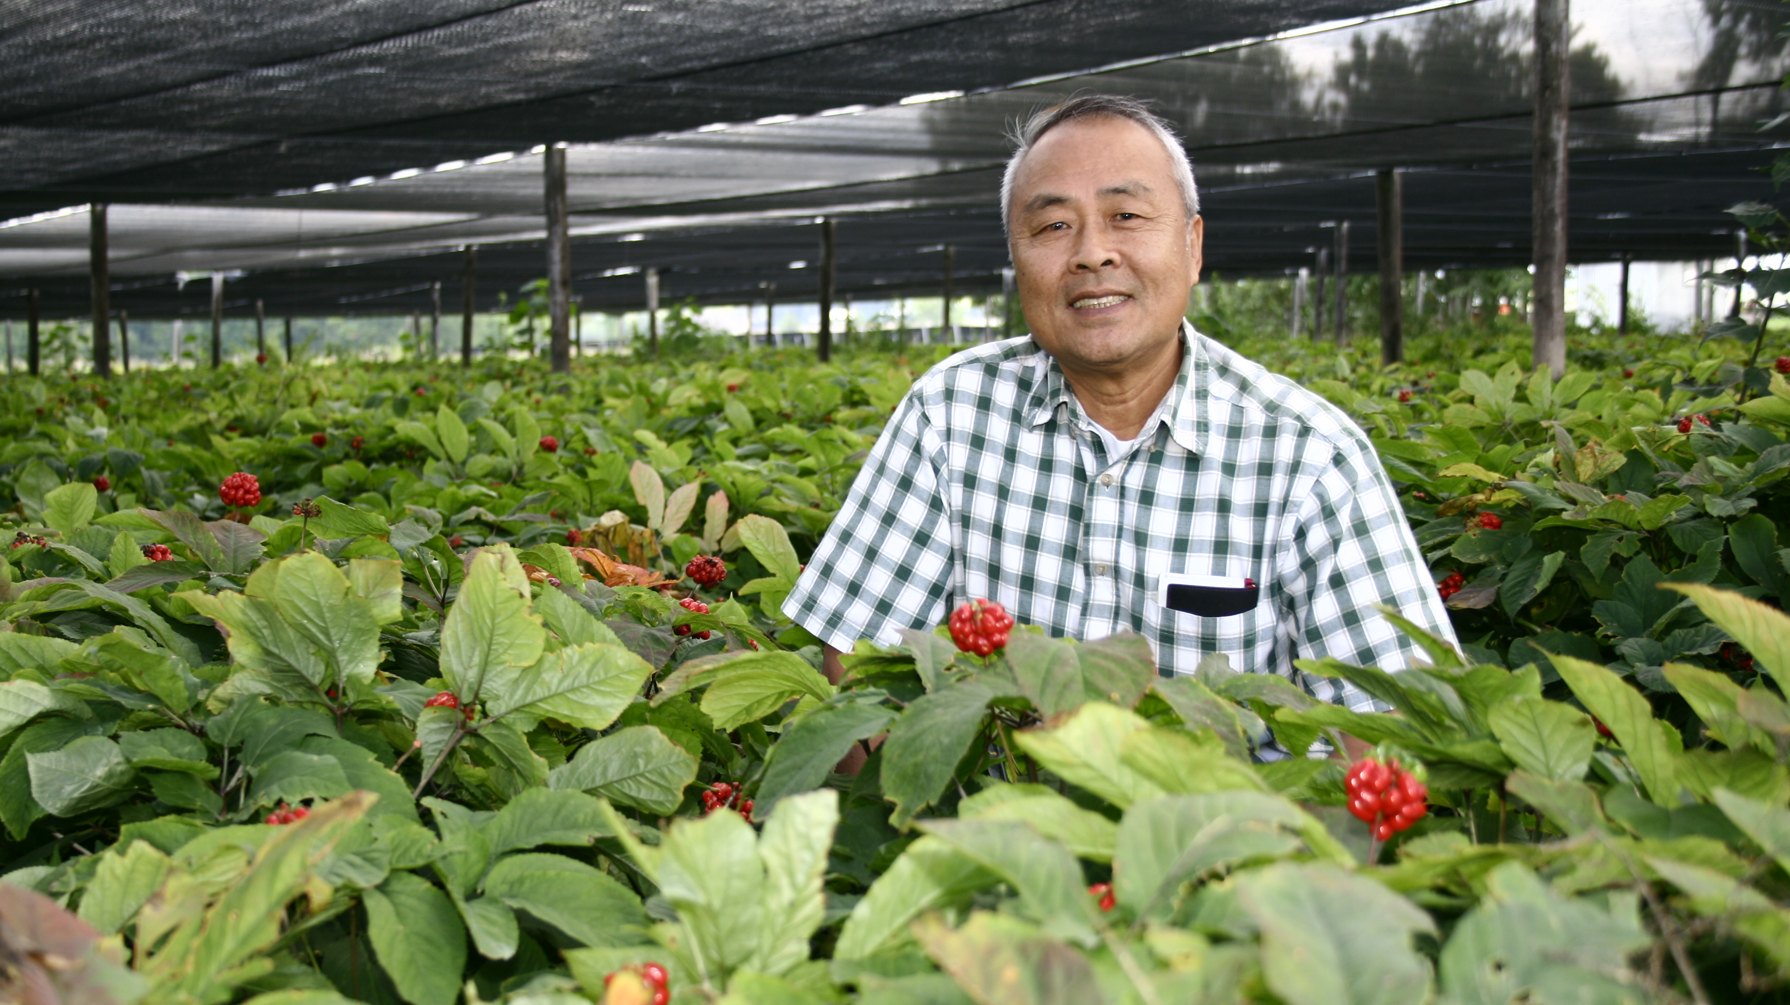

Slide 6
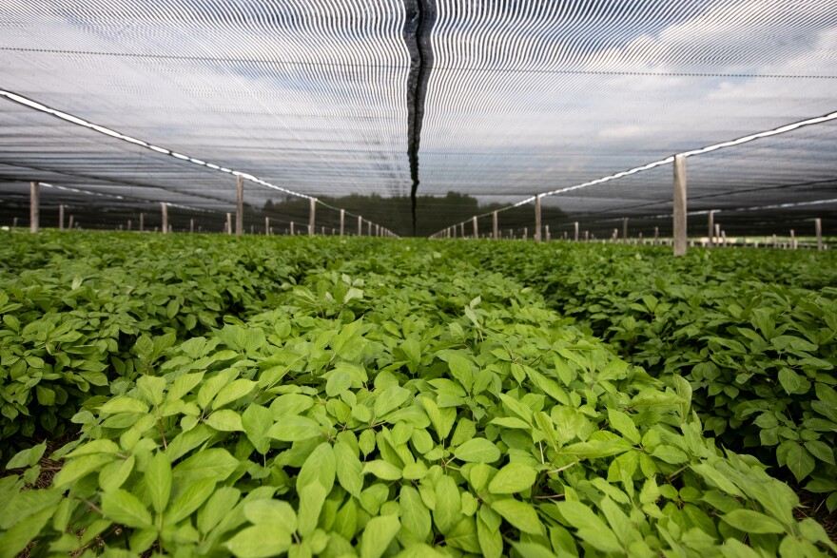
Grower population and prices
Year | Wisconsin Growers | Price/lb | WI Market Share %
1960 | 12 | $12 | 75%
1990 | 1400 | $50 | 60%
1995 | 1300 | $25 | 50%
1999 | 1500 | $15 | 35%
2004 | 400 | $21 | 20%
2012 | 150 | $63 | 12%
2022 | 119 | $17 | 10%
2025 | 67 | $23 | <10%
Large fluctuations in prices over the years due to weather, supply & demand
Number of growers continues a precipitous decline
Prices unlikely to recover as Wisconsin grows <10% of global production today
Canada and China are the largest growers of Am ginseng
Wisconsin still premium priced

Slide 7
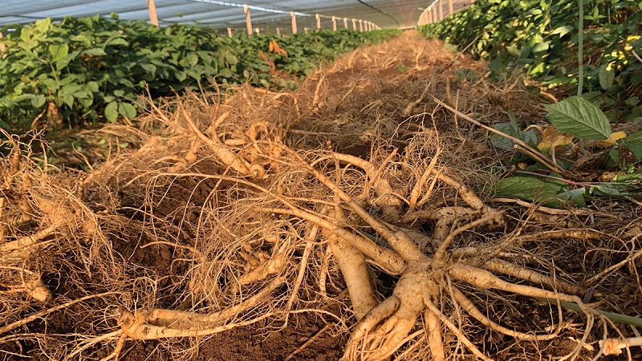

Slide 8
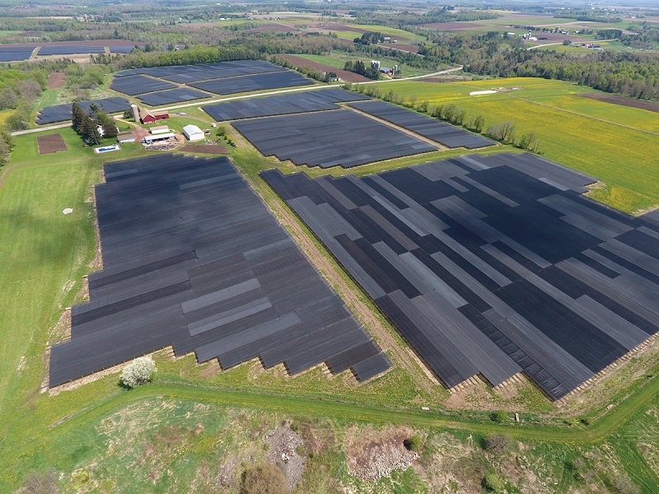
Hsu’s ginseng Enterprises, Inc.
Hsu Ginseng Farms LLP
Founded in 1974 by Paul & Sharon Hsu as a ginseng retailer
Family-owned business and farms headquartered in Wausau
On a multi-year plan to improve internal systems, technology, company infrastructure and modernizing farming practices
Niche focus on affluent ethnic Chinese and Asian Americans, Mandarin and Cantonese speakers and influencers
Future plans to develop agroforestry and global e-commerce
Ginseng industry leader vertically-integrated from farm to retail

Slide 9
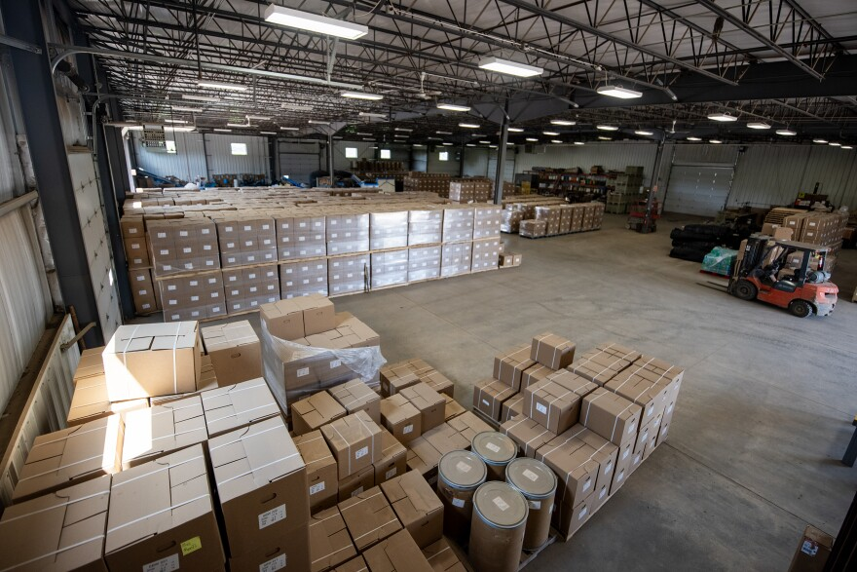
One Dragon With a long tail
Farm
Ocean Ship
China
Process
Ocean Ship
Sale
Pick/
Pack
US Ship
Door
Finish

Slide 10
One Dragon With a long tail
4-5 Years
1 month
1 month
3 months
1 month
2-3 months
1 month
1-2 days
1 week
5-6 years

Slide 11
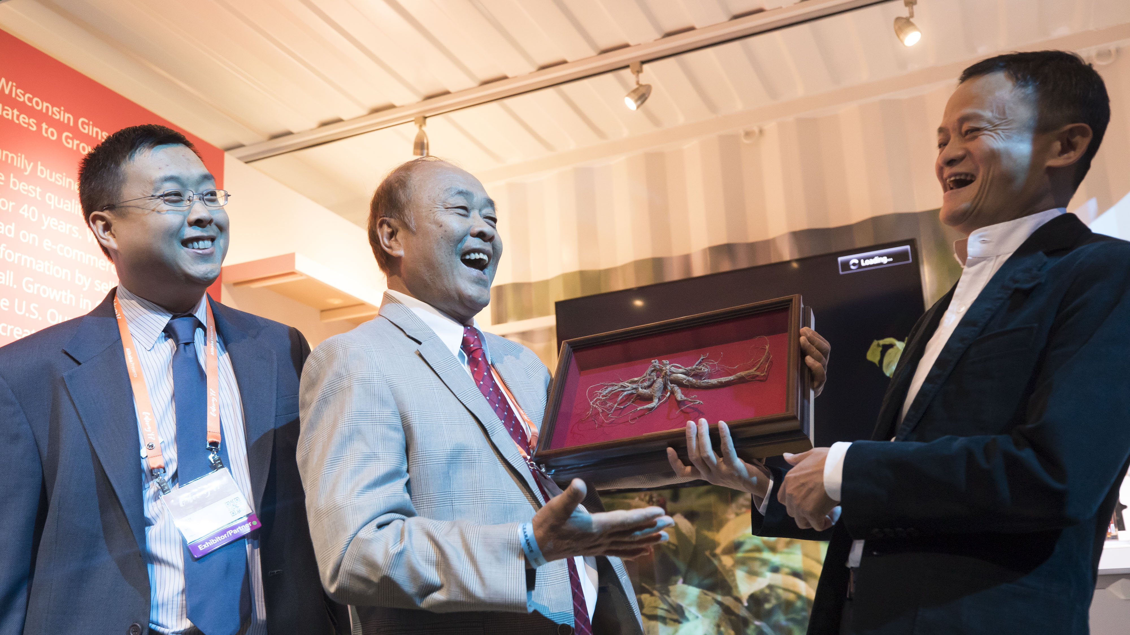

Slide 12
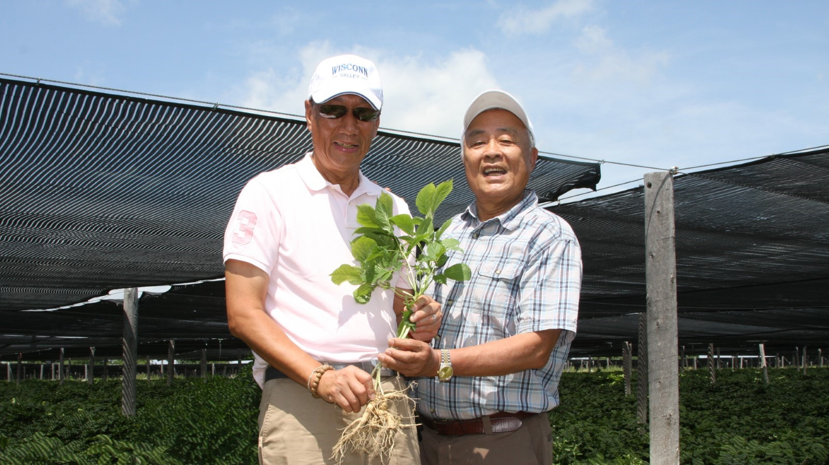

Slide 13
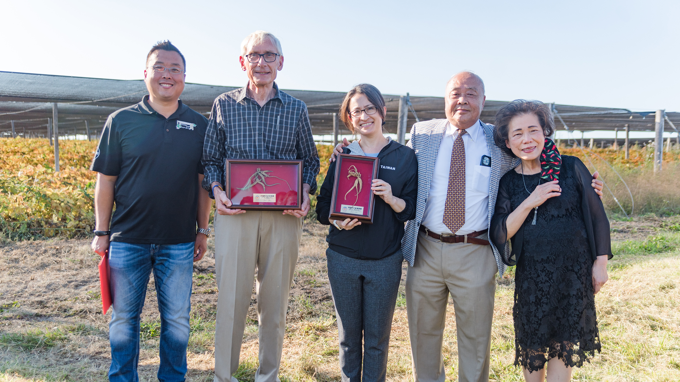

Slide 14
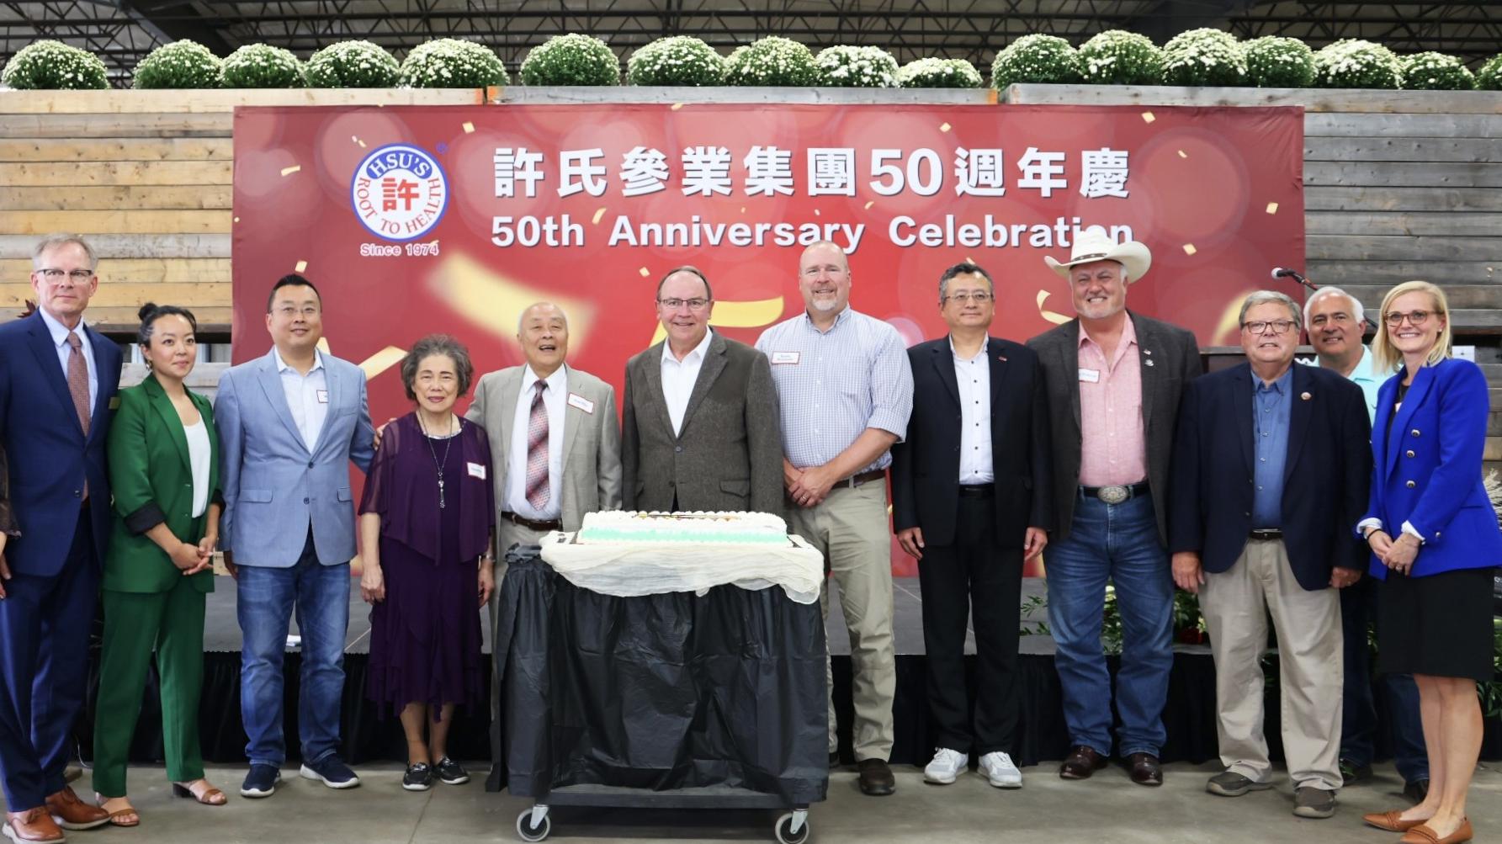

Slide 15
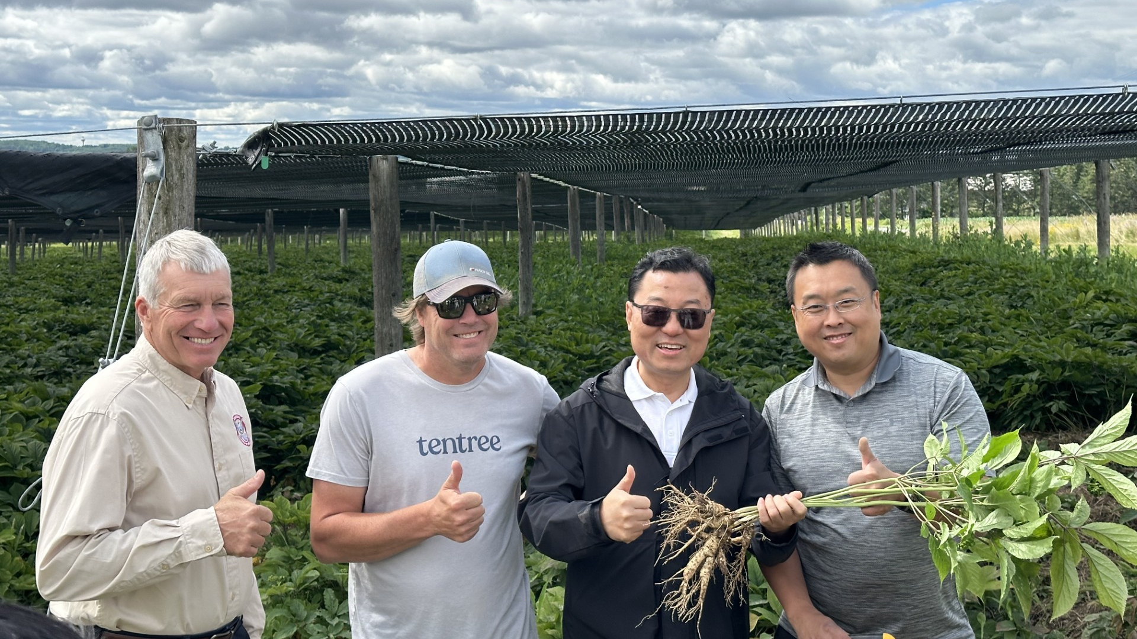

Slide 16
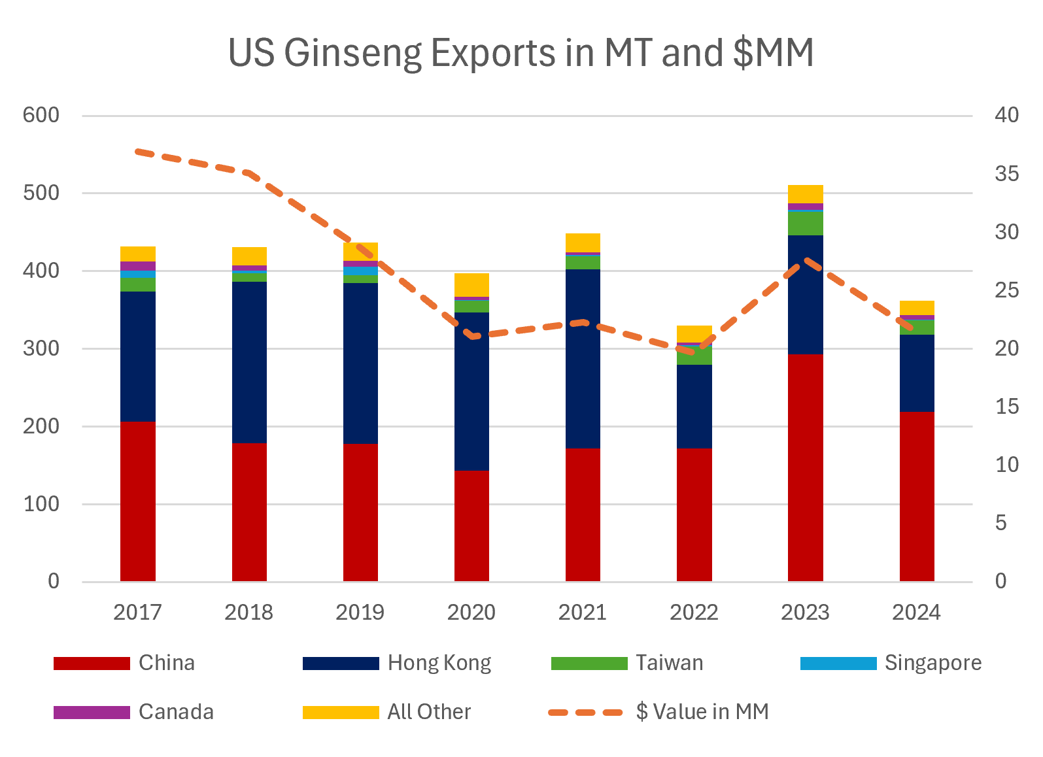

Slide 17
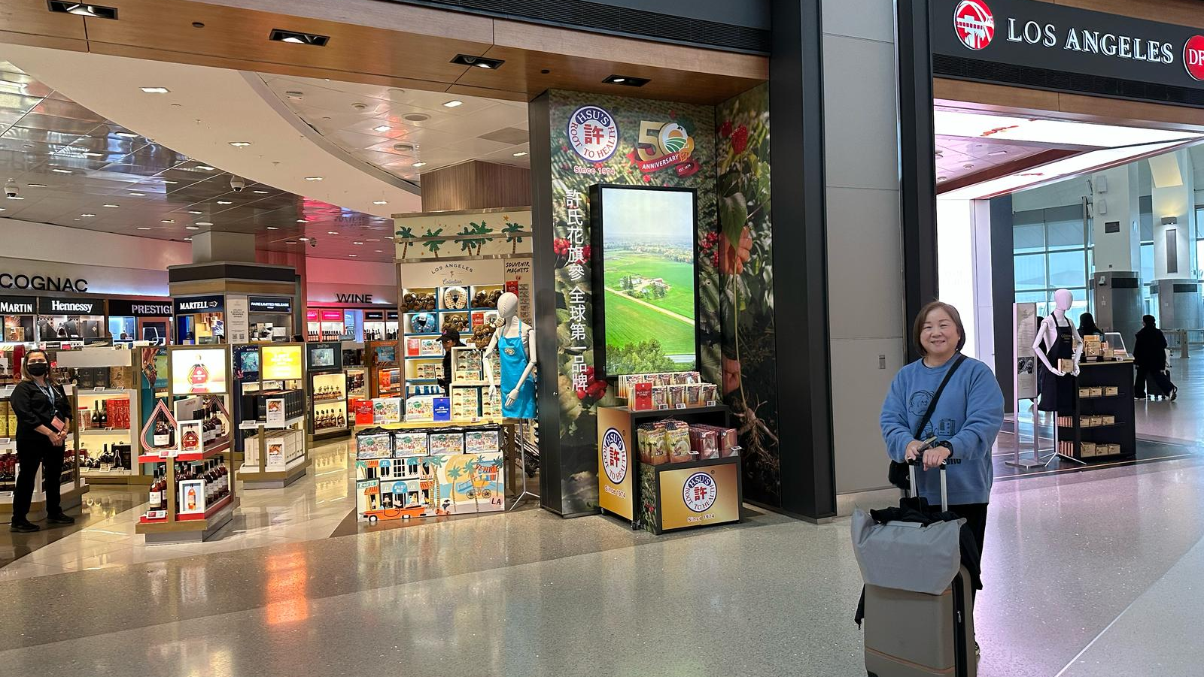

Slide 18
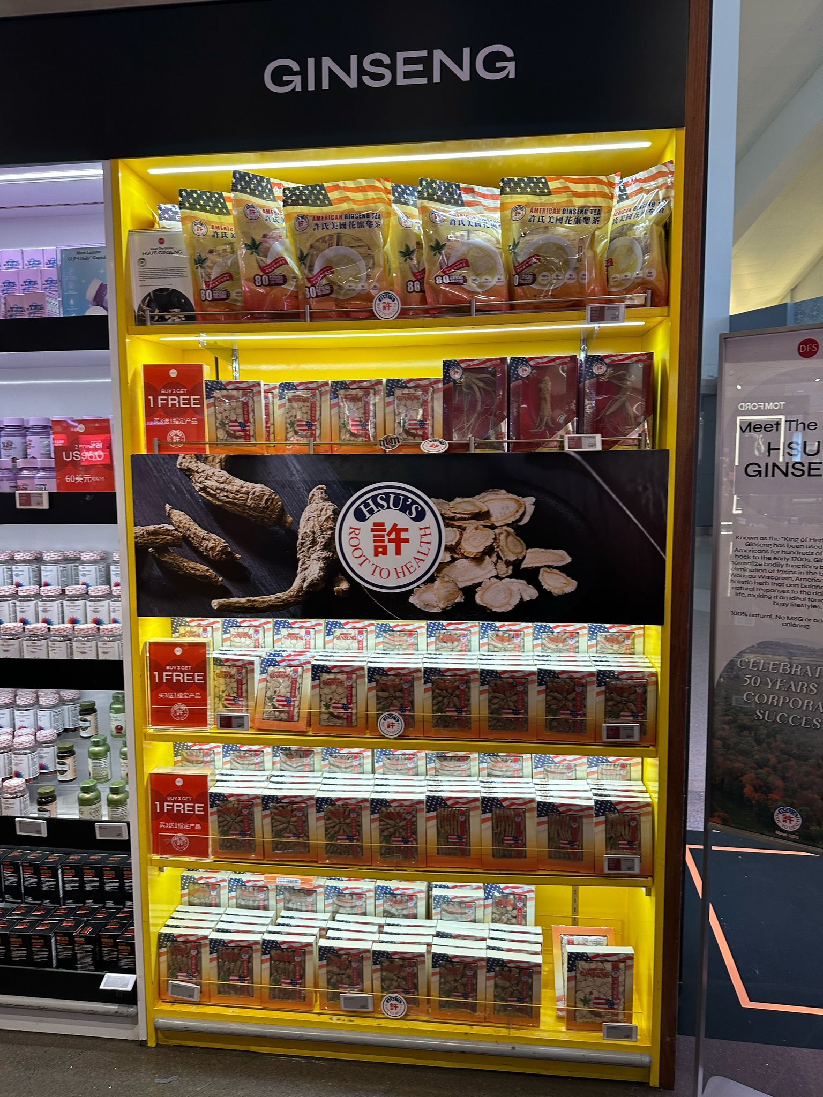
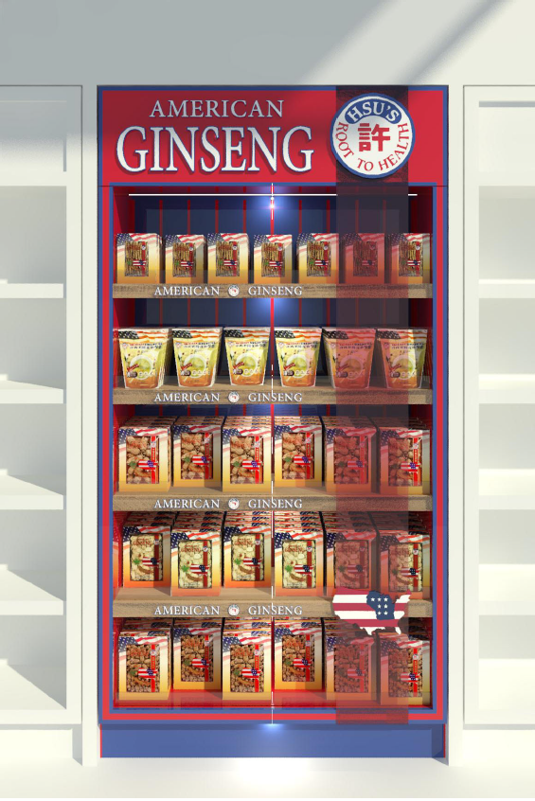

Slide 19
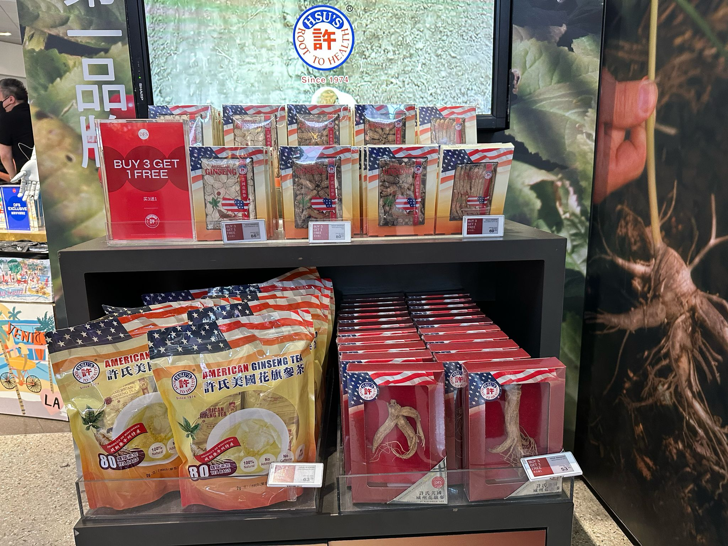

Slide 20
Summary
Wisconsin is the “Napa Valley” of American Ginseng, but we’re also an industry at risk of becoming irrelevant to consumers
Increasing barriers to trade, including tariffs, and travel make it harder for consumers to find our products amongst competitors
Differentiation of our product is not enough to compete against lower cost and lower quality ginseng grown in Canada & China
Without enough farmers and operators growing ginseng in Wisconsin we’ll lose our leadership or other countries will step in

Slide 21
