Slide 1
WISCONSIN
CORN – Shane Goplin

Slide 2
WISCONSIN
CORN
Introduction
Involvement with Wisconsin
Corn Promotion Board
U.S. Grains Council Connection
Notes:
Good Morning, I would like to Thank the entire DATCP board for the invitation to speak on the topic of my experiences with Agricultural Exports.
My name is Shane Goplin, I am a 6th generation farmer from Osseo, WI. Our farm is located in the Driftless area of West Central WI. I was a 6th generation dairy farmer up until 13 years ago when we sold our dairy herd and became a 1st generation Cash Grain and Forage Farmer. On our farm we raise corn, for both silage and grain, Soybeans and Alfalfa that is sold as Silage to our former dairy farm. I am privileged to serve as the Secretary/Treasurer of the WI Corn Promotion Board and also serve on the Trade Policy Advisory Team for the US Grains Council. Wisconsin is fortunate to have 5 other producers, from throughout the state that serve on other Advisory Teams with USGC that focus on different export opportunities around the globe.
Up until, not that many years ago, I am ashamed to say that I took the importance of exports for granted. I can not remember a time where I unloaded a load of corn and thought of where the corn may end up. Much less, how many people were working on our behalf to find new opportunities for Wisconsin Corn and all of the value added products that come from Corn. It was not until I attended my first US Grains Council meeting in the Summer of 2022 that I realized “The Future of our Farm and the Success of It, Depends on Organizations, Like US Grains Council.”

Slide 3
WISCONSIN CORN
U.S. GRAINS COUNCIL GEM MISSION
Develop Markets
Understand how USGC works to expand international markets
Enable Trade
Witness Firsthand how the Council facilitates trade by connecting US grain producers with international buyers and addressing trade barriers
Improve Lives
Showcases how the USGC’s work ultimately benefits both US farmers and the global community through increased access to affordable and nutritious food.
Notes:
The U.S. Grains Council Grain Export Mission is an annual program designed to showcase how the USGC develops markets, enables trade and improves lives. It provides an educational experience for Council members, particularly those new to market development to understand the practical applications to the 3 pillars of the USGC mission. The GEM aims to cultivated the next generation of US agricultural leaders and demonstrationed the Councils work

Slide 4
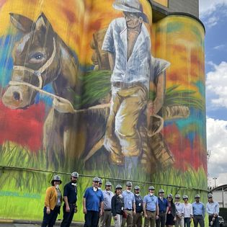
WISCONSIN CORN
U.S. GRAINS COUNCIL GEM MISSION
Key results and outcomes include:
Increased U.S. Agricultural Exports to Colombia
Strengthened Relationships and Market Position in Colombia
Expanded Reach and Diversification of U.S. Grains in Panama
Focus on Market Expansion and Trade Facilitation:
Notes:
Key results and outcomes include:
Increased U.S. Agricultural Exports to Colombia:
U.S. agricultural exports to Colombia rose significantly in 2024, reaching a new record of $4.5 billion, with corn, distiller's dried grains with solubles (DDGS), and ethanol being major drivers of this growth.
Colombia's corn market is projected to expand, presenting a significant market opportunity for U.S. producers.
Strengthened Relationships and Market Position in Colombia:
Colombia is considered a key agricultural trading partner for the U.S.
The U.S. has a strong market position in Colombia's imported corn market.
The U.S. Grains Council has played a role in resolving trade issues and protecting U.S. corn exports to Colombia.
Expanded Reach and Diversification of U.S. Grains in Panama:
GEM participants engaged in trade facilitation training and attended the Latin America Regional Nutrition Conference while in Panama.
The conference in Panama showcased the possibility of using sorghum and barley in animal diets, increasing awareness of the diverse uses of U.S. grains.
Focus on Market Expansion and Trade Facilitation:
The Council is actively working to deepen and diversify trade relationships in Latin America.
Discussions have taken place regarding the critical role of the Panama Canal in grain trade and strategies to enhance its capacity.
Panama's new ethanol blending program presents further opportunities for U.S. exports.
In summary, the GEM to Colombia and Panama, along with the U.S. Grains Council's ongoing efforts in the region, have contributed to increased U.S. agricultural exports, strengthened trade partnerships, and opened doors for diversified uses of U.S. grains in these markets.

Slide 5
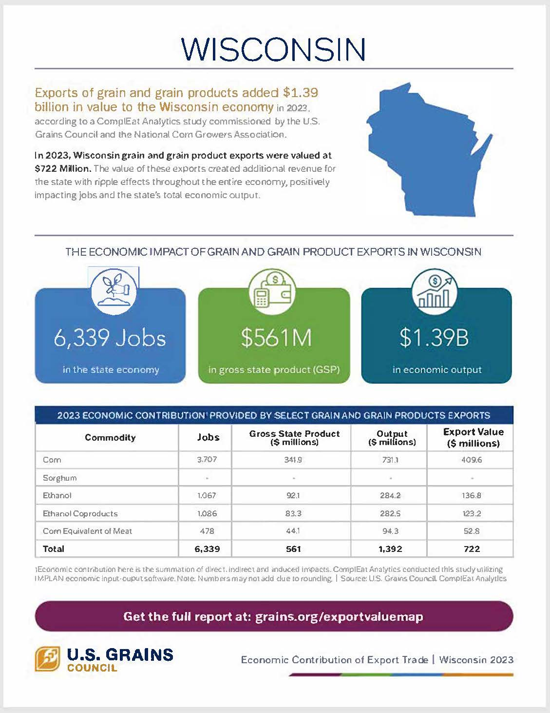
WISCONSIN CORN
AGRICULTURAL EXPORTS
Wisconsin grain and grain product exports were valued at $722 million.
6339 Jobs to Wisconsin’s economy
$561M in gross domestic product
$1.39B in economic output
Notes:
Agricultural exports are crucial to Wisconsin's economy, providing a major revenue stream for farmers and boosting state economic growth. Wisconsin's crop products, especially corn are highly sought after in international markets, particularly in Canada, Mexico, China, Korea, and Japan. This success has made Wisconsin a top agricultural exporting state.
Exports accounted for approximately 30% of Wisconsin's farm cash receipts in 2008. These exports generate revenue and support jobs in agriculture and manufacturing, often with higher wages at exporting plants.
When I think about how much exports add to Wisconsin Agriculture, I also think about what would happen if we did not have the amount of exports we have currently. The Billions of dollars that help support Wisconsin Producers, that in turn support our communities.
In 2023, Wisconsin grain and grain product exports were valued at $722 Million. The value of these exports created additional revenue for the state with ripple effects throughout the entire economy, positively impacting jobs and the state's total economic output
6339 Jobs to Wisconsin’s economy
$561M in gross domestic product
$1.39B in economic output

Slide 6
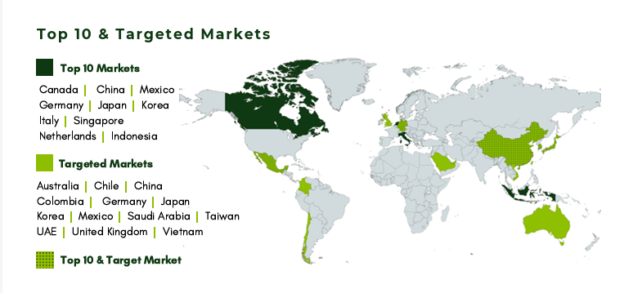
WISCONSIN DEPARTMENT OF AGRICULTURE MARKETS
Notes:
Target Markets –
Southeast Asia – DDGs
Vietnam – Ethanol markets
What were the top 3 take aways from GEM in Columbia – how can we increase trade from WI

