Slide 1
Dairy Market, Exports
Dairy plays a major role in WI economy, rural economy
Now a significant focus for Dairy Farmers of WI (DFW), expanding processor partnerships
Almost 1/5 of WI milk is exported
DATCP plays a significant role in exports
WI Initiative for Ag Exports & Wisconsin Ag Export Advisory Council (WAXC)

Slide 2
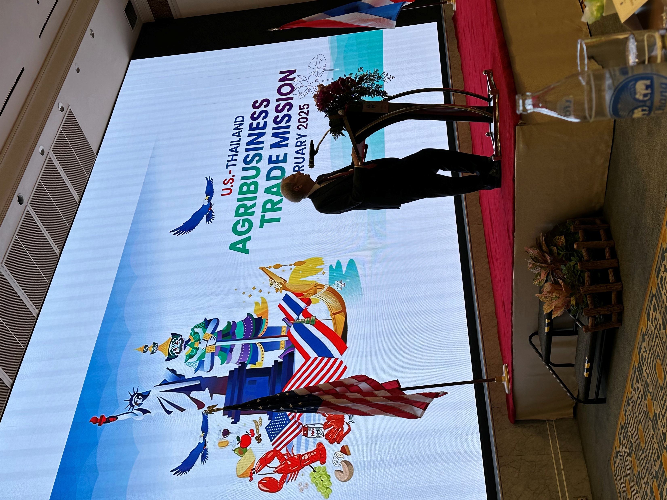
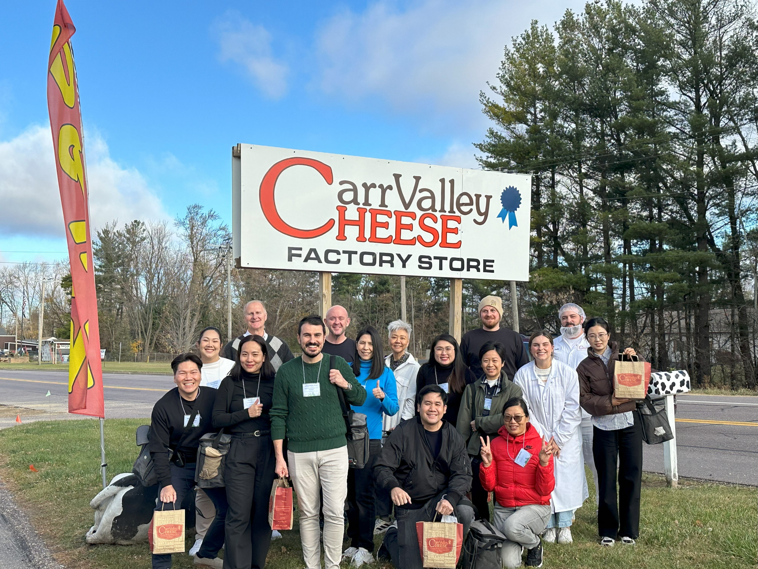
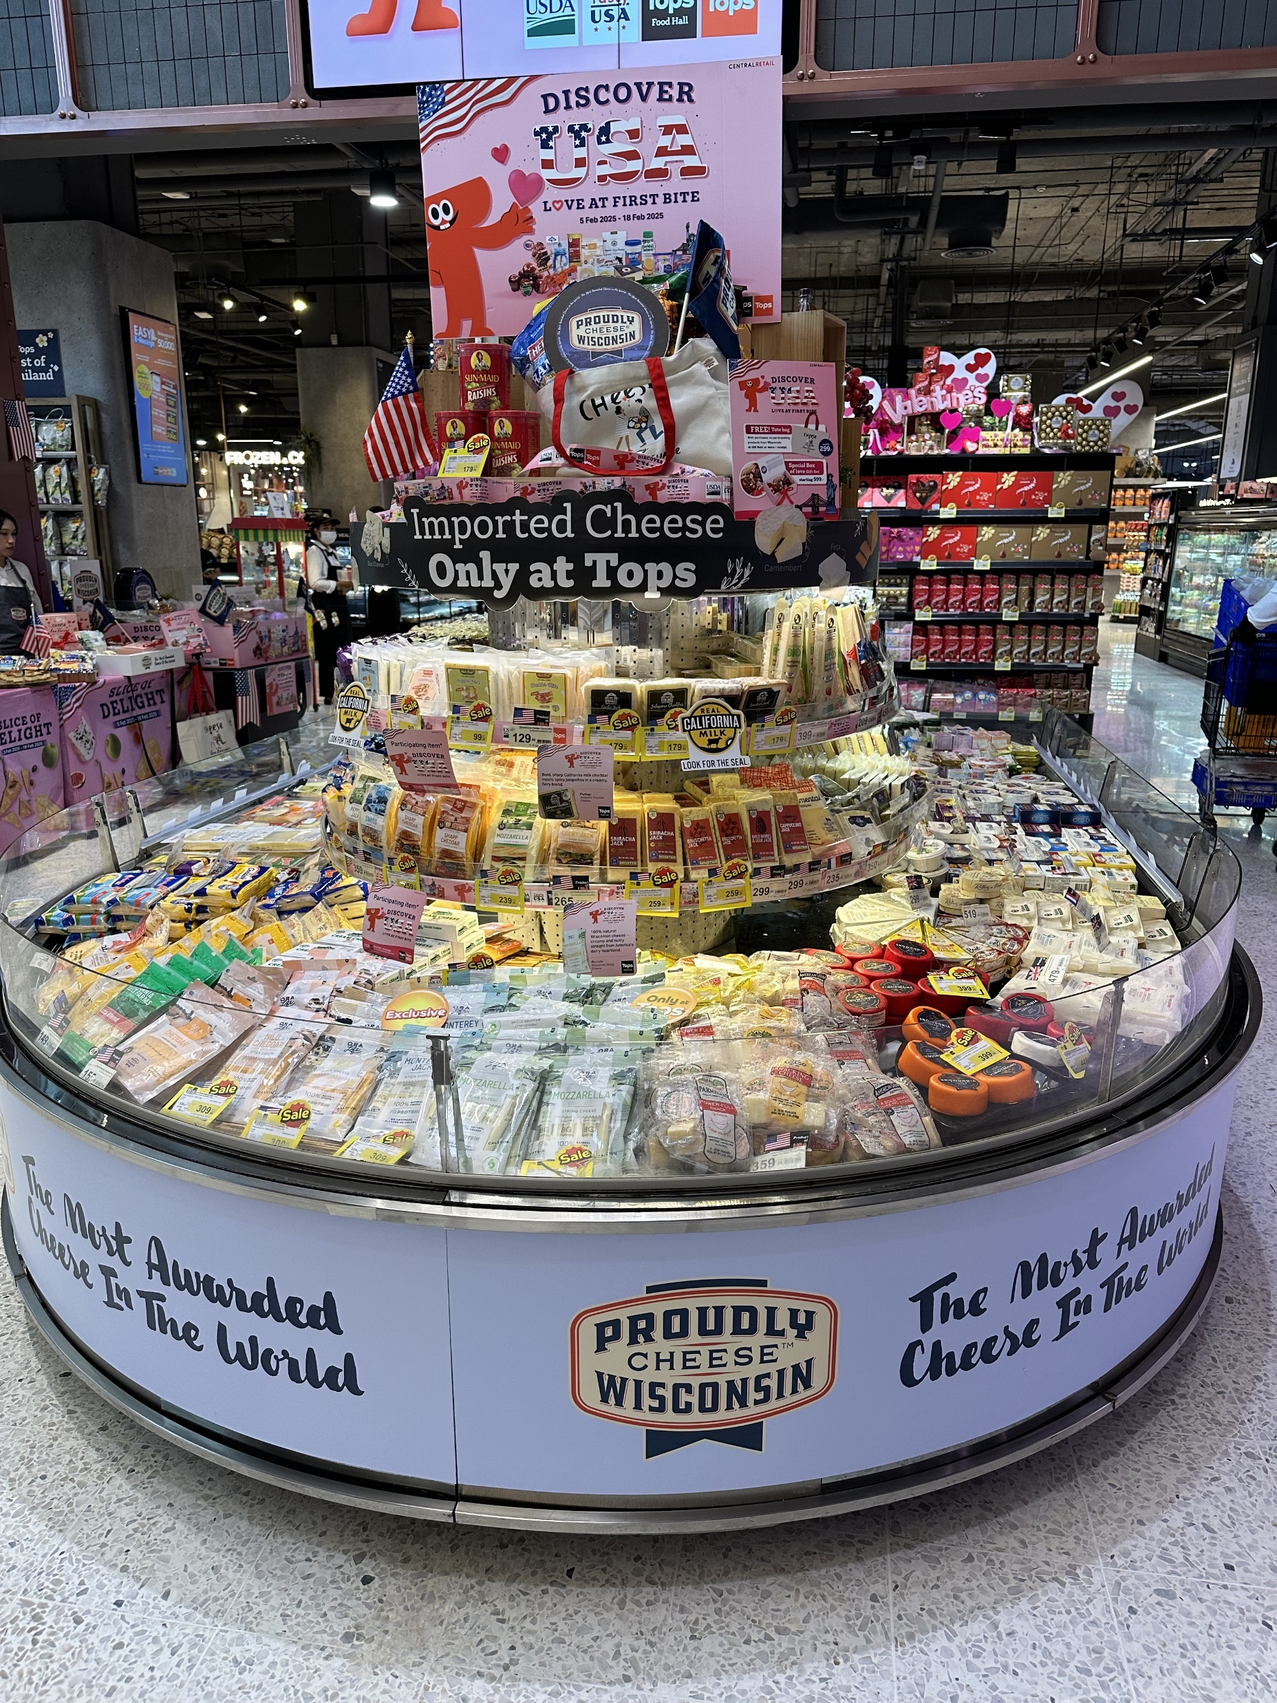
DFW Roadmap for Driving Export Business
Market visit, connections with key decision makers, influencers
Direct Engagement
– Impactful meetings, buyer missions, WDC connections & resources
PWC In Market
Wisconsin Cheese brand placement/message, promotional programs
Learn, immerse, understand opportunities and key decision makers/accounts
Create Interest in Wisconsin Cheese
Activate at key retailers and industry events

