Slide 1
Biosecurity for Agricultural Service Providers
Division of Animal Health
WISCONSIN DEPARTMENT OF AGRICULTURE, TRADE AND CONSUMER PROTECTION
May 2024

Slide 2
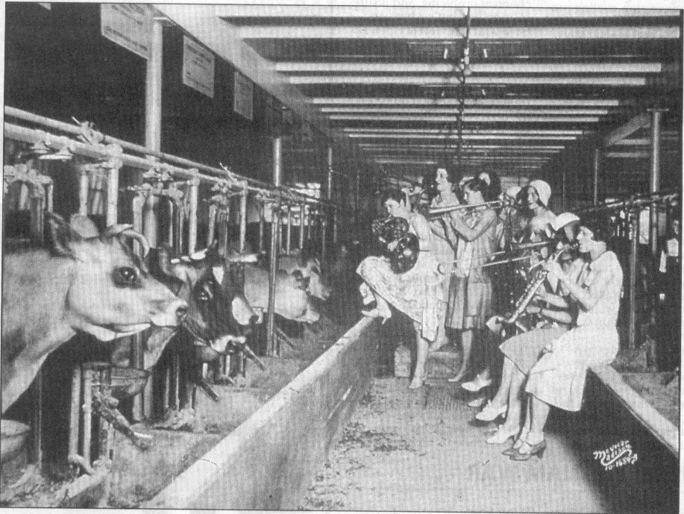
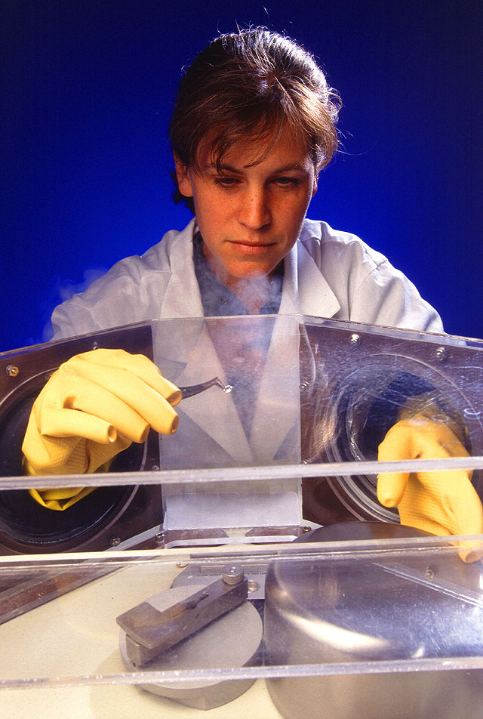
What is Biosecurity?
Precautions taken to minimize the risk of introducing or spreading an infectious disease.
Somewhere in between these two scenarios

Slide 3
Purpose of Biosecurity
To prevent the introduction of disease organism(s) to a susceptible herd or flock of animals.
To prevent spread of disease within a group of animals.

Slide 4
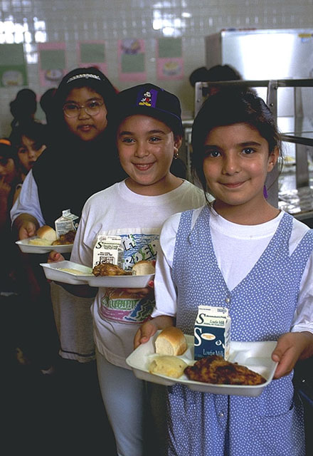
Why Biosecurity is Important?
To protect our food supply and human health

Slide 5
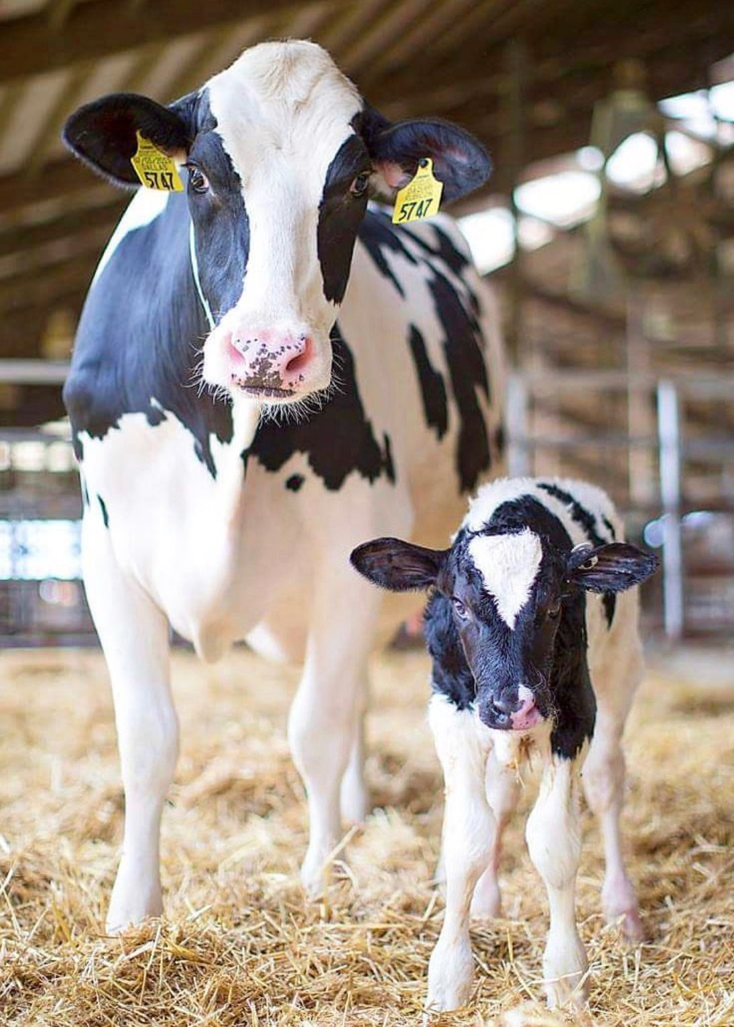
Why Biosecurity is Important?
To protect animal health

Slide 6
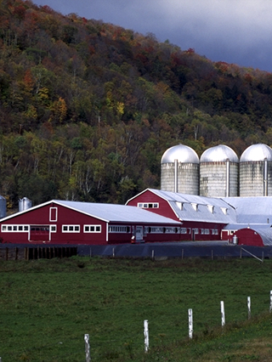
Why Biosecurity is Important?
To protect the owner’s investment

Slide 7
Routes of Transmission
How disease is spread

Slide 8
aerosol
Droplets are passed through the air from one animal to another

Slide 9
oral
Consuming disease causing agents via:
Contaminated feed or water
Contaminated animal products ex. raw milk
Licking/chewing on contaminated objects

Slide 10
Direct contact
An animal is exposed when the disease agent directly touches:
Open wounds
Mucous membranes
Saliva
Nose to nose contact
Rubbing
Biting

Slide 11
fomite
An inanimate object carrying a disease agent from one susceptible animal to another

Slide 12
Vector-borne
An insect acquires a disease agent from one animal and transmits it to another

Slide 13
Zoonotic
Diseases transmitted between animals and humans

Slide 14
Important Livestock disease examples
How disease is spread

Slide 15
Highly pathogenic Avian influenza
Transmitted via:
Oral
Fomite
Direct contact
Aerosol
Vector-borne

Slide 16
Highly pathogenic Avian influenza - cattle
Known transmission routes as of May 2024:
Direct contact
Oral – virus may be present in raw milk
Fomite
Aerosol

Slide 17
Paratuberculosis (Johne’s Disease)
Transmitted via:
Oral
Direct contact - reproductive

Slide 18
Transmissible Encephalopathies (Mad Cow or BSE/CWD)
Transmitted via:
Oral
Fomite
Direct contact

Slide 19
Routine biosecurity practices
How to prevent spreading disease

Slide 20
Arriving at a farm
Ask for a farm’s specific biosecurity plan
If they have one, follow it!
Parking your vehicle
Designated parking area or
Cleanest spot available
Avoid driving through animal areas or high farm traffic areas

Slide 21
Working in livestock buildings
Minimum biosecurity levels
Wear protective footwear (rubber boots or disposable shoe coverings)
Wear disposable or cloth coveralls
For each farm visited, new outerwear is advised after working with and around animals
Includes coat, hat, gloves, etc.
Have animals moved away from the work site, if possible
Have organic matter (manure) removed from work site, if possible

Slide 22
Working in outdoor livestock areas
Wear protective footwear (rubber boots or disposable shoe coverings)
Avoid wearing disposable shoe coverings in some conditions
Slippery conditions—ice or snow
Extended work or work on rough surfaces—shoe coverings will wear through

Slide 23
Equipment
Keep equipment on a clean surface
Use equipment/supplies that can be disinfected or are disposable
Bring only the required equipment for the job onto the farm

Slide 24
Protecting electronic equipment
It’s best to leave cell phones, tablets and cameras in your vehicle
If you need to have your electronic devices with you, protect them
Waterproof case
Ziploc bags

Slide 25
Cleaning & disinfecting
Stopping disease from spreading

Slide 26
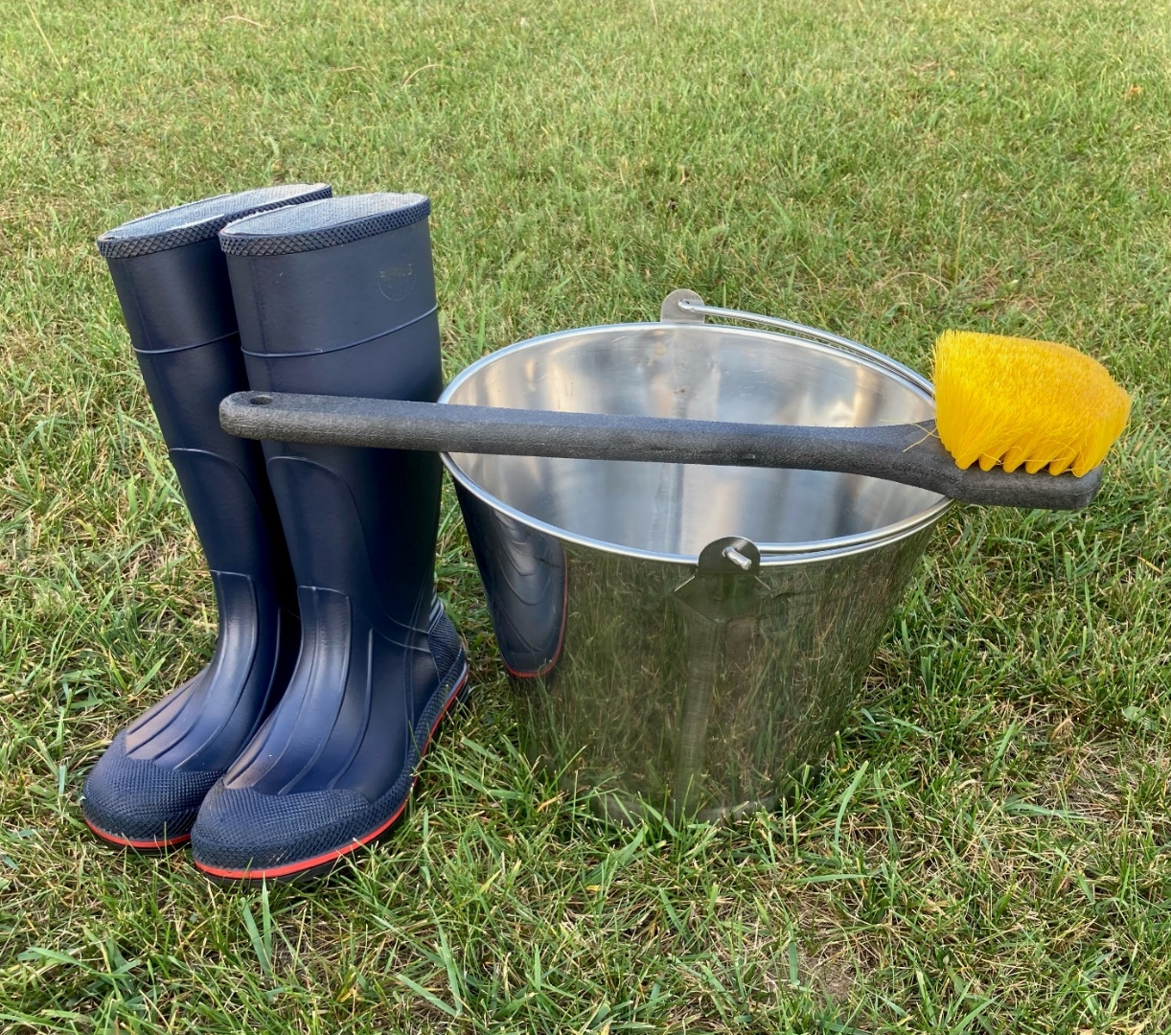
Cleaning & Disinfecting Protocol
Clean all visible organic matter with water and a detergent
Disinfect
Select a disinfectant appropriate for the disease of concern
Follow the disinfectant’s directions for concentration and contact time
* Successful disinfection = little to no organic matter present

Slide 27
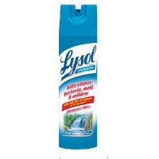
Disinfectant selection
DATCP approved disinfectants (general use) for boots and equipment:
Virkon S®
Trek-Trol® or comparable phenolic disinfectant-cleaner
*Broad spectrum bacteriocidial, fungicidal & virucidal
Lysol® or other similar broad spectrum disinfecting spray or wipes (vehicle interior and other small surfaces)

Slide 28
Disinfectant Concentration & Contact time
Disinfectant | Best Use | Mixing | Contact Time | Efficacy
Tek-Trol® | TB, Brucellosis | 1 Tbsp (or 1/2 oz) / 1 gallon water | 10 minutes | Minimally effected by organic matter or hard water
Virkon-S® | FAD investigations, vesicular lesions, non-enveloped viruses* | 1% solution 1.3 oz (included scoop) / 1 gallon water | 10 minutes | Moderately effected by organic matter
*Non-enveloped viruses: adenovirus, epizootic hemorrhagic disease virus (EHD), foot and mouth disease virus (FMD), hepatitis A virus, norovirus, parvovirus, rabbit hemorrhagic disease virus, rotavirus

Slide 29
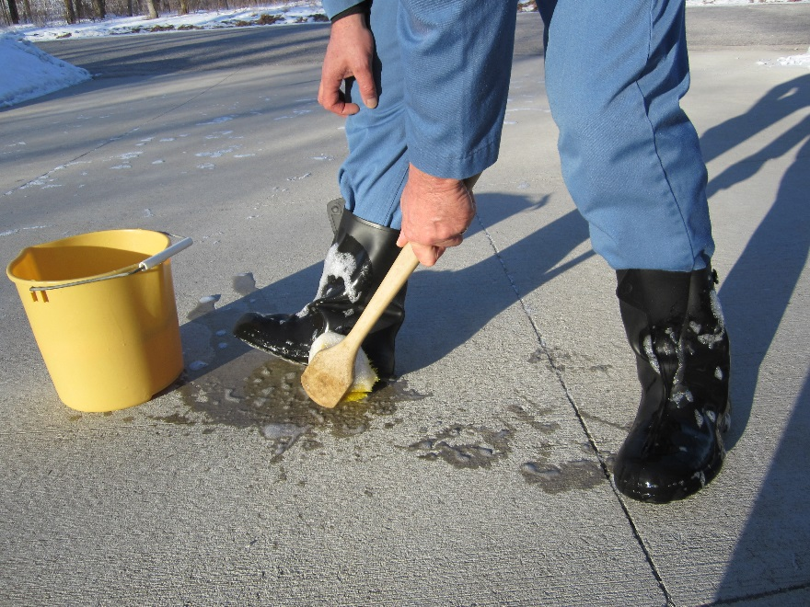
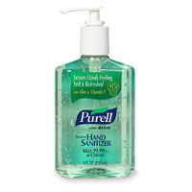
Cleaning & Disinfecting Protocol
Clean and disinfect equipment and boots prior to returning them to your vehicle
OR
Bag equipment for later disinfection and spray disinfect on the outside of the bag
Wash hands with soap & water
or use hand sanitizer

Slide 30
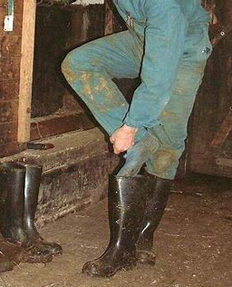
Cleaning & Disinfecting Protocol
Remove outermost layer of clothing and dispose of or store for laundering
Keep clean clothing in “clean” container
After use, place dirty clothing into “dirty” container
Launder all clothing with hot water and detergent between uses

Slide 31
Vehicle C&D
Follow farm’s protocol for vehicles exiting and entering the farm
May be appropriate to take your vehicle through a car wash prior to visiting another farm
Pay special attention to contaminated areas like tires and undercarriage

Slide 32
Take-Home Message
You do not want to be the method of disease transmission from one farm to another.
Good biosecurity practices will help you accomplish this.
Biosecurity is based on:
Protective wear
Cleaning
Disinfecting

Slide 33
Resources
Iowa State – The center for food security & public health
Infection control and Prevention
https://www.cfsph.iastate.edu/infection-control/
Cleaning & Disinfection
https://www.cfsph.iastate.edu/infection-control/disinfection/ -
WI DATCP Division of animal Health
Basic biosecurity
https://datcp.wi.gov/Pages/Programs_Services/BasicBiosecurity.aspx -

Slide 34
Division of Animal Health
(608) 224-5012 - DATCP Home Basic Biosecurity (wi.gov)
Wisconsin Department of Agriculture, Trade and Consumer Protection (DATCP)
May 2024

