Slide 1
Growing Wisconsin Food and Agricultural Exports
International Agribusiness Center
2022 YTD Q2 Wisconsin Agricultural Export Advisory Council Interim Meeting on Export Data

Slide 2
Wisconsin Agricultural Export Advisory Council Interim Meeting on Export Data
Agenda
Welcome and Opening Remarks
Secretary Randy Romanski
Wisconsin Export Data, All Goods
Katy Sinnott, VP Global Trade and Investment, WEDC
Wisconsin Export Data, Agricultural Goods
Mark Rhoda-Reis Director, Export and Business Development Bureau, DATCP
Discussion
Adjourn

Slide 3
2022 All Agricultural Product exports $2.18 billion - YtD Q2 2022
Year to Date Q2 Highlights
Wisconsin Up 14.1%, $270 million
Five-year average – $3.53 billion
U.S. $112 billion – up15%, $14 billion
On track to beat the 2021 record
Growth despite strong challenges, driven by high demand and key, global commodity shortages
3.37
Notes:
Wisconsin export of food, forestry, and agricultural products reached an all-time record of $3.96 billion in 2021. Q2 2022 YTD exports are $2.18 billion, 14.1% up from the same period in 2021. Wisconsin’s top five export markets posted gains in the second quarter, with Canada, China, and Korea recording double digit gains and Mexico showing sluggish growth in the first half. Dairy is up over 37%, crops are up 14% and meat is up nearly 2%.
Wisconsin agricultural exports remain strong in light of of headwinds from inflation, a strong U.S. dollar, conflict between Russia and Ukraine, high logistics costs, low container availability, high fuel costs, continued tariffs on agricultural products, and COVID-19 lockdowns in China. Strong demand and global shortages of some key commodities continue to push growth for U.S. food, forestry, and agriculture products despite the headwinds.

Slide 4
2022 All Agricultural Product Exports $2.18 billion - YTD Q2, 2022
Top 5 Market Highlights
Top five markets make up 68% of the total
Three of the top five are up double digits, Mexico is showing sluggish growth
Wisconsin ranks 13th in the U.S. for dairy, meat, and crop product exports.
Notes:
Wisconsin “punches above our weight class” in FF&A exports We are ranked 13th in FF&A Exports. The state is 20th in Population, 23rd in Size and 21st in the export of all manufactured and agricultural products.
Top Markets - Wisconsin exported $2.18 billion in agricultural and food products to 134 countries by the end of the second quarter of 2022, an increase of 14.1%, or $270 million, in value compared to last year. U.S. agricultural and food exports were valued at $112 billion year to date, an increase of 15%, or nearly $15 billion, compared to 2020 year to date quarter two.
Wisconsin’s top ten export markets make up about 78% of the total $2 billion. Of the top ten markets, UK and Germany posted declines while Canada, China, Mexico, Korea, Japan, Finland, Italy, and Australia increased, nearly all by double digits.
Top Products - The top ten individual products exported from Wisconsin make up more than 66% of total exports totaling over $1.45 billion. The top ten product showing the highest increase from 2021 to 2022 are Beverages, Spirits, and Vinegar, up 66% or $74 million. Miscellaneous food preparations, dairy, prepared cereals, flour and starch, and food waste products also all showed double digit growth over last year. Four of the top ten products posted a decline.
Wisconsin currently ranks 13th among U.S. states in total agricultural exports and first for the export of ginseng roots, prepared/preserved cranberries, raw furskins, bovine semen, whey and milk products, specialty cheeses, and prepared/preserved sweet corn. Wisconsin als ranks sixth in cheese.

Slide 5
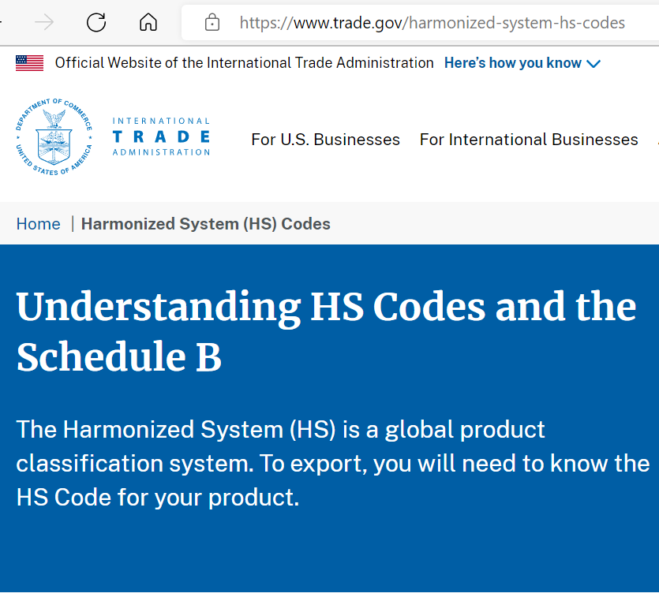
Harmonized System (HS) Code
Harmonized System (HS) Codes are commonly used throughout the export process for goods. The Harmonized System is a standardized numerical method of classifying traded products. It is used by customs authorities around the world to identify products when assessing duties and taxes and for gathering statistics.

Slide 6
Harmonized System (HS) Code
How You Use the HS Code
You will need both the U.S. Schedule B number and the foreign country’s version of the HS code for your product during the export process. You use it to:
Classify physical goods for shipment to a foreign country;
Report shipments in the Automated Export System (AES) when the value is more than $2,500, or the item requires a license.
Complete required shipping documentation such as shipper’s letter of instructions, commercial invoice or certificate of origin;
Determine import tariff (duty) rates and figure out if a product qualifies for a preferential tariff under a free trade agreement;
Conduct market research and obtain trade statistics;
Comply with U.S. law, where applicable.
Census Bureau Schedule B Search Engine (3ceonline.com)

Slide 7
Harmonized System (HS) Code
How is frozen pizza classified, cheese, meat, other?

Slide 8
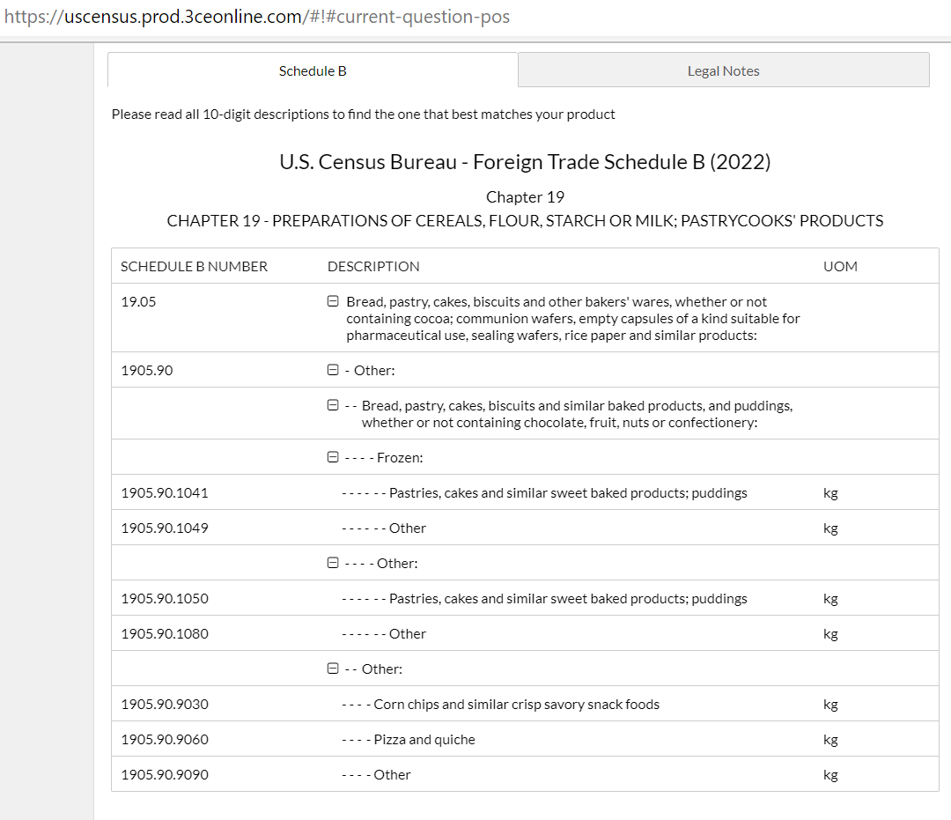
Harmonized System (HS) Code

Slide 9
Dairy Product exports, 2022 YTD Q2 $295 Million
Dairy Product Highlights (up 37.5%)
14% of all Wisconsin ag exports: four of the top five products had double digit increases, largest is butter and other fats followed by milk albumins, cheese, whey
Top 5 products are 92% of the group total: whey 30%, cheese and curd 28%,milk albumin 17%, lactose 14%, butter-fats-others 11%
Top 5 countries are 63% of the group total: Canada, China, Korea, Mexico, Japan all double digit increases from 2021

Slide 10
Meat Product exports, 2022 YTD q2 $421 Million
Meat Product Highlights (up 1.9%)
19 % of all Wisconsin ag exports: three of the top five products are down double digits, furskins (mink) is up 98%, meat up 31%, genetics up 9%
Top 5 products are 90% of the group total: Meat Preparations 26%, Genetics 24%, Meat & Offal 22%, Furskins 12%, Peptones and Proteins 5%, all other 11%.
Top 5 countries are 76% of the group total: Canada, China, Finland, Korea, Japan.
Notes:
Top five products and top five countries increased share of total by 1% in 2021 over 2020 showing a bit more consolidation

Slide 11
Crop Product exports, 2022 Ytd q2 $1.47 billion
Crop Product Highlights (up 14%)
67% of all Wisconsin ag exports: beverages & spirits up 66%, prep. cereals up18%, food preparations up 16% prep. vegetables down 21%, wood down4%
Top 5 products are 55% of the group total: Beverages & Spirits13%, prepared vegetables 12%, wood10%, food preparations 9%, prep. Cereals 8%, all others 48%
Top 5 countries are 65% of the group total: Canada, Mexico, China, Germany, Japan- all but one of the top five up, Canada by double digits
Notes:
Oil Seeds (soybeans) picked up in the last quarter, replacing Oderiferous Mixtures. Crop percent of total dropped from 67% to 64% due to increase in share of Meat and Dairy.

Slide 12
Agricultural Export Data Sources
US Census Export Data
AES Filing of HS & $
Most Comprehensive
Actual Shipment Values
Lack of unit volume data
USDA GATS Export Data
Value Reporting from Census
Focused on Commodities
Unit volume at the National Level only
State value data does not include all items
ERS additional data

Slide 13
Discussion
Unit volume reporting for agricultural product exports
Other data requirements
Questions, Comments.

Slide 14
Meet The International Agribusiness Center Team
Mark Rhoda-Reis
Director,
Export and Business Development Bureau
608-224-5125
Mark.rhodareis@wi.gov
Jennifer Lu
Animal Feed, Forestry Products, Ginseng,
Livestock & Genetics
Asia, Middle East, Africa
608-224-5102
Jennifer.lu@wi.gov
Lisa Stout
Processed Foods and Food Ingredients
Canada, Asia, Middle East
608-224-5126
Lisa.stout@wi.gov
Luis E Santana
Animal Feed, Livestock & Genetics, Ag. Equipment
Americas, Europe, Africa
608-640-8075
luise.santana@wi.gov
Notes:
The International Agribusiness Center team has multiple decades of experience in helping companies grow their export sales. By contacting one of us, you reach all of us and the many resources both at the federal level as well as in Wisconsin.

Slide 15
THANK YOU!
International Agribusiness Center
2022 YTD Q2 Wisconsin Agricultural Export Advisory Council Interim Meeting on Export Data

